Slide 1
Cotton Outlook
Will Maples
Department of Agricultural Economics
Mississippi State University Extension Service
September 29th, 2020
Southern Outlook Conference

Slide 3
Global Cotton Situation
2020/21 – Projections
2019/20 - Estimates

Slide 4
World Cotton Production and Consumption

Slide 5
World Cotton Production

Slide 6
Major Exporters
2020/21 Total World Trade
- 41.72 million bales

Slide 7
% Share of Total Cotton Consumption
Account for 80% of Use in 2020

Slide 8
World Ending Stocks

Slide 9
World Ending Stocks

Slide 10
U.S. Cotton Situation

Slide 11
U.S. Planted Acres

Slide 12
Planted Acres of Upland Cotton by State (1,000 acres)
State | 2018 | 2019 | 2020
Alabama | 510 | 540 | 450
Arkansas | 485 | 620 | 525
Florida | 117 | 112 | 100
Georgia | 1,430 | 1,400 | 1,200
Kansas | 165 | 175 | 200
Louisiana | 195 | 280 | 170
Mississippi | 620 | 710 | 530
North Carolina | 430 | 510 | 360
Oklahoma | 780 | 640 | 525
South Carolina | 300 | 300 | 190
Tennessee | 360 | 410 | 280
Texas | 7,750 | 7,050 | 6,800
Virginia | 98 | 103 | 80
United States | 13,850 | 13,507 | 11,915

Slide 13
Planted vs. Harvested Acres

Slide 14
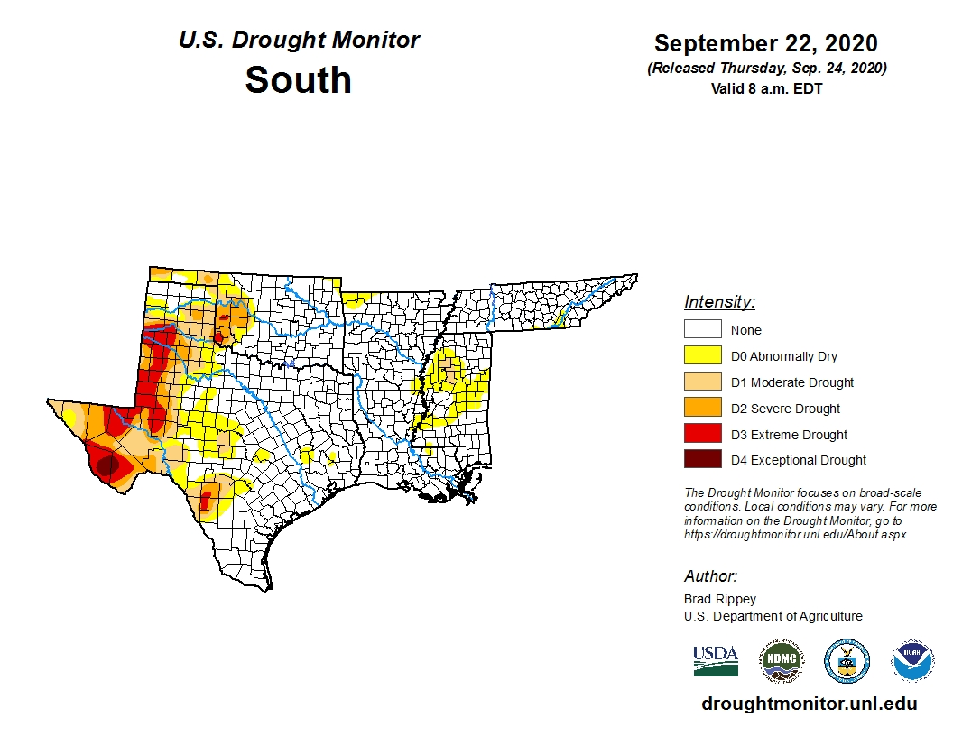

Slide 15
2020 Planted vs. Harvested Acres
State | Area planted (1,000 acres) | Area Harvested (1,000 acres) | Difference (1,000 acres)
Texas | 6,800 | 3,850 | 2,950
United States | 12,115 | 9,005 | 3,110

Slide 16
U.S. Cotton Yield

Slide 17
U.S. Cotton Production

Slide 18
U.S. Ending Stocks

Slide 19
U.S. Cotton Stocks-to-Use and Price

Slide 20
U.S. Cotton Exports

Slide 21
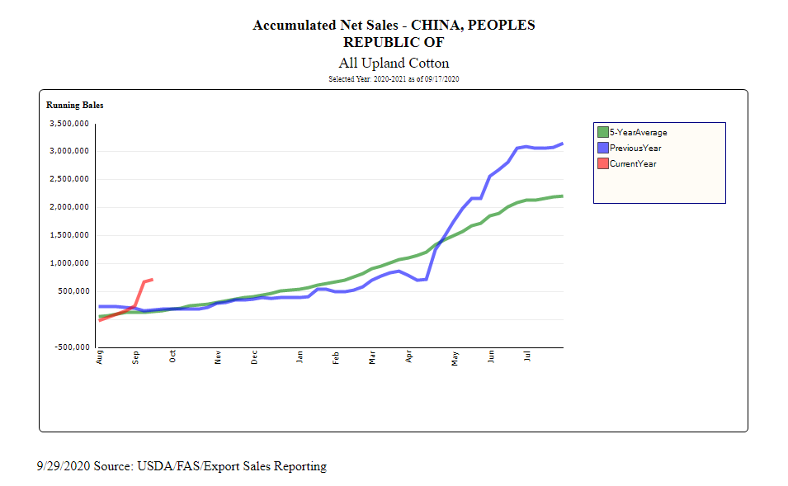

Slide 22
U.S. Cotton Grades
Small Texas High Plains crop
Hurricane Sally and Tropical Storm Beta
China usually buys high grades (middling/strict middling)
Tighter supply of 31-3-36 and better from new crop
Could boost Brazilin and Australian exports
Strict Low Middling well supplied

Slide 23
Seed Cotton Program
99.1% enrolled in PLC for 2019 and 2020
Current PLC Estimated Payment Rates*
2019 - $0.0622 pound
2020 - $0.0613 pound
Seed cotton yield is 2.4 * lint yield
*Source: Farm Service Agency

Slide 24
CFAP 2
Marketing Percentage – 40%
Payment Rate - $0.08 lb
APH | Payment ($/acre)
500 | $ 16.00
600 | $ 19.20
700 | $ 22.40
800 | $ 25.60
900 | $ 28.80
1000 | $ 32.00
1100 | $ 35.20
1200 | $ 38.40
1300 | $ 41.60

Slide 25
2021/2022
Impacts from COVID-19 will linger
Profitable cotton?
Soybean and corn prices?
Cotton acres will face pressure
Opportunity for higher price

Slide 26
Thanks!
Will Maples
will.maples@msstate.edu

