Slide 1
2019 Poultry Outlook
Jordan Shockley, Ph.D.
Farm Management Specialist
2019 Southern Outlook Conference
September 23-25, 2019
Atlanta, GA

Slide 2
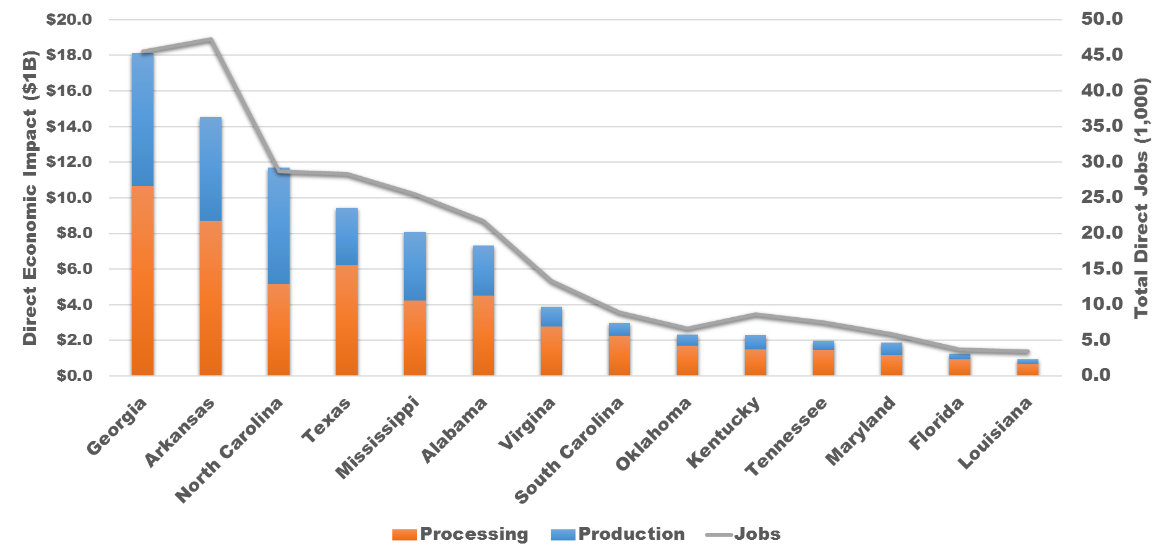
2018 Economic Impact of the Broiler Industry by State
Source: National Chicken Council and US Poultry & Egg Federation

Slide 3
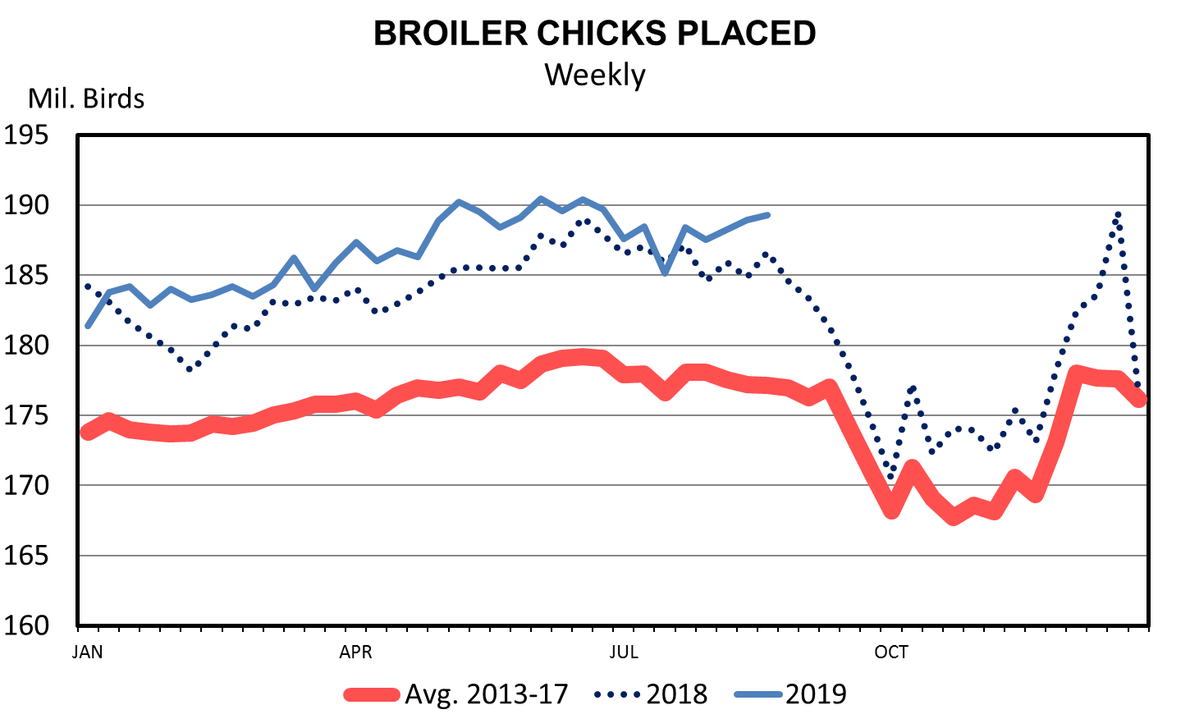

Slide 4
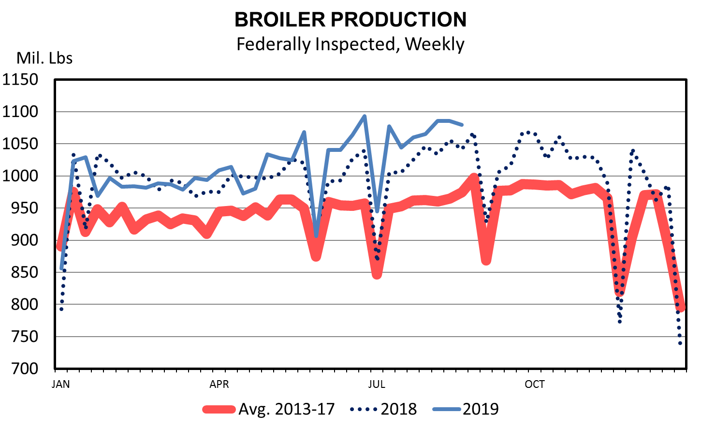

Slide 5
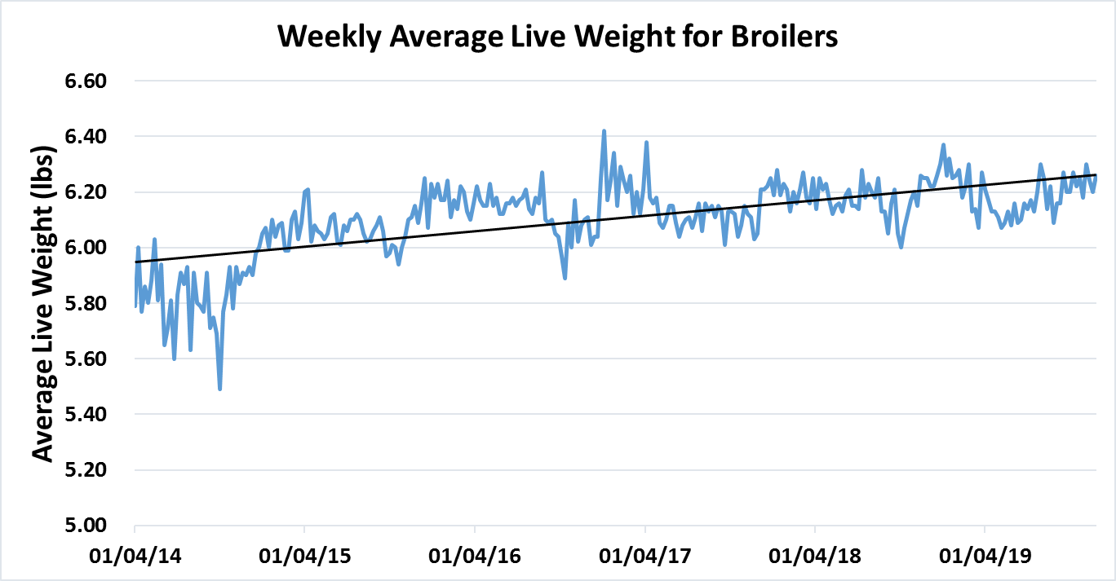

Slide 6
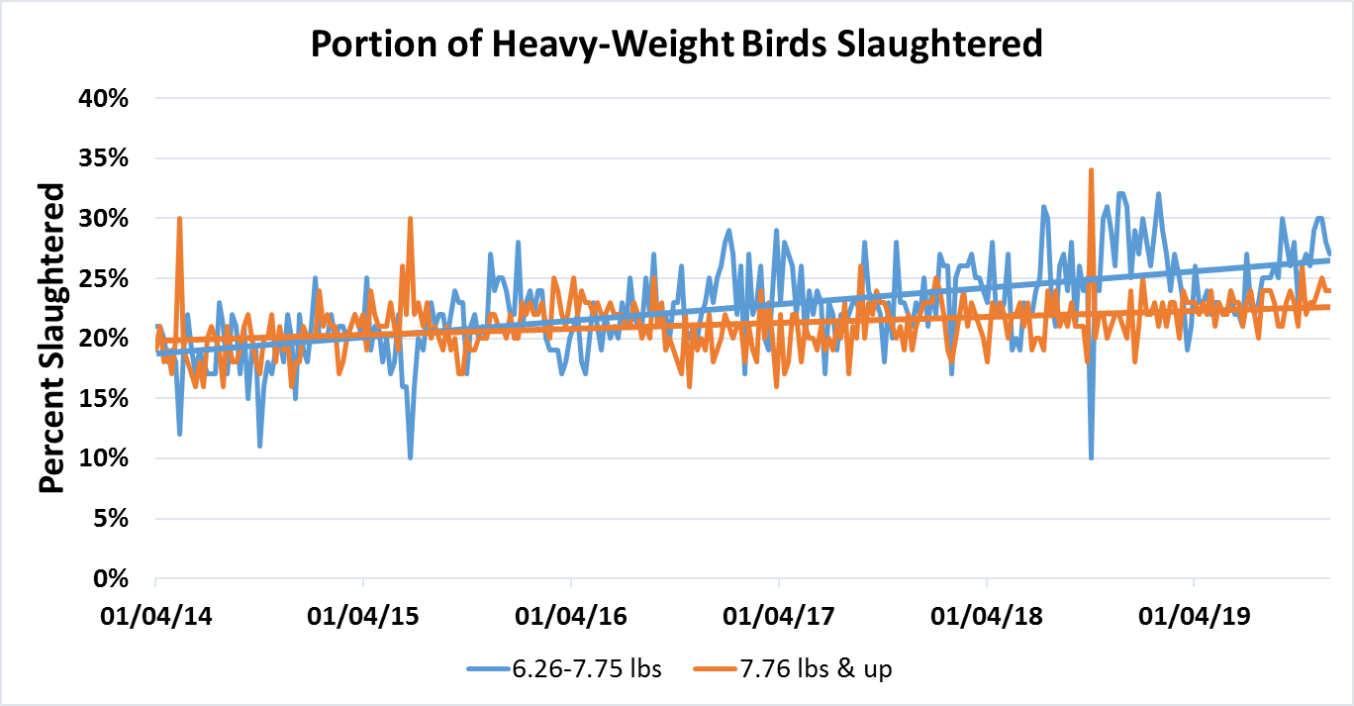

Slide 7
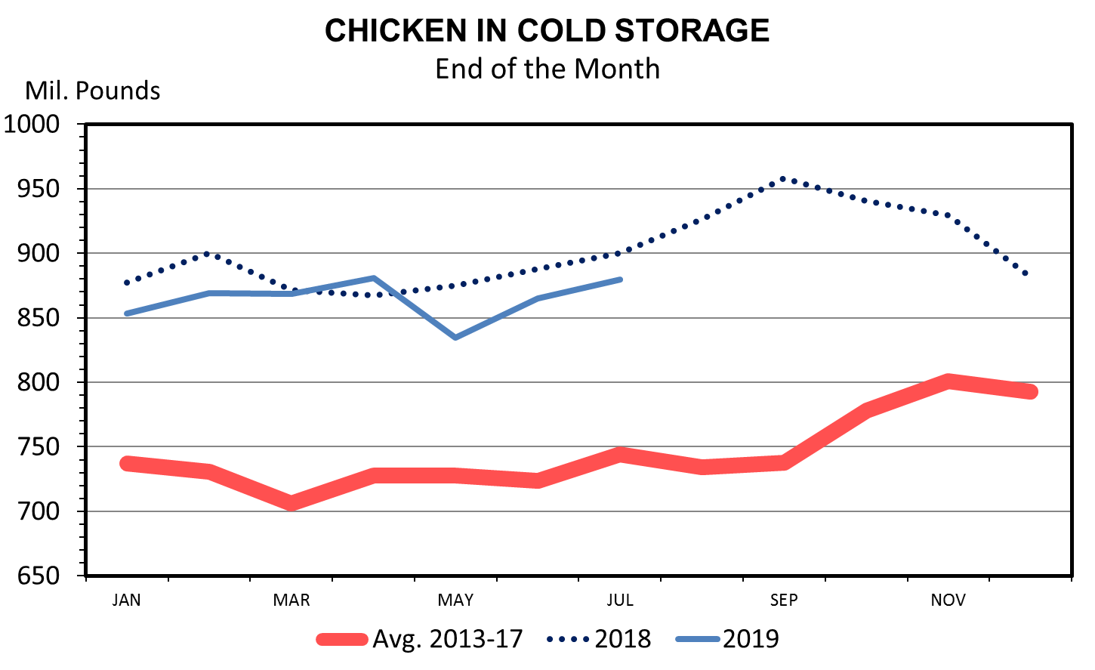

Slide 8
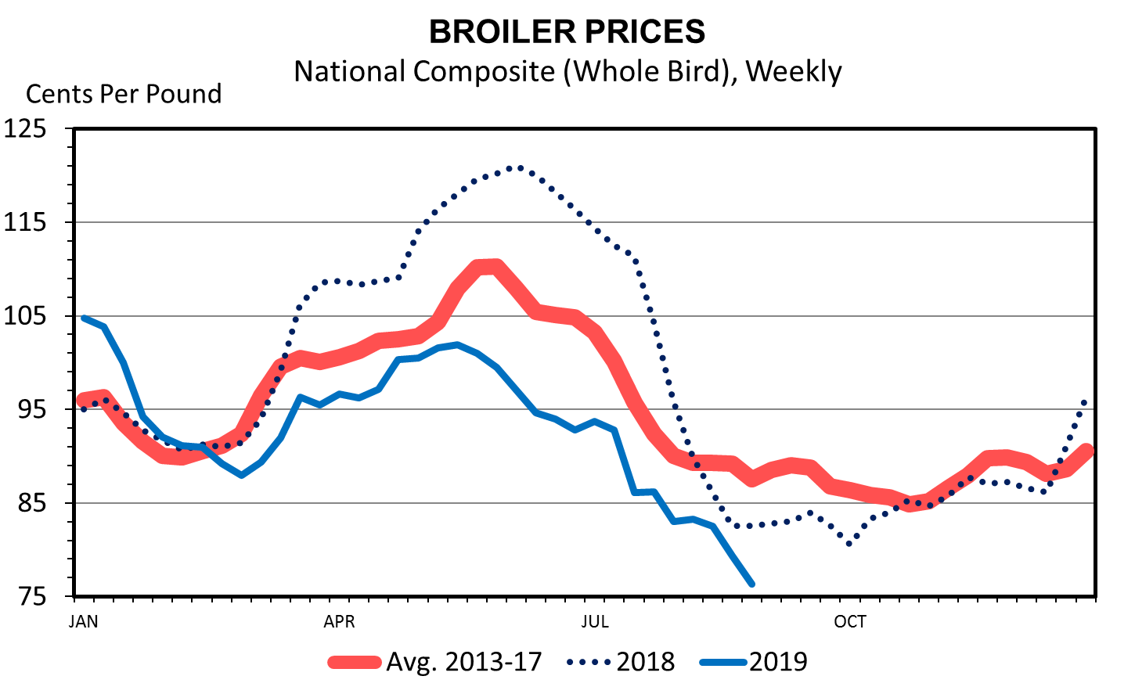

Slide 9
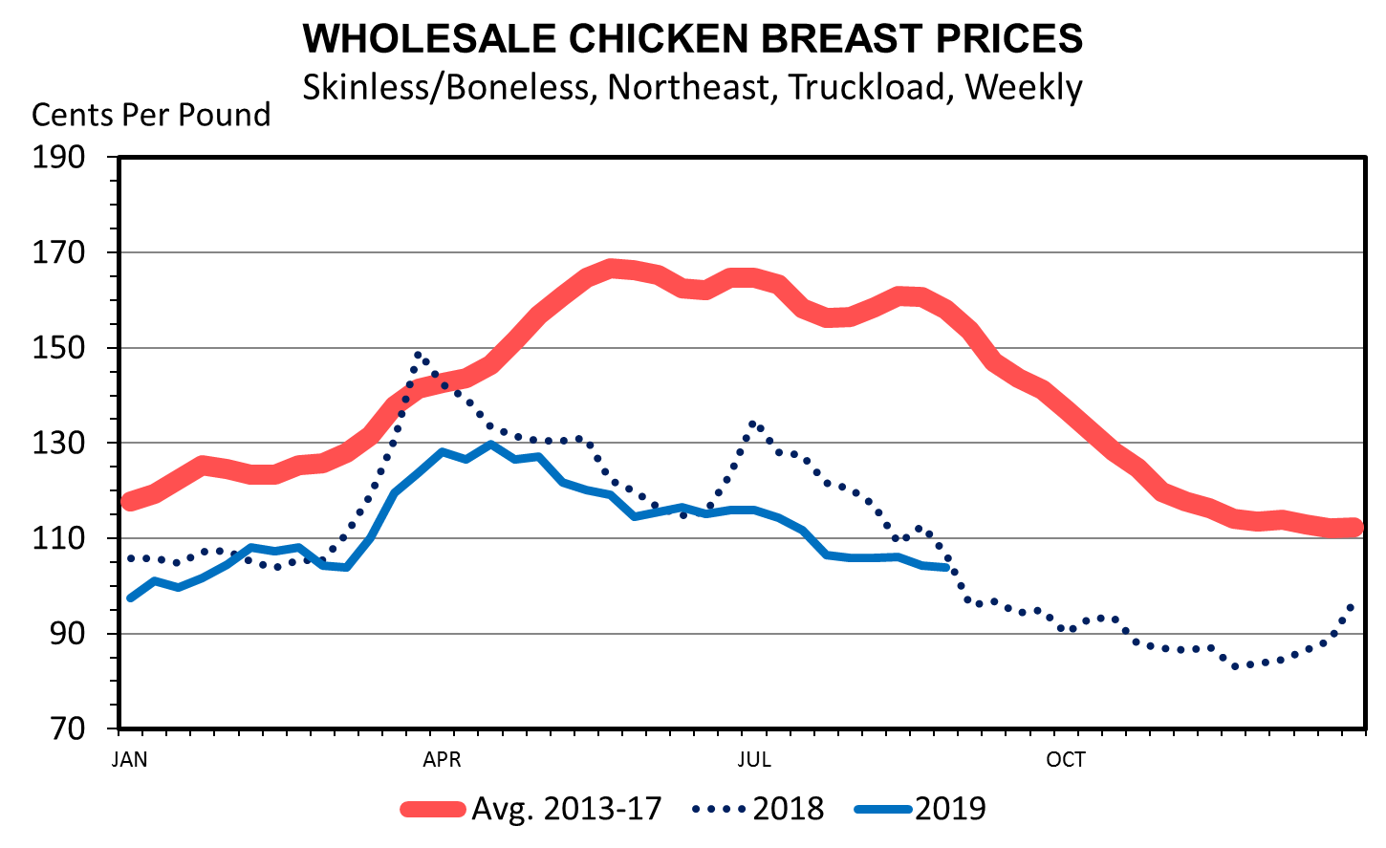

Slide 10
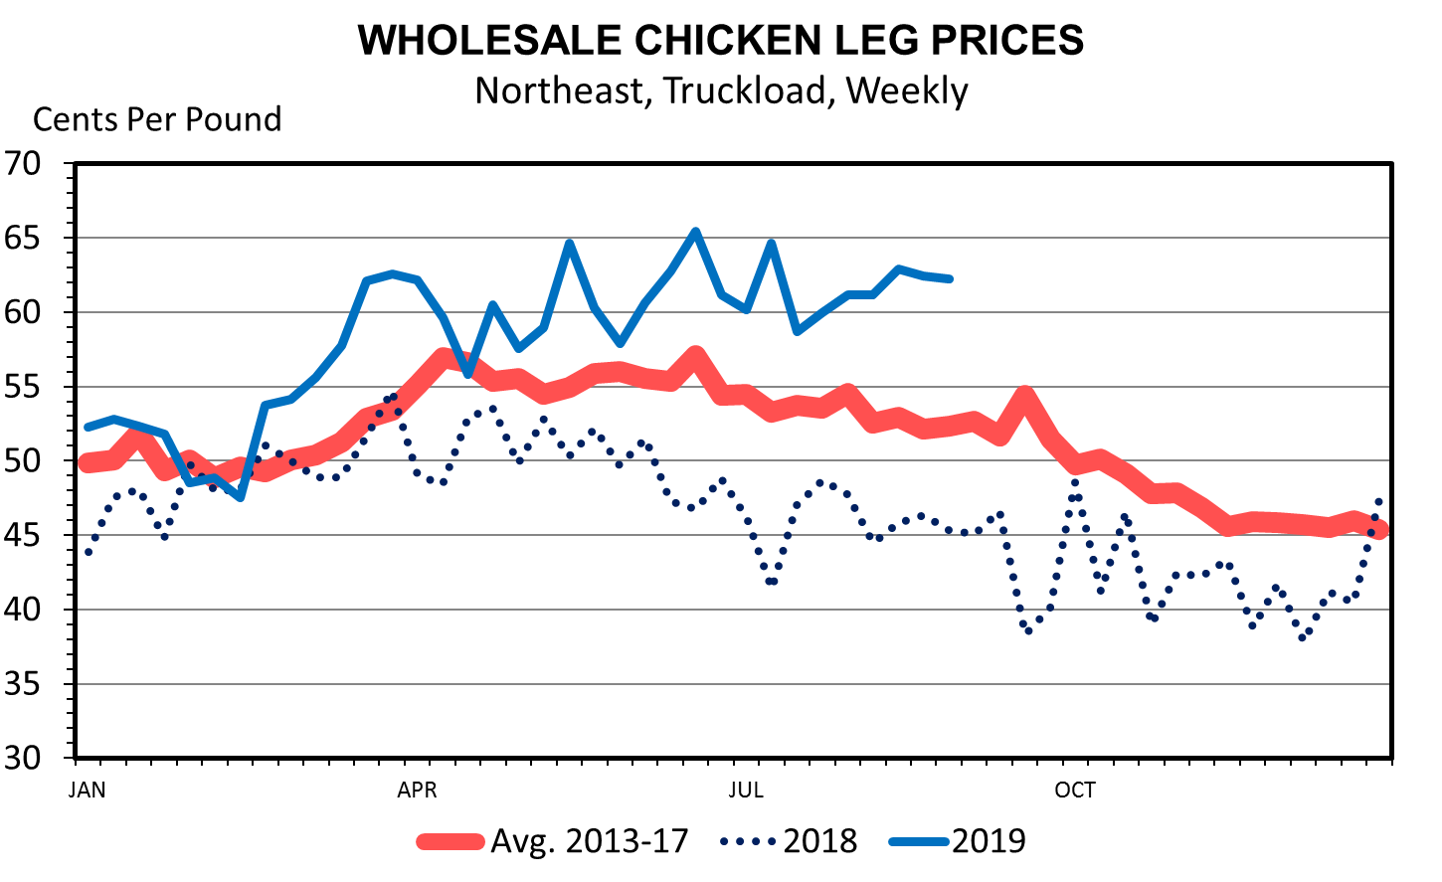

Slide 11
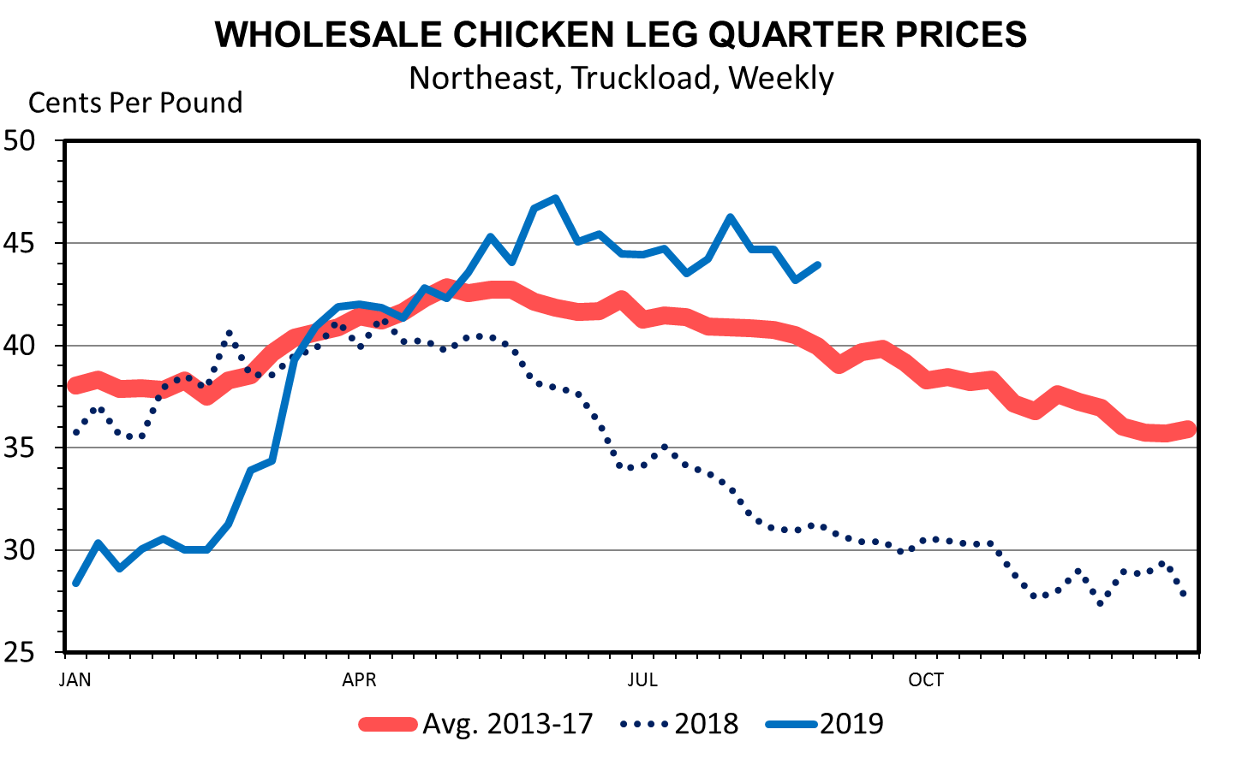

Slide 12
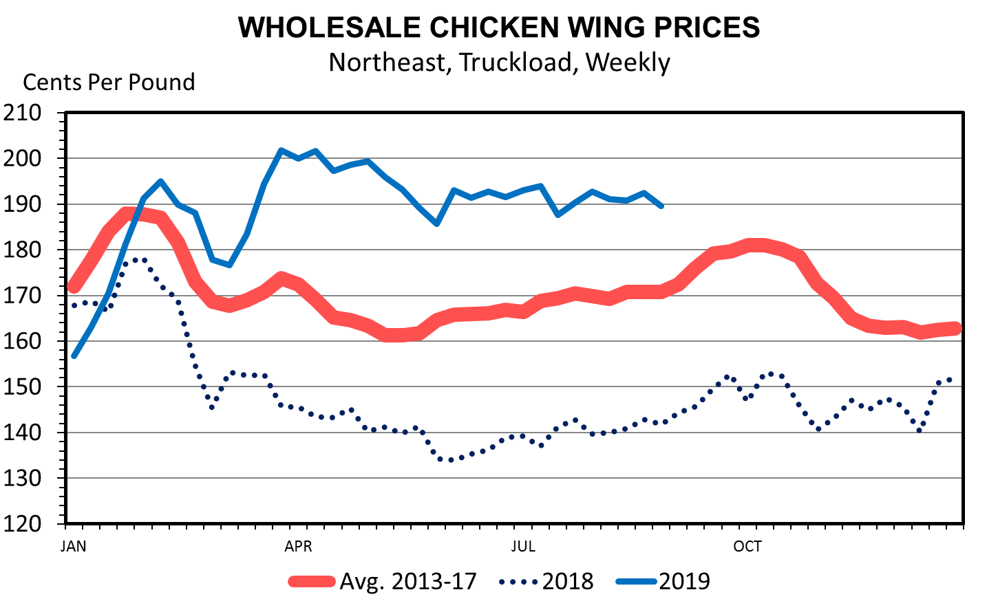

Slide 13
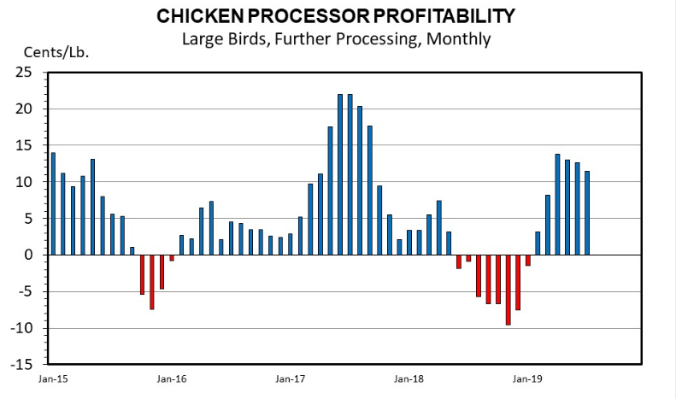

Slide 14
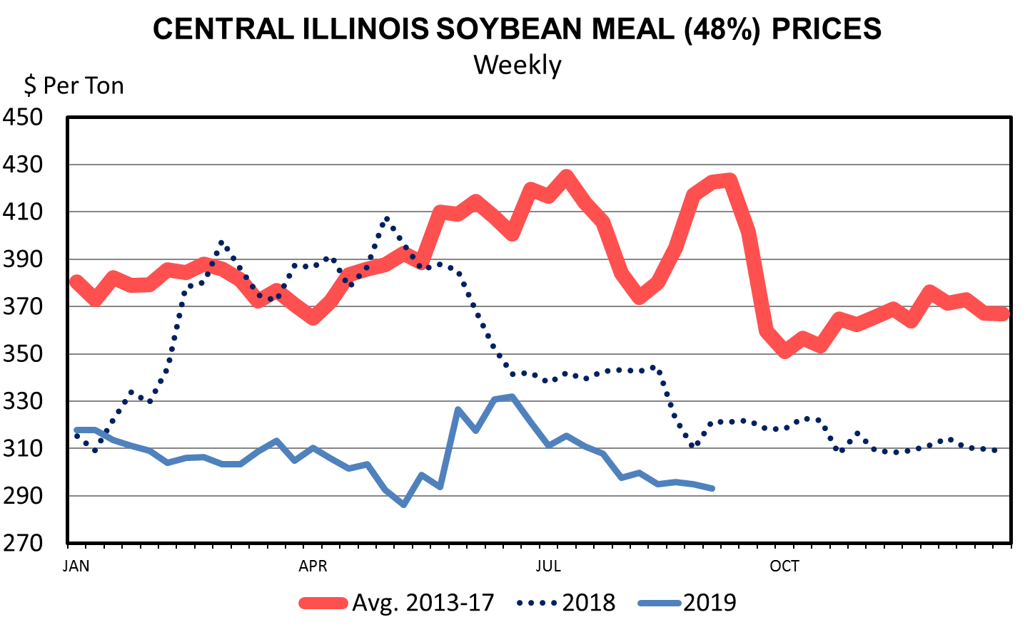

Slide 15
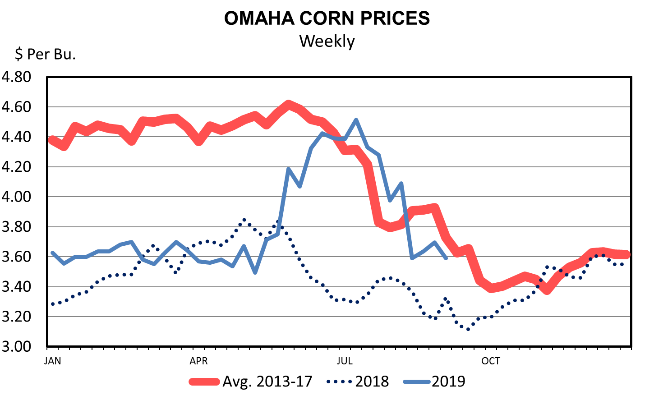

Slide 16
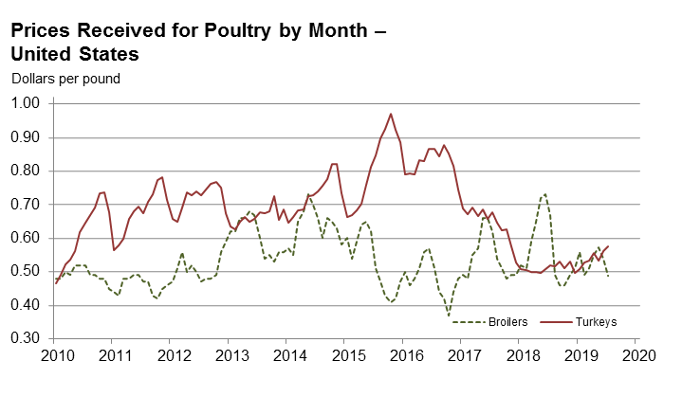
Source: USDA - NASS

Slide 17
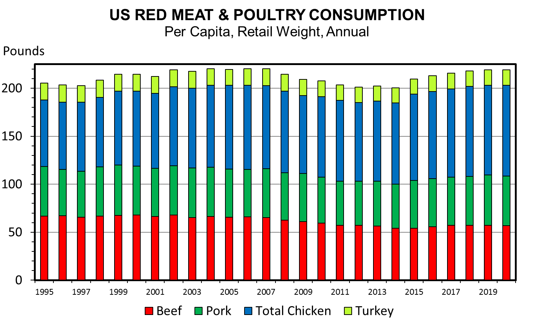

Slide 18
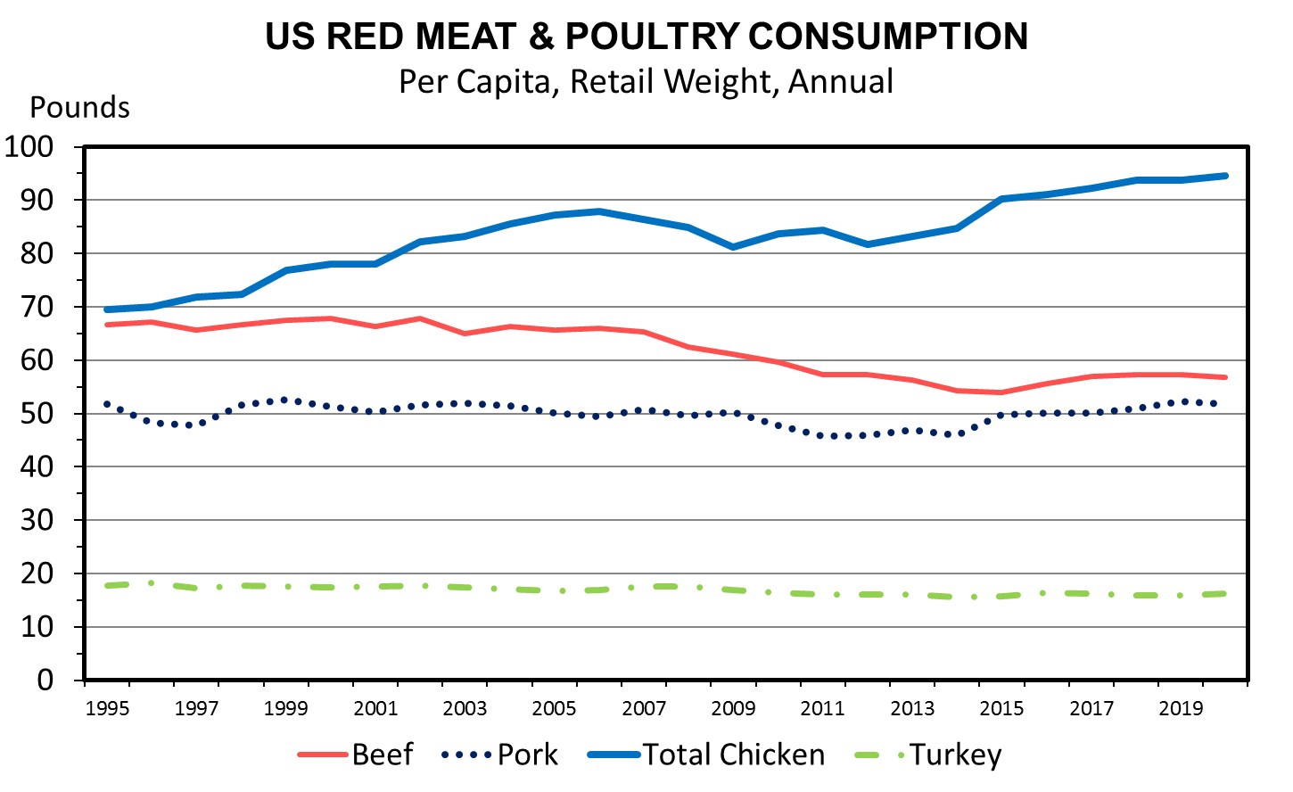

Slide 19
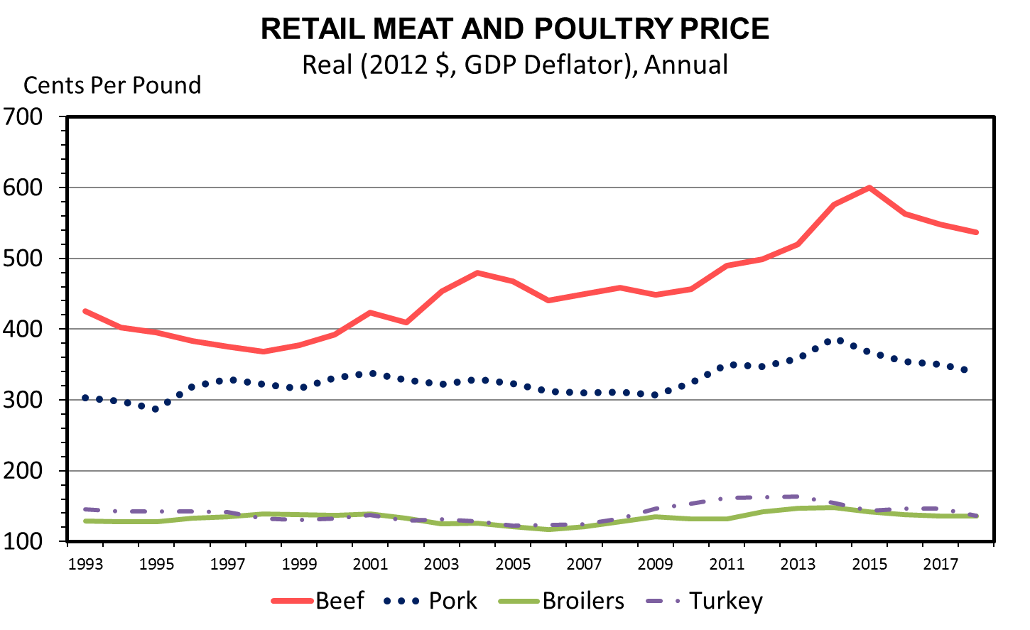

Slide 20
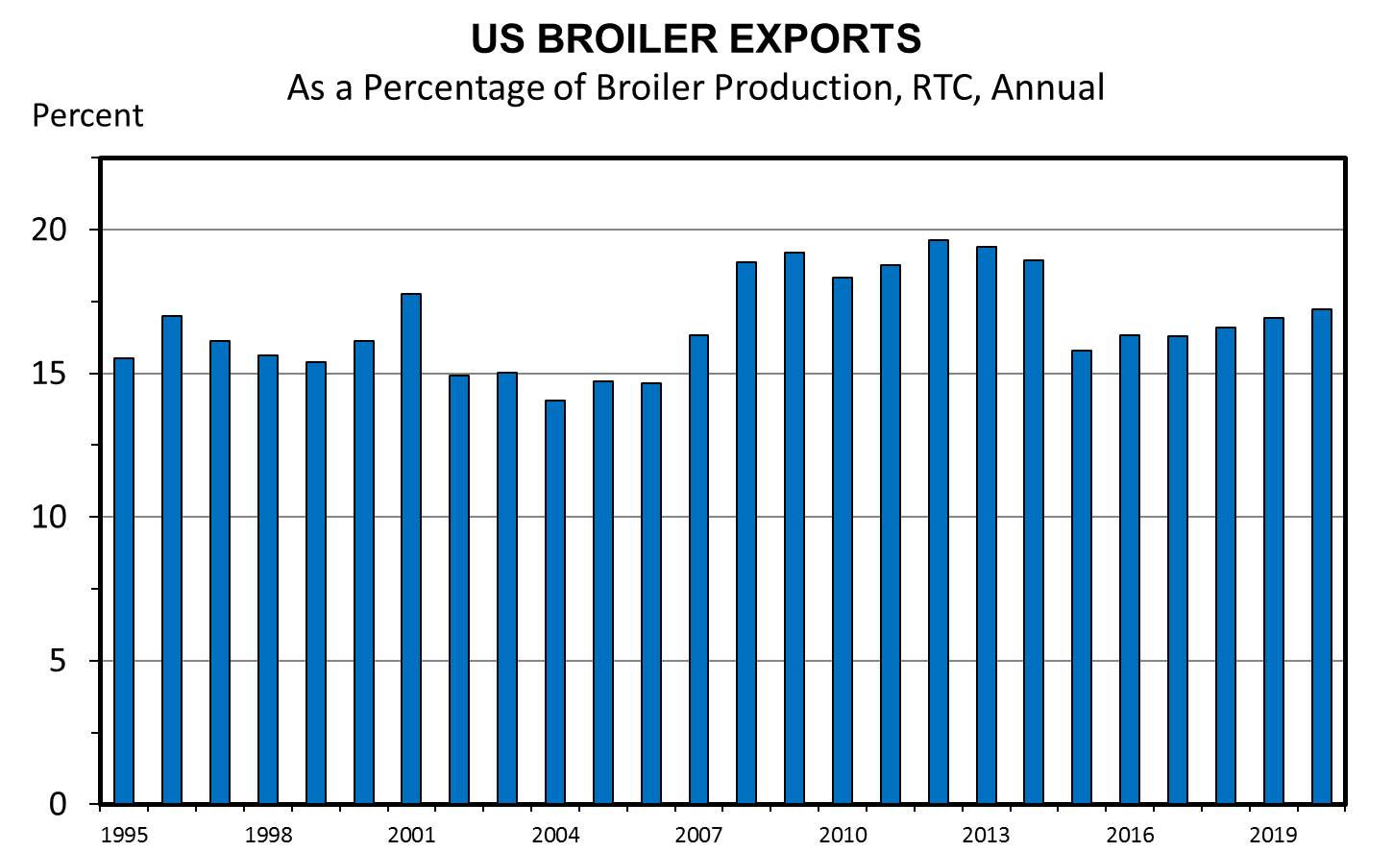

Slide 21
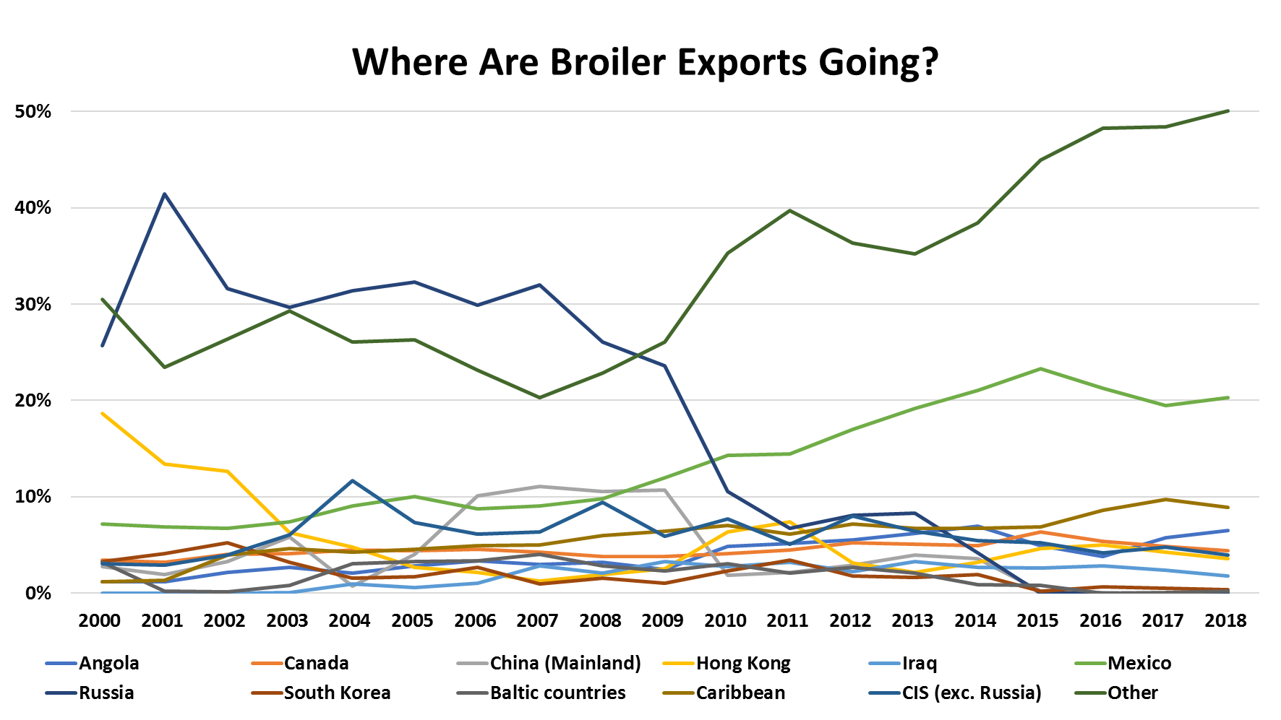

Slide 22
Avian Influenza
Virus that infects poultry and wild birds
Highly Pathogenic AI (HPAI) and Low Pathogenic AI (LPAI)
Largest poultry health disaster in history was in 2014/2105
50 million chickens and turkeys died
87% was in Minnesota with turkeys and layer flocks
$879 million in federal government expenditures
Since then, 667k more birds have died from HPAI and LPAI in Indiana, Alabama, Georgia, Tennessee, and Kentucky

Slide 23
Avian Influenza
If a flock is infected with HPAI:
Immediate quarantine zone of 10 km
USDA-APHIS only provides financial aid for:
Depopulation
Cleaning
Indemnity payment ONLY ON BIRDS INFECTED.
GROWERS ARE NOT GUARANTEED 100% OF THE INDEMNITY PAYMENT
Timeframe to prove the contaminated area is cleared of virus can last more than 120 days.

Slide 24
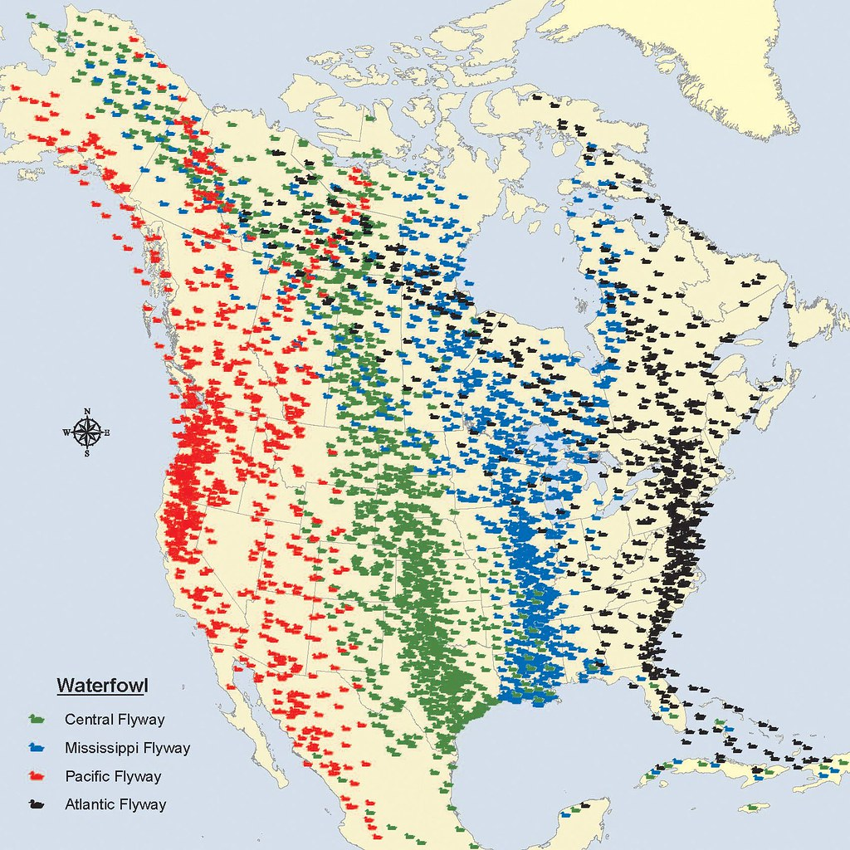
North American Migratory Bird Flyways
Source: Anderson, M.G. and P.I. Padding. “The North American approach to waterfowl management: synergy of hunting and habitat conservation”. International Journal of Environmental Studies (2015)

Slide 25
On-Farm Equity Required to Self-Insure Against a HPAI Outbreak
# of Flocks Out | Year 2 | Year 10 | Year 18
1 | $46,512 | $67,179 | $70,504
2 | $97,658 | $123,113 | $131,675
3 | $158,348 | $169,417 | $181,112

Slide 26
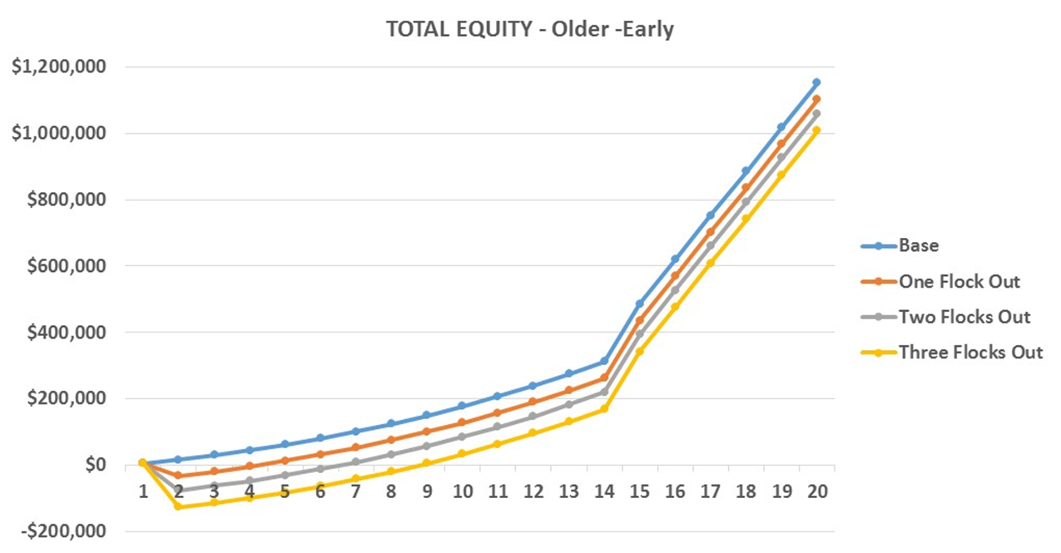
Impact on Annual Total Equity for a Experienced Farmer based on the Number of Flocks Lost Due to HPAI
Year

Slide 27
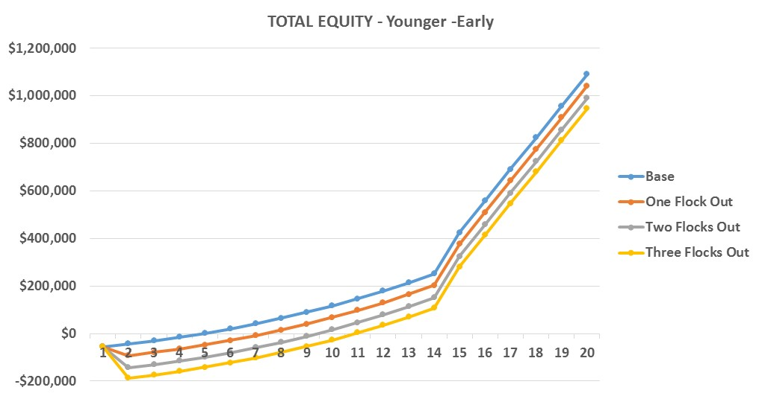
Impact on Annual Total Equity for a Beginning Farmer based on the Number of Flocks Lost Due to HPAI
Year

Slide 28
Poultry Outlook Summary
Supply
Expansion continues: 6 new processors expected by 2020
Production will continue to increase and with larger birds
With low feed costs expected, processor profits will be positive
HPAI Concerns
Demand
U.S. Consumption continues to increase
Exports continue to increase to Other Countries, Mexico, and the Caribbean
HPAI Concerns
African Swine Fever increasing demand

Slide 29
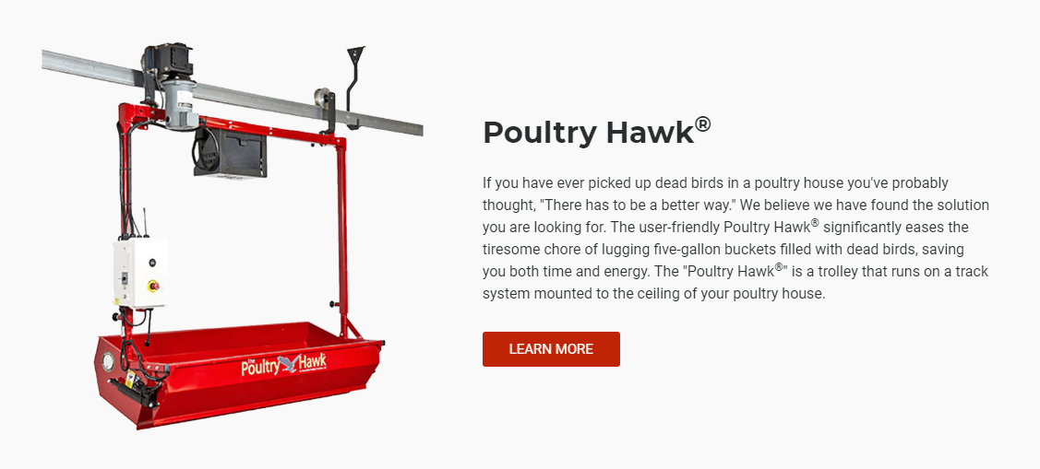
Hot Topics in the Poultry Industry
Slow growth broilers
Increased demand for free range, organic broilers
Increased regulation on litter
New production technology

Slide 30
Thank You!
Jordan Shockley, Ph.D.
Farm Management Specialist
Phone: 859.218.4391
Email: jordan.shockley@uky.edu
http://www.uky.edu/Ag/AgEcon/shockley_jordan.php
@Shock_N_AgMgmt
Dr. Jordan Shockley

