Slide 1
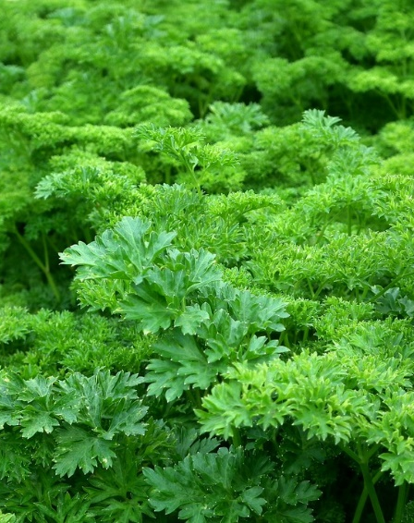
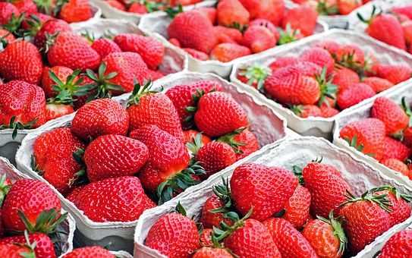
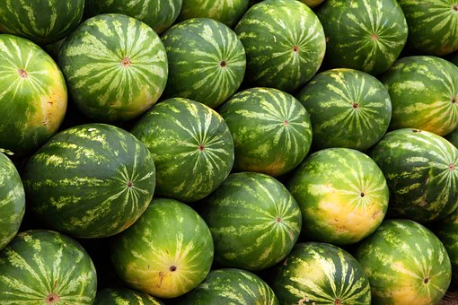
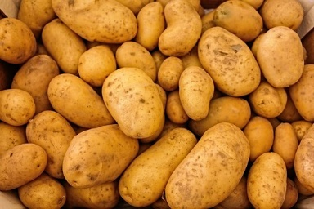
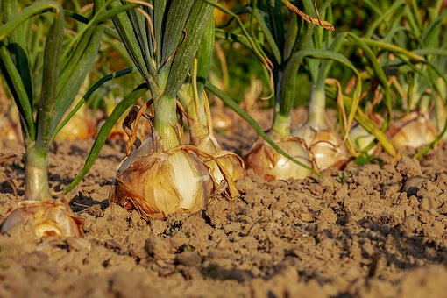
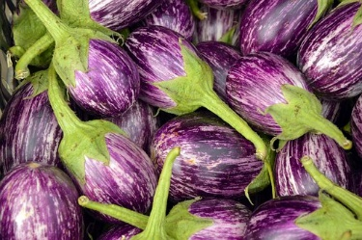
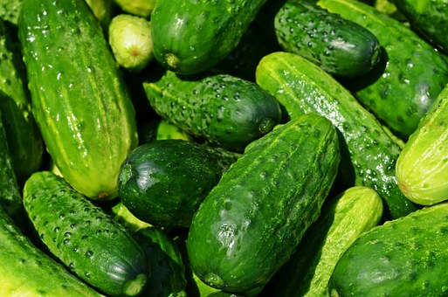
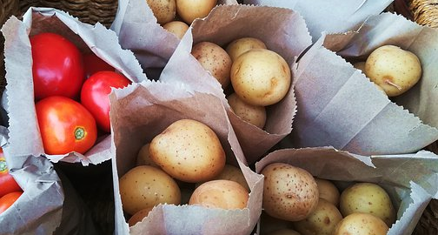
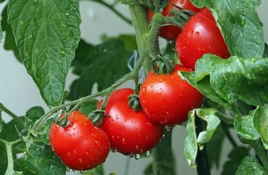
Specialty Crop Outlook
Southern Outlook Meeting
Atlanta, GA
September 24, 2019
Elizabeth Canales
Mississippi State University

Slide 2
Outline
General overview and forecast
Consumption trends
Value of production, prices, production area
Trade
Issues facing the industry

Slide 3
General overview and forecast

Slide 4
Industry overview
Vegetables, fruits and nuts, nursery, greenhouse, floriculture - according to the 2017 U.S. Census of Agriculture:
~232,000 farms
~10 million acres (3.3% harvested cropland)
~ $64 billion value of production
~ 17% of total agriculture value of production
Source: USA. Census of Agriculture, 2017.
Notes:
~34% of crop sales
Total harvested acres = 320,041,858 acres of harvested crops

Slide 5
Acres in production
11
10
0.9
9
2.2
8
7
Berries
0.3
Acres (millions)
Citrus
0.8
6
Non-
citrus
1.9
5
4
Processed
2.6
3
2
1
Fresh
1.7
0
Vegetables
Fruit
Nuts
Nursery, Floriculture, Sod
Total
Source: USA. Census of Agriculture, 2017.

Slide 6
U.S. vegetable and pulse industry at a glance, 2016-2019F
Item | 2016 | 2017 | 2018 | Percent change 2017-18 | 2019F | Change 2018-19F
Area harvested (1,000 acres) | 7,895 | 8,016 | 7,329 | -8.6 | 7,747
Production (Million cwt) | 1,332 | 1,283 | 1,269 | -1.1 | 1,299
Crop value ($ millions) | 20,179 | 21,120 | 18,938 | -10.3 | 20,025
Unit value ($/cwt) | 15.15 | 16.46 | 14.93 | -9.3 | 15.41
Imports ($ millions) | 12,947 | 13,062 | 13,875 | 6.2 | 13,640
Exports ($ millions) | 6,846 | 6,866 | 6,543 | -4.7 | 7,083
Per-capita availability (Pounds) | 394.2 | 402.6 | 395.1 | -1.9 | 397.29
Source: USDA-ERS. Vegetables and Pulses Outlook, 2019.
Notes:
Mostly higher prices, lower volumes

Slide 7
Specialty crop industry forecast
Fruit, vegetable, and tree nuts over the next ten years:
Value of production expected to increase: 2.7% per year
Higher prices
Production is expected to increase: 0.5% annually
Citrus production expected to decline slowly
Tree nut output is expected to increase
Share of vegetables for fresh use and process market expected to remain relatively constant
Source: USDA Agricultural Projections to 2028.

Slide 8
Consumption trends

Slide 9
Per-capita availability of vegetables, 2000-2017
+1%
Slight increase in availability of fresh vegetables.
Domestic production ↓
Vegetables imports ↑
Vegetable exports ↓
Decrease in availability of processed vegetables.
Pounds
-18%
-9%
Fresh
Canned
Frozen
Source: USDA-ERS. Food Availability (Per Capita) Data System.

Slide 10
Per-capita availability of fruits, 2000-2017
+11%
-36%
Increase in the availability of fresh and frozen
Large decrease in availability of fruit for juice and for canned market
Pounds
-24%
+7%
Fresh
Juice
Canned
Frozen
Source: USDA-ERS. Food Availability (Per Capita) Data System.

Slide 11
Consumer expenditures: Annual growth in fruit and vegetable consumption (CAGR 2013-2018)
+3%
Steady increase in per capita consumption of fruit and vegetables
Consumption of processed fruit and vegetables relatively flat
Consumption of fresh fruit and vegetables steadily increasing
2013
2015
2017
2014
2016
2018
Average Annual Expenditures ($)
+3%
+4%
0%
+2%
Total Fruits and vegetables
Fresh fruits
Fresh vegetables
Processed fruits
Processed vegetables
Source: Bureau of Labor. Consumer Expenditure Surveys.

Slide 12
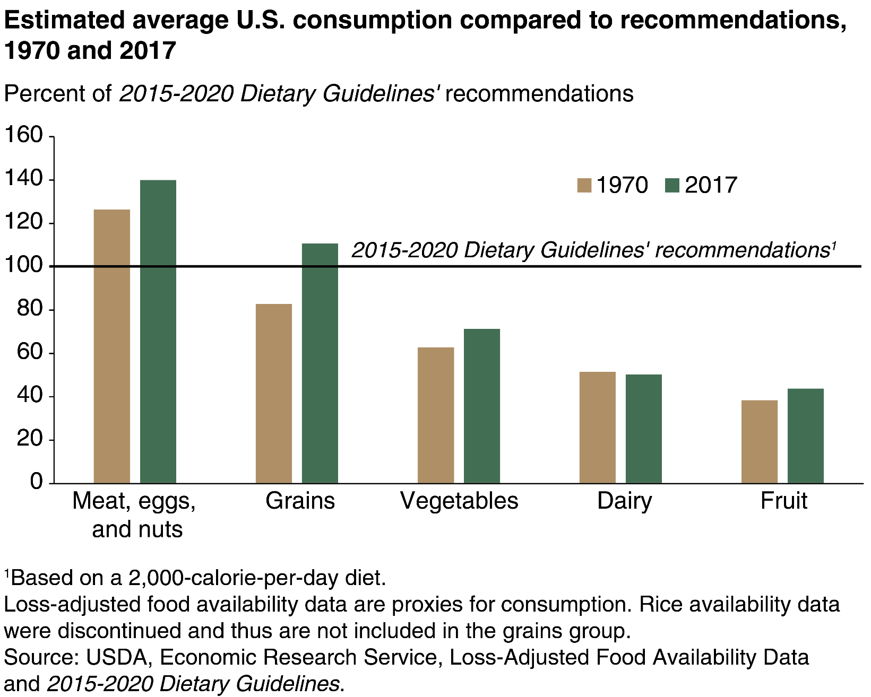
Opportunity: consumption of fruit and vegetables is below recommended levels
Notes:
Source: https://www.ers.usda.gov/webdocs/charts/58333/food-availability_fig06-2-.png?v=6978.

Slide 13
Direct-to-consumers and local sales by farm size (acres)
Local and direct-to-consumer channels are important for the industry
82% of the farms sell through direct marketing channels
Represent 24% of market value
Growth of direct-to-consumer markets has started to slow down
Increase of local offerings
Local products offered at conventional stores
Food sold directly to - Consumers
50
600
Value of Production (Million)
No. farms
No. farms (Thousand)
Value of Production
40
500
30
400
300
20
200
10
100
0
0
1 to 9
10 to 49
50 to 69
70 to 99
100 to 139
140 to 179
180 to 219
220 to 259
260 to 499
500 to 999
1,000 to 1,999
2,000 +
Source: USDA. 2017 Census of Agriculture.

Slide 14
2019 Culinary Forecast
What’s Hot in 2019 survey - the National Restaurant Association:
Produce Category:
Uncommon herbs
Locally sourced produce
Imperfect/ugly produce
Exotic fruit (e.g. rambutan, dragon fruit, paw paw, guava)
Super fruit (e.g. acai, goji berry, mangosteen)
Culinary Concepts:
Cannabis/CBD-infused food
Zero-waste cooking (elevated cuisine using food scraps)
Hyper-local (e.g. restaurant gardens, house-made items)
Veggie-centric/vegetable-forward cuisine
Natural ingredients/clean menus

Slide 15
Consumption trends
Consumption of juices and canned fruit and vegetables declining
Consumption of fresh and some frozen categories (e.g., berries) expected to increase
Increase in the consumption of “superfoods”
e.g., berries, avocados

Slide 16
Value of production
Prices
Production area

Slide 17
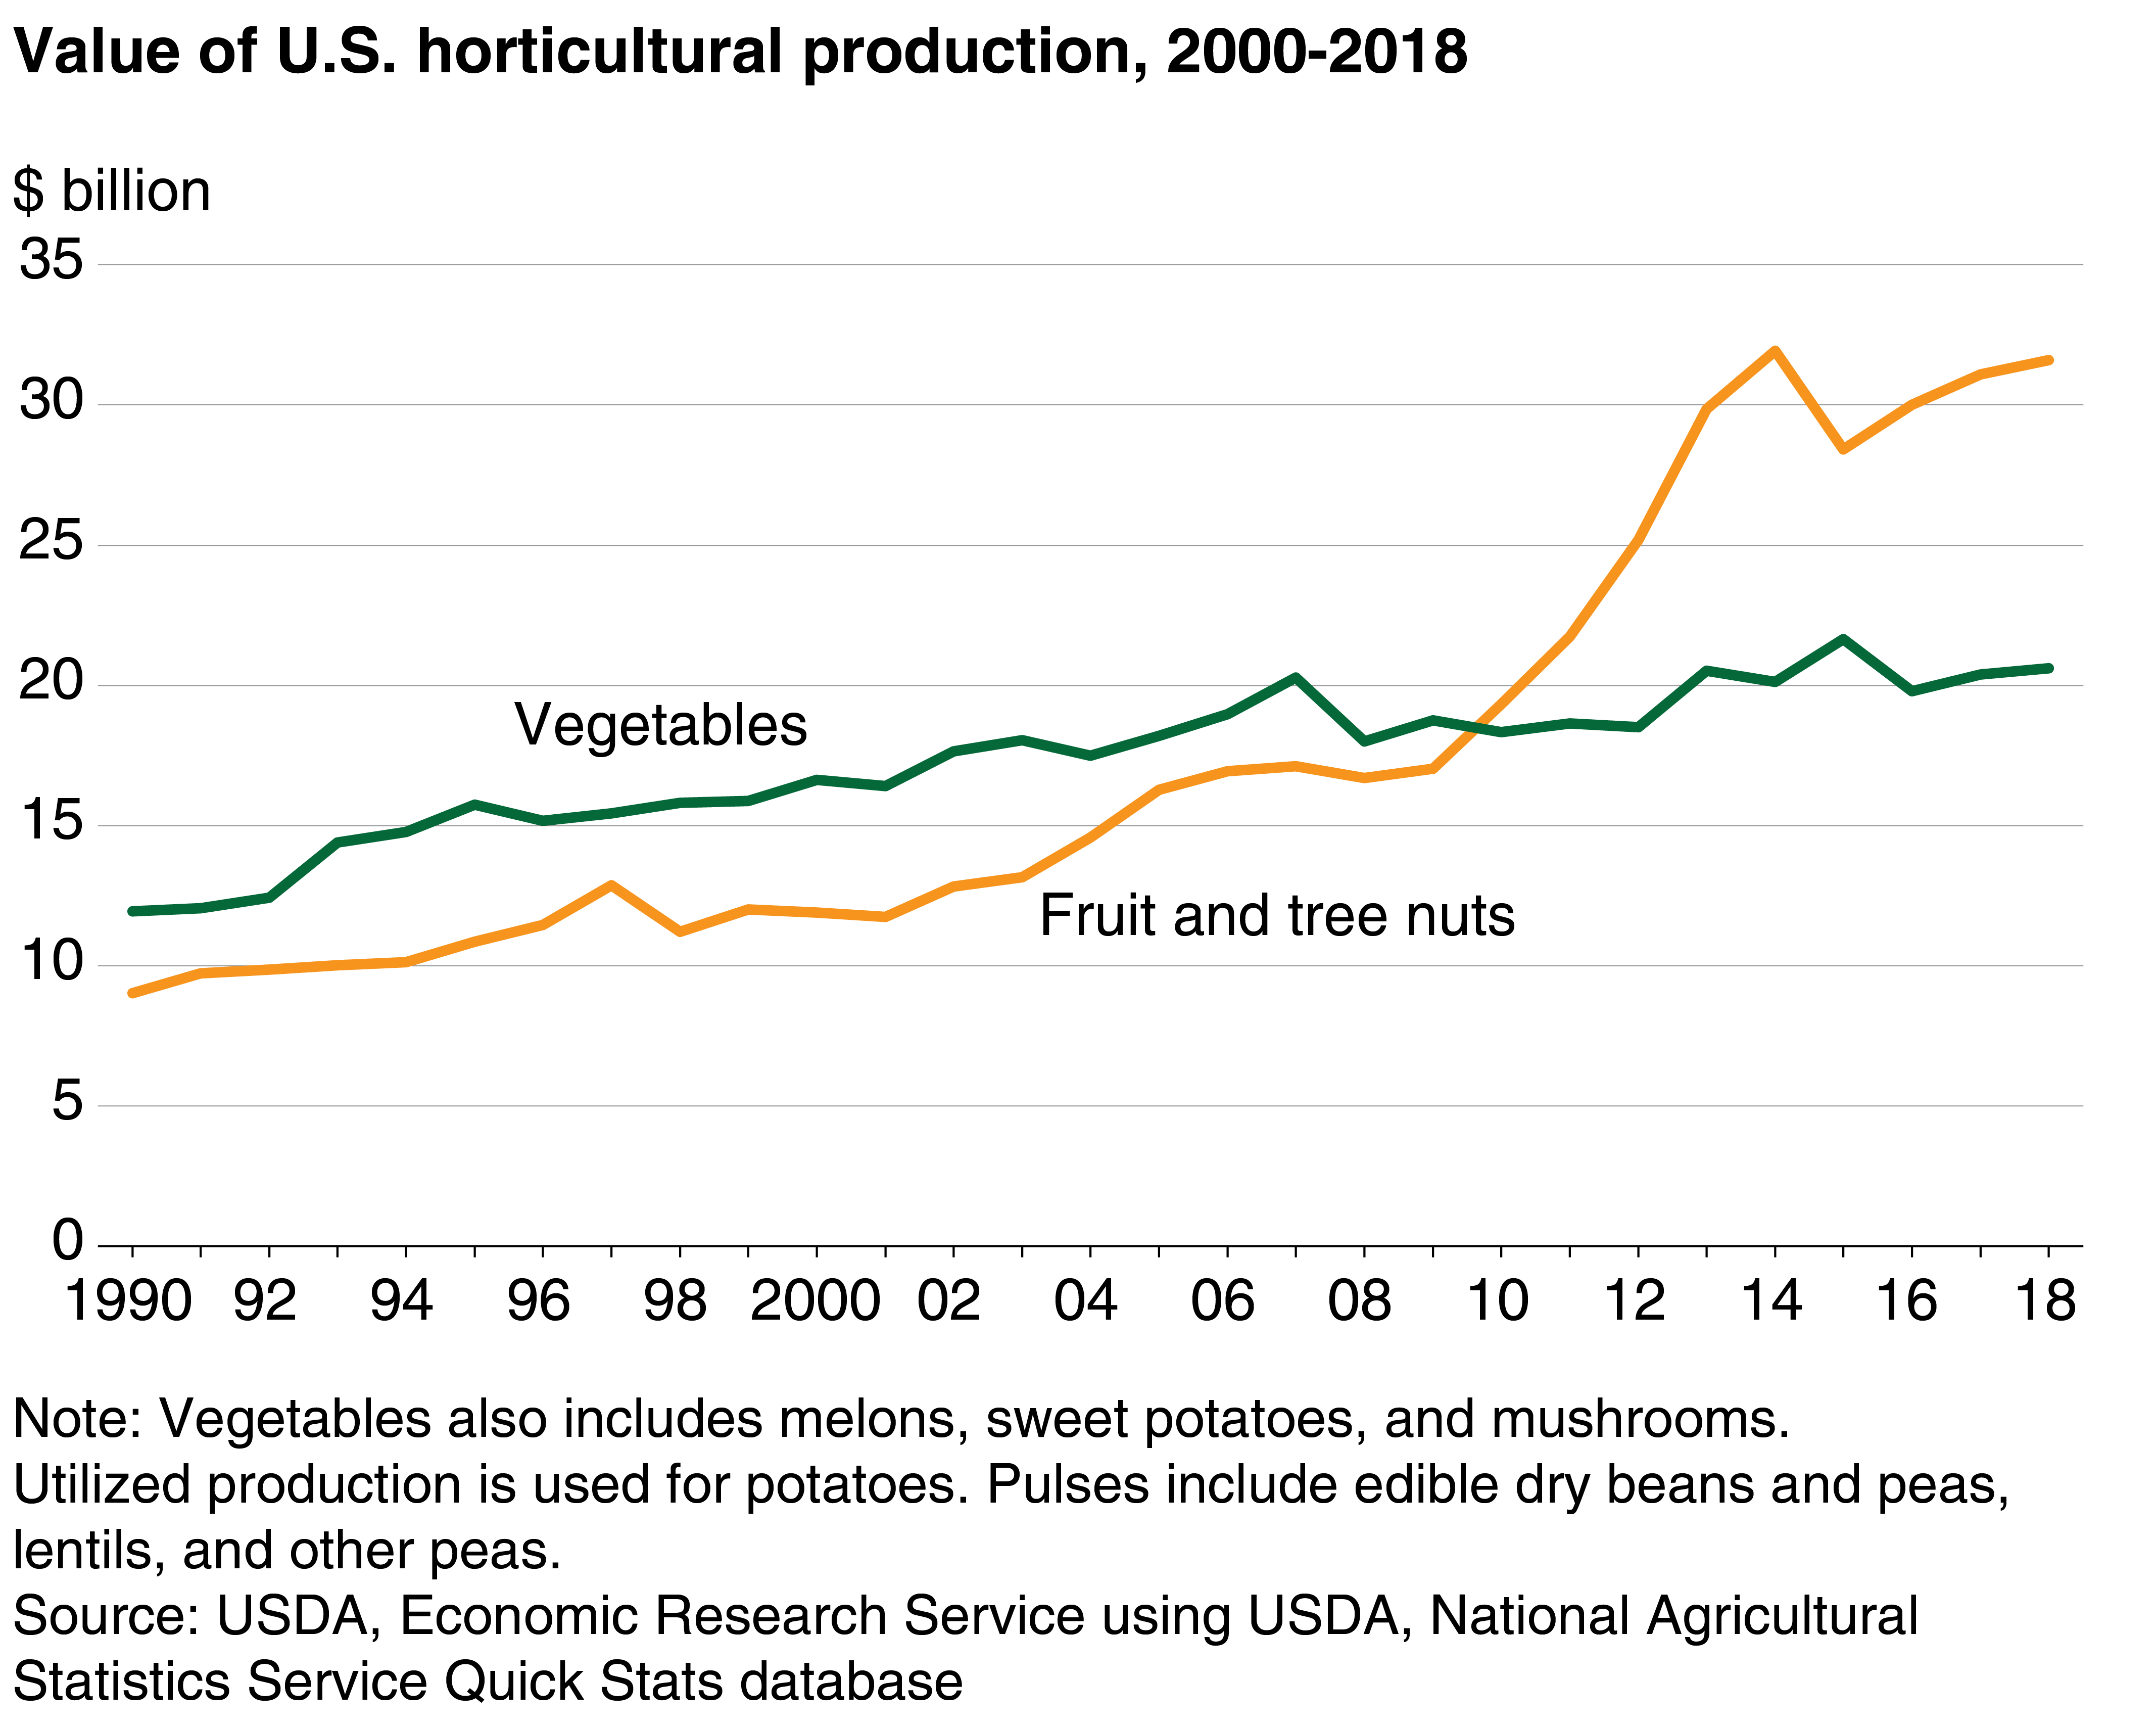
The value of production of fruit and vegetables shows steady increase

Slide 18
U.S. Cash receipts by source, 2010-2019F
85
Expected crops sales changes 2018-2019:
Vegetables and melons: 
Fruits and nuts: 
Other crops (tobacco, sugar, greenhouse, and nursery crops): 
80
2010
2012
2014
2016
2018
75
2011
2013
2015
2017
2019F
70
65
60
Nominal ($ Billion)
55
50
45
40
+36%
35
30
25
+13%
20
15
10
5
0
Feed crops
Oil crops
Fruits and nuts
Vegetables and melons
Food grains
Cotton
Tobacco
Data Source: USDA-ERS. Farm Income and Wealth Statistics. Value added to the U.S. economy by the agricultural sector, 2010-2019F.
Available online: https://data.ers.usda.gov/reports.aspx?ID=17830.

Slide 19
Vegetables, and fruits & nuts: Annual growth in U.S. cash receipts (CAGR 2010-2019F)
Fruits and nuts
Vegetables and melons
35
+4%
35
30
30
Nominal ($ Billion)
25
25
+1%
20
20
15
15
10
10
5
5
0
0
2010
2011
2012
2013
2014
2015
2016
2017
2018
2019F
2010
2011
2012
2013
2014
2015
2016
2017
2018
2019F
Data Source: USDA-ERS. Farm Income and Wealth Statistics. Value added to the U.S. economy by the agricultural sector, 2010-2019F.
Available online: https://data.ers.usda.gov/reports.aspx?ID=17830.
Notes:
https://www.ers.usda.gov/topics/farm-economy/farm-sector-income-finances/farm-sector-income-forecast/

Slide 20
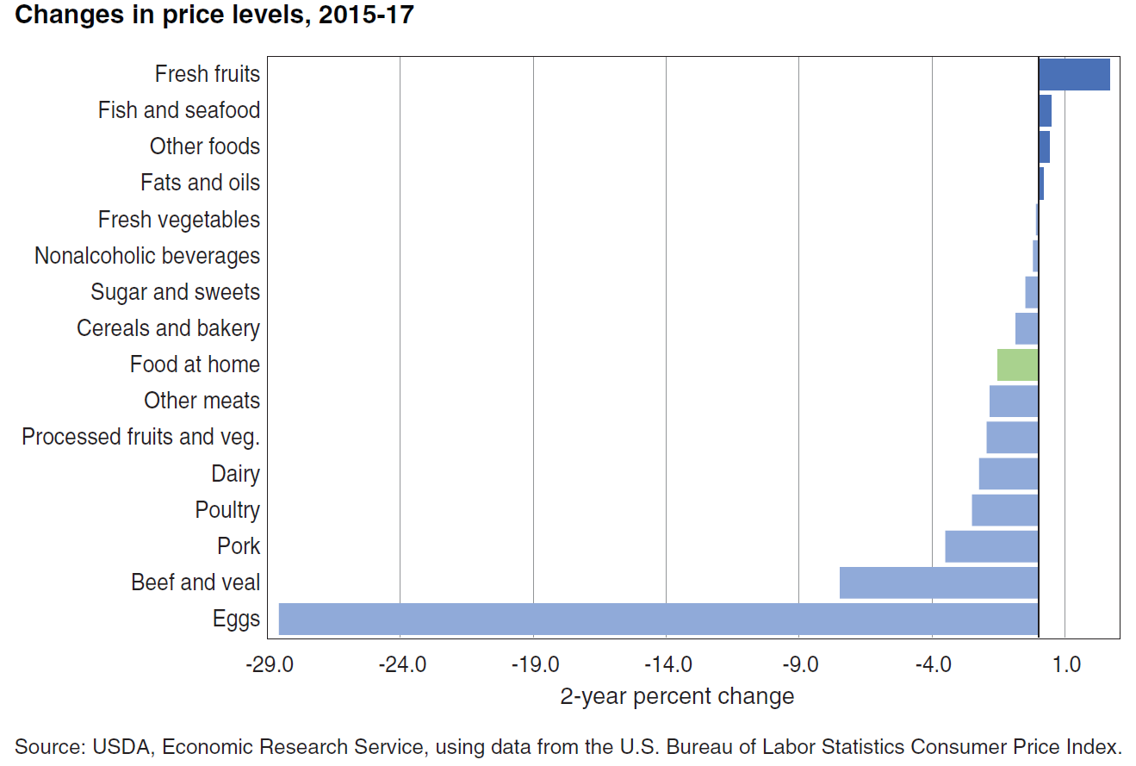
Changes in consumer food prices, 2015-2017
Notes:
Source: https://www.ers.usda.gov/publications/pub-details/?pubid=92932

Slide 21
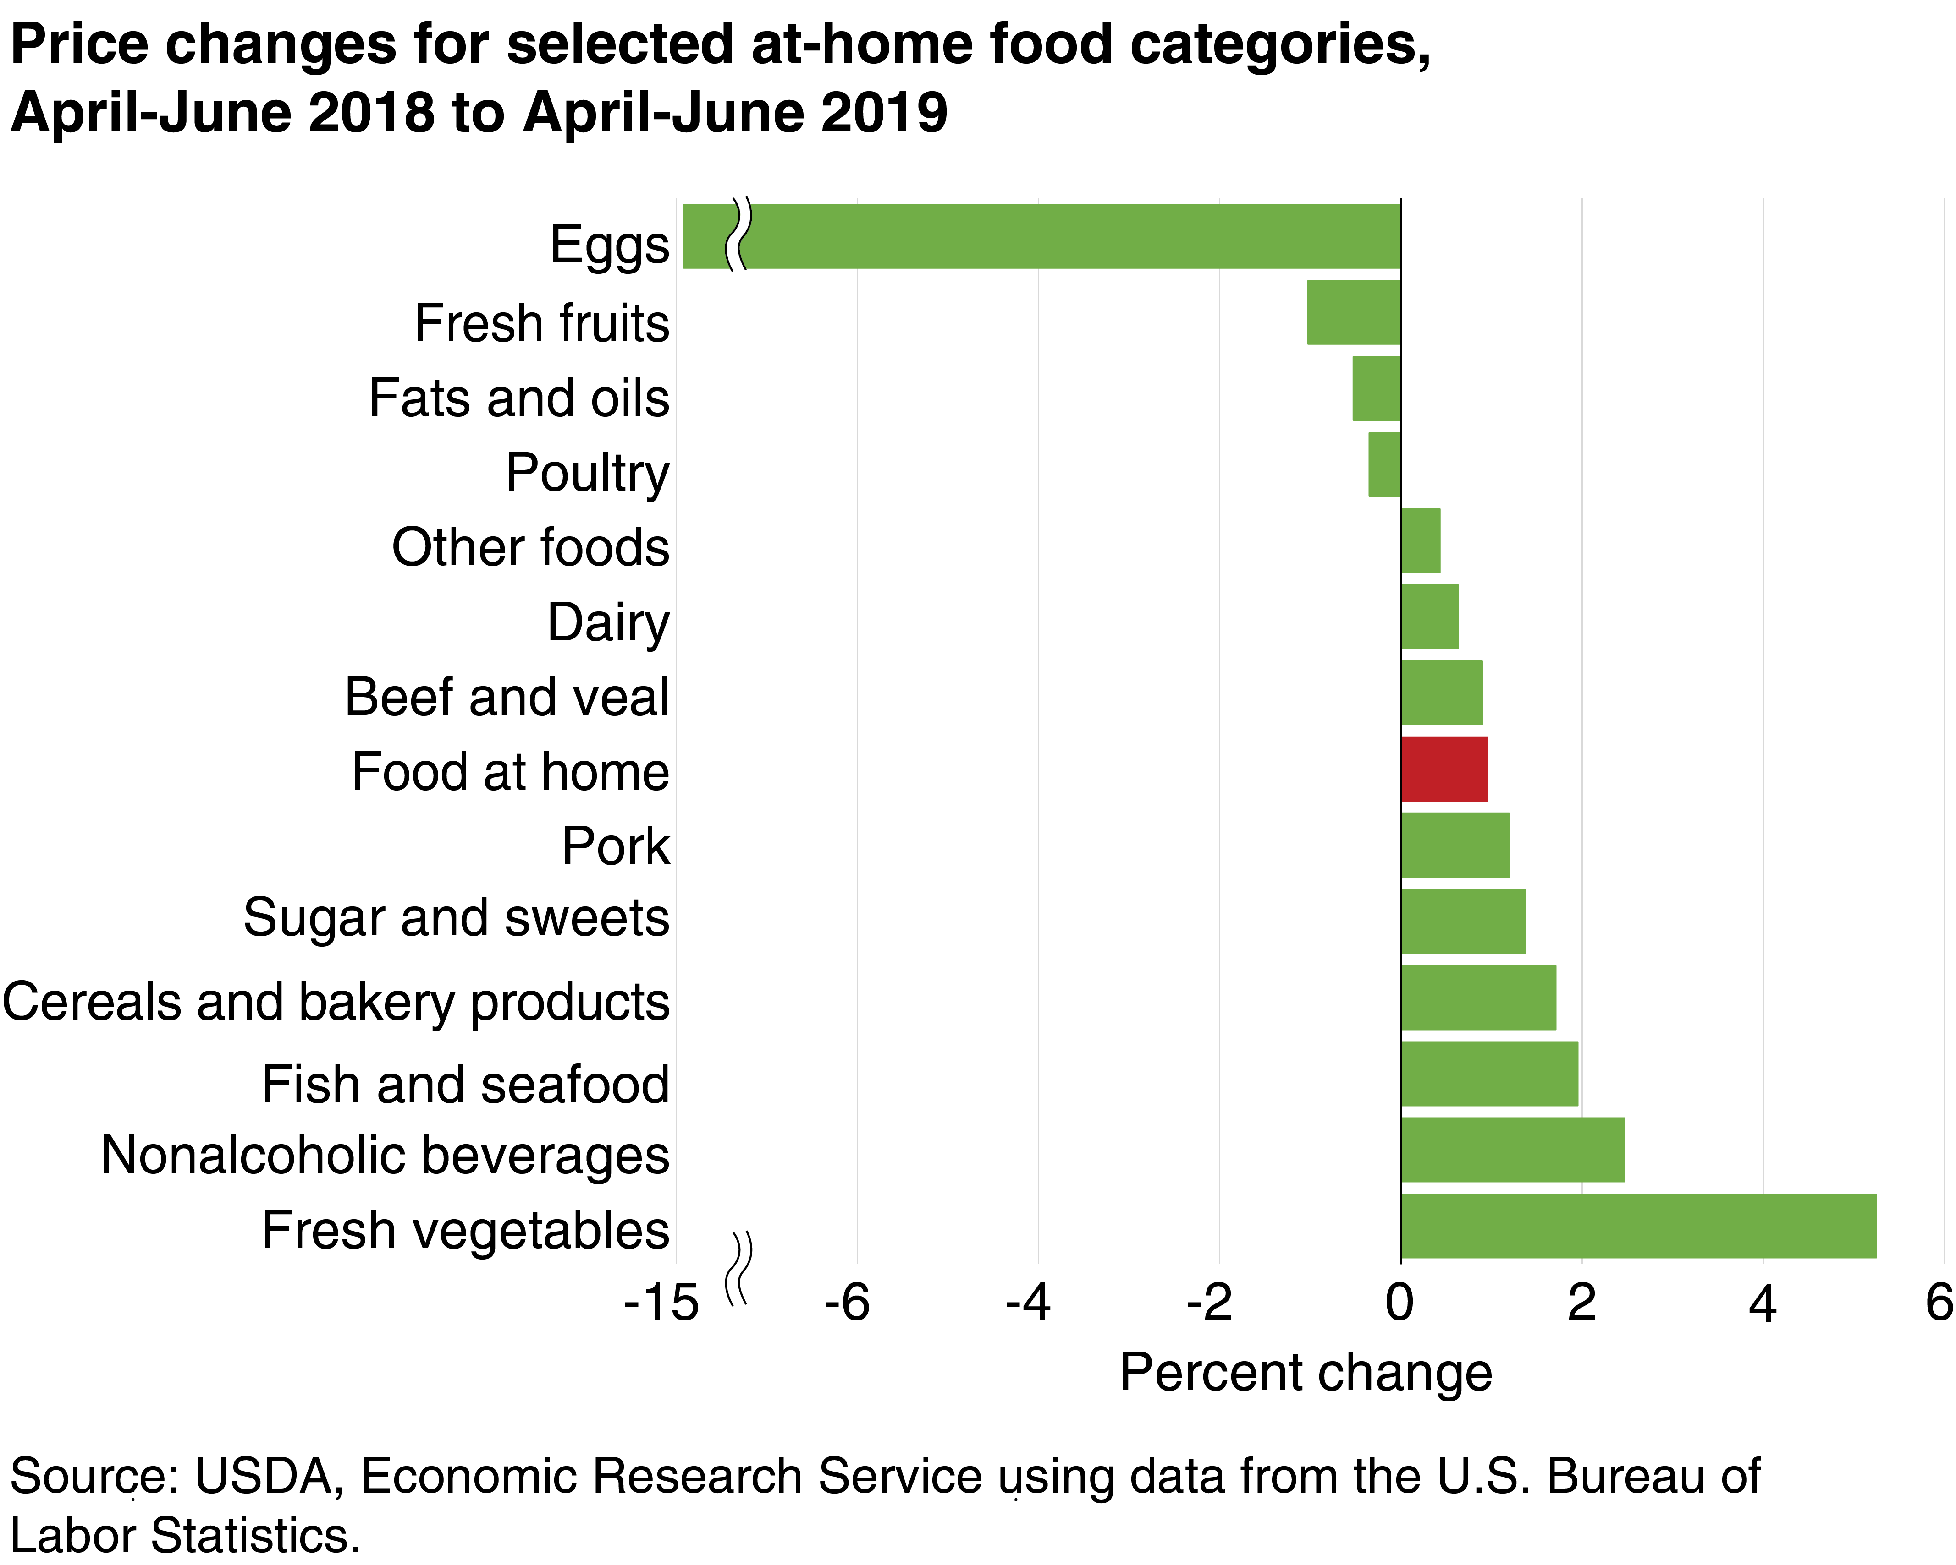
Changes in consumer food prices, 2018-2019

Slide 22
Index of prices received by growers for fruits and tree nuts
Base year: 1982=100
1,600
1,500
1,400
Tree nuts
1,200
1,100
1,000
900
300
200
100
0
Citrus fruits
Canned fruits/juices
Frozen fruits/juices
Fresh fruits/melons
Data Source: USDA-ERS. Farm Income and Wealth Statistics. Vegetables and Pulses Data. Yearbook – Producer Price Indexes.

Slide 23
Index of prices received by growers for fruits and tree nuts
Base year: 1982=100
340
320
300
280
260
240
220
200
180
160
140
120
0
Citrus fruits
Canned fruits/juices
Frozen fruits/juices
Fresh fruits/melons
Data Source: USDA-ERS. Farm Income and Wealth Statistics. Vegetables and Pulses Data. Yearbook – Producer Price Indexes.

Slide 24
Index of prices received by growers for fresh vegetables Base year: 1982-100
Base year: 1982=100
250
240
All fresh vegetables
230
220
210
200
190
180
170
160
150
140
0
Data Source: USDA-ERS. Farm Income and Wealth Statistics. Vegetables and Pulses Data. Yearbook – Producer Price Indexes.

Slide 25
Average price for selected vegetables
 | 2016 | 2017 | 2018p | % Change 2017-18
 | -------------- $/cwt ---------------- |  |  | Percent
Artichokes | 78.80 | 70.00 | 63.00 | -10
Asparagus | 117.00 | 132.00 | 122.00 | -8
Broccoli | 38.20 | 46.00 | 43.10 | -6
Cabbage | 21.70 | 19.80 | 22.90 | 16
Carrots | 32.10 | 30.20 | 27.30 | -10
Sweet Potatoes | 20.70 | 18.40 | 23.90 | 30
Celery | 18.50 | 20.50 | 25.90 | 26
Beans, snap | 60.10 | 57.10 | 59.80 | 5
Lettuce, leaf | 46.20 | 60.90 | 51.90 | -15
Garlic | 74.00 | 76.30 | 78.90 | 3
Lettuce, head | 26.70 | 35.90 | 30.10 | -16
Lettuce, romaine | 30.40 | 44.80 | 31.00 | -31
Onions | 16.50 | 14.40 | 13.50 | -6
Peppers, bell | 33.10 | 44.10 | 41.50 | -6
Spinach | 52.50 | 68.80 | 59.00 | -14
Squash | 24.50 | 29.60 | 26.60 | -10
Tomatoes | 42.30 | 36.8 | 41.5 | 13
Average | 43.14 | 47.39 | 44.82 | -5.4
Foodborne illness outbreaks in 2018
Source: USDA-ERS. Vegetables and Pulses Outlook, 2019.

Slide 26
Index of prices received by growers for fresh vegetables
Base year: 1982=100
2017
2018
2019
340
320
300
280
260
240
220
200
180
160
0
Jan
Feb
Mar
Apr
May
Jun
Jul
Aug
Sept
Oct
Nov
Dec
Data Source: USDA-ERS. Farm Income and Wealth Statistics. Vegetables and Pulses Data. Yearbook – Producer Price Indexes.

Slide 27
Prices in the organic sector
 | % of retail sales |  |  | Retail Price ($/lb)
 | 2016 | 2017 |  | 2016 | 2017 | Change
Kale | 46% | 44% |  | 2.8 | 3.0 | 7%
Apples | 10% | 10% |  | 2.5 | 2.3 | -9%
Spinach | 40% | 40% |  | 6.7 | 6.5 | -3%
Strawberries | 9% | 11% |  | 4.1 | 4.3 | 5%
Carrots | 26% | 27% |  | 1.4 | 1.5 | 1%
Salad mix | 3% | 3% |  | 7.7 | 7.8 | 1%
Tomatoes | 6% | 5% |  | 3.4 | 3.2 | -5%
Grapes | 4% | 4% |  | 2.8 | 3.0 | 6%
Garlic | 5% | 5% |  | 6.8 | 7.1 | 4%
Blueberries | 11% | 12% |  | 10.0 | 9.4 | -6%
Citrus | 4% | 4% |  | 3.1 | 3.1 | 0%
Mushrooms | 10% | 11% |  | 4.9 | 4.9 | -1%
Onions | 11% | 13% |  | 1.6 | 1.6 | -1%
Sector increasing but at slower rate
Higher organic volumes putting downward pressure on prices
Organic premiums shrinking for some commodities
Organic products still slow to penetrate foodservice
Source: The Packer. Organic Fresh Trends 2019. Available: https://www.thepacker.com/newspaper/packers-organic-fresh-trends-2019

Slide 28
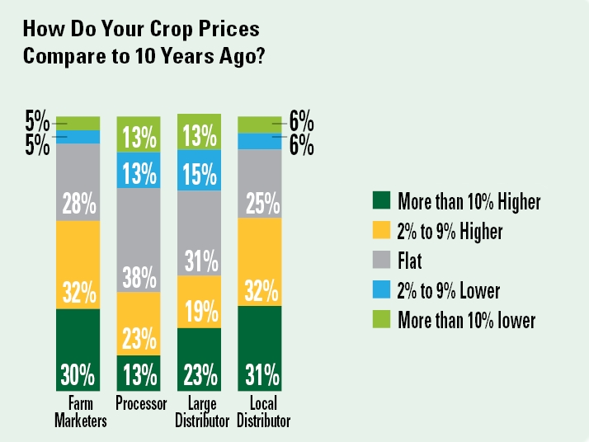
Perceptions of changes in crop prices The Packer: 2019 State of the Vegetable Industry Survey
Source: 2019 State of the Vegetable Industry Survey – American Vegetable Grower Magazine. Available: https://www.growingproduce.com/vegetables/crop-prices-are-frozen-in-time-opinion/

Slide 29
Census of Ag: Number of farms and acreage
2007
2012
2017
+3%
+8%
80
-3%
5.0
70
4.5
4.0
No. Farms (thousand)
60
3.5
50
+27%
Acres (million)
+7%
3.0
-2%
40
2.5
30
2.0
-7%
-6%
1.5
20
1.0
10
0.5
0
0.0
Vegetables
Noncitrus fruit
Citrus fruit
Nuts
Vegetables
Noncitrus fruit
Citrus fruit
Nuts
Source: USDA. 2017 Census of Agriculture.

Slide 30
Changes in acreage for selected commodities
-
1,200
1,100
2012
2017
1,000
900
800
Acres (millions)
700
600
-
500
+
-
400
300
+
+
200
-
+
+
-
+
100
0
Potatoes
Sweet corn
Lettuce, all
Tomatoes (in the open)
Sweet potatoes
Broccoli
Carrots
Spinach
Kale
Oranges
Tangerines
Source: USDA. 2017 Census of Agriculture.

Slide 31
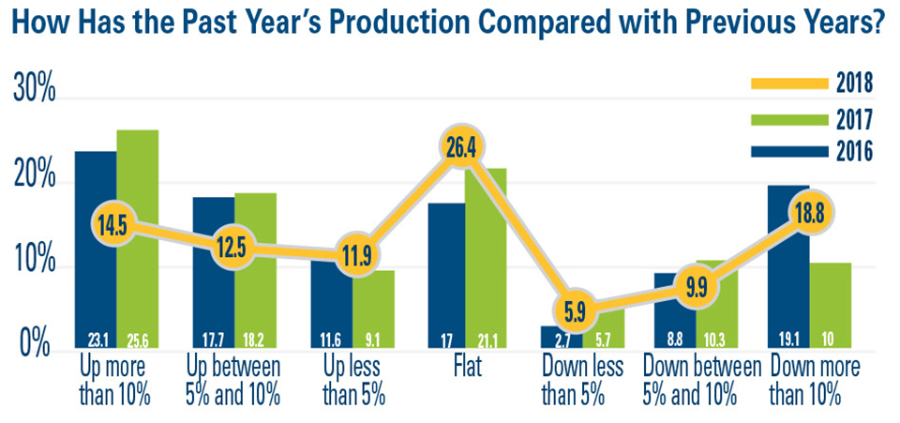
Changes in vegetable production The Packer: 2019 State of the Vegetable Industry Survey
Source: 2019 State of the Vegetable Industry Survey – American Vegetable Grower Magazine. Available: https://www.growingproduce.com/vegetables/production-levels-weakened-last-year-2019-state-of-the-vegetable-industry/

Slide 32
Area under protected agriculture
The area under protected agriculture (e.g., greenhouse, high tunnels, etc.) has risen since 2012.
Commodity | 2012 (acres) | 2017 (acres) | Change 2012-17
Tomatoes | 1,267 | 1,468 | 16%
Other vegetables, herbs | 983 | 1,116 | 14%
Fruit and berries | 183 | 269 | 47%
Nursery | 5,934 | 7,091 | 19%
Floriculture | 20,048 | 19,961 | -0.4%
Source: USDA. 2017 Census of Agriculture.
Notes:
Fruit and vegetables= 2,853
~50% of vegetable area production used for tomatoes

Slide 33
Trade

Slide 34
Exports and imports of vegetables (World total)
14
Imports
Exports
13
12
11
10
9
US$ billion
8
7
6
5
4
3
2
1
0
2000
2001
2002
2003
2004
2005
2006
2007
2008
2009
2010
2011
2012
2013
2014
2015
2016
2017
2018
Data Source: USDA. Foreign Agricultural Service. Global Agricultural Trade System.

Slide 35
U.S. Vegetable Imports (World total)
8.5
8.0
Fresh Veg Exc Potato
7.5
Vegetables, Frozen
7.0
Vegtbls,Prep or Pres
6.5
Vegtbls,Dried/Dehydr
6.0
Olives,Prep or Pres
5.5
Potatoes, Fresh & Seed
5.0
Dried Beans
US$ Billion
Vegetable Juices
4.5
Dried Chickpeas
Dried Peas
3.5
Dried Lentils
3.0
2.5
2.0
1.5
1.0
0.5
0.0
Data Source: USDA. Foreign Agricultural Service. Global Agricultural Trade System.

Slide 36
U.S. Vegetable Exports (World total)
2.4
Fresh Veg Exc Potato
2.2
Vegtbls,Prep or Pres
Vegetables, Frozen
2.0
Vegtbls,Dried/Dehydr
1.8
Dried Beans
Potatoes, Fresh & Seed
1.6
Dried Peas
Dried Lentils
US$ Billion
1.4
Dried Chickpeas
1.2
Vegetable Juices
1.0
0.8
0.6
0.4
0.2
0.0
Data Source: USDA. Foreign Agricultural Service. Global Agricultural Trade System.
Notes:
Prepared or preserved

Slide 37
Exports and imports of fruit and tree nuts (World total)
20
14
Fruit Imports
Tree Nuts Imports
18
Fruit Exports
Tree Nuts Exports
12
16
14
10
US$ billion
12
8
10
8
6
6
4
4
2
2
0
0
2000
2002
2004
2006
2008
2010
2012
2014
2016
2018
2000
2002
2004
2006
2008
2010
2012
2014
2016
2018
Data Source: USDA. Foreign Agricultural Service. Global Agricultural Trade System.

Slide 38
U.S. Fruit Exports (World total)
3.0
Fresh Fruits, Decidi
Fresh Fruits, Citrus
Fresh Fruit, Other
2.5
Fruit Juices
Fruit, Dried
Fruit, Processed
2.0
Fruit, Prep, Misc
Fruit, Frozen
US$ Billion
Fresh Melons
1.5
1.0
0.5
0.0
Data Source: USDA. Foreign Agricultural Service. Global Agricultural Trade System.

Slide 39
Imports of selected commodities from Mexico 1990-2018
2.4
CAGR (1990-2018)
2.2
Berries +18%
2.0
Avocados +47%
Tomatoes +6%
1.8
1.6
US$ (Billion)
1.4
1.2
1.0
0.8
0.6
Cucumbers +8%
0.4
Asparagus +11%
0.2
0.0
1990
1992
1994
1996
1998
2000
2002
2004
2006
2008
2010
2012
2014
2016
2018
Data Source: USDA-FAS. Global Agricultural Trade System.
Notes:
Data Source: USDA-FAS. Global Agricultural Trade System.
Note: Avocados (HS 080440), Tomatoes – fresh or chill (HS 0702), Berries (HS 0810), Cucumber (HS 0707), Asparagus (HS 070920).
CAGR: Compound annual growth rate.

Slide 40
New tomato suspension agreement
Suspension agreements set minimum prices for fresh tomatoes imported from Mexico
No dumping investigations or duties
In may U.S. Department of Commerce withdrew from the 2013 agreement due to complaints from fresh tomato domestic growers
New suspension agreement (Sept. 19)
End 17.56% antidumping duty paid by importers of Mexican tomatoes
Minimum reference prices for U.S. imports of Mexican tomatoes
Suspend dumping investigation of Mexican tomatoes into the U.S
Allows for border inspection of ~66% of tomatoes imported (rounds, romas, bulk grapes)

Slide 41
Issues facing the industry

Slide 42
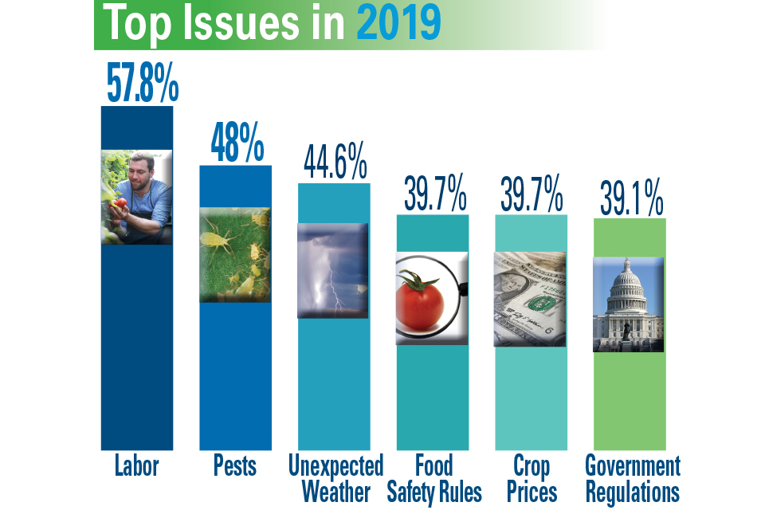
Source: 2019 State of the Vegetable Industry Survey – American Vegetable Grower Magazine. Available online: https://www.growingproduce.com/vegetables/which-issues-have-your-attention-2019-state-of-the-vegetable-industry/

Slide 43
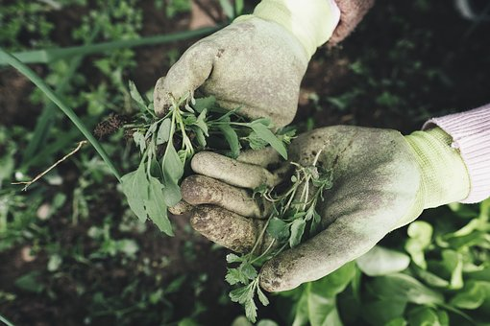
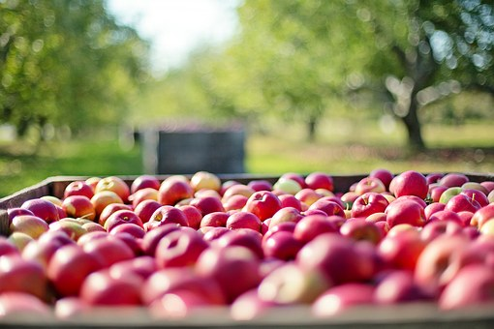
Challenge with Labor
2019 State of the Vegetable Industry Survey (The Packer):
44.1%: Cost of Labor
37.8%: The physically difficult nature of farm work
36.2% We can’t offer year-round work
32.9%: Not enough people applying
26.6% Lack of expertise among applicants
23%: Long hours
Source: 2019 State of the Vegetable Industry Survey – American Vegetable Grower Magazine. Available: https://www.growingproduce.com/vegetables/which-issues-have-your-attention-2019-state-of-the-vegetable-industry/

Slide 44
The avg. adverse effect wage rate for 2019 is $12.96/hr, up 6.2%
Available at: https://www.thepacker.com/article/court-action-filed-stop-new-h-2a-wage-rates.

Slide 45
Other issues…
Pressure to respond to foodborne illness outbreaks
Voluntary label for romaine lettuce: harvest location, date, or labeled as being hydroponically or greenhouse-grown
Blockchain-enabled traceability (e.g., Walmart and leafy greens suppliers)
Fruit and nut exporters will continue struggle to maintain global sales
Retaliatory tariffs
Efforts to expand online grocery commerce

Slide 46
Thank you! Questions?

