Slide 1
Peanut Outlook
September 24, 2019
Southern Agricultural Outlook Conference
Adam N. Rabinowitz, Ph.D.
Assistant Professor and Extension Economist
Agricultural and Applied Economics

Slide 2
Snapshot of the Peanut Outlook
Supply –
still a lot of peanuts
Demand –
stagnant
Trade –
relatively minimal impact
Policy/Legal –
status quo although watch the lawsuit
Prices –
little upward movement expected

Slide 3
Peanut Supply

Slide 4
Peanut Acreage
State | 2014 | 2015 | 2016 | 2017 | 2018 | 2019P | % Change
 | 1,000 acres
AL | 175 | 200 | 175 | 195 | 165 | 160 | -3.0%
AR | 10.5 | 16.3 | 24 | 30 | 26 | 35 | 34.6%
FL | 175 | 190 | 155 | 195 | 155 | 165 | 6.5%
GA | 600 | 785 | 720 | 840 | 665 | 670 | 0.8%
MS | 32 | 44 | 39 | 44 | 25 | 20 | -20.0%
SE | 993 | 1,235 | 1,113 | 1,304 | 1,036 | 1,050 | 1.4%
NM | 5 | 5 | 8 | 9 | 6 | 5 | -16.7%
OK | 12 | 10 | 13 | 21 | 16 | 16 | 0.0%
TX | 130 | 170 | 305 | 275 | 155 | 160 | 3.2%
SW | 147 | 185 | 326 | 305 | 177 | 181 | 2.3%
NC | 94 | 90 | 101 | 120 | 102 | 104 | 2.0%
SC | 112 | 112 | 110 | 125 | 87 | 65 | -25.3%
VA | 19 | 19 | 21 | 27 | 24 | 25 | 4.2%
VC | 225 | 221 | 232 | 272 | 213 | 194 | -8.9%
US | 1,365 | 1,641 | 1,671 | 1,881 | 1,426 | 1,425 | -0.1%
Source: USDA NASS Crop Production Reports – Last updated 9/12/19

Slide 5
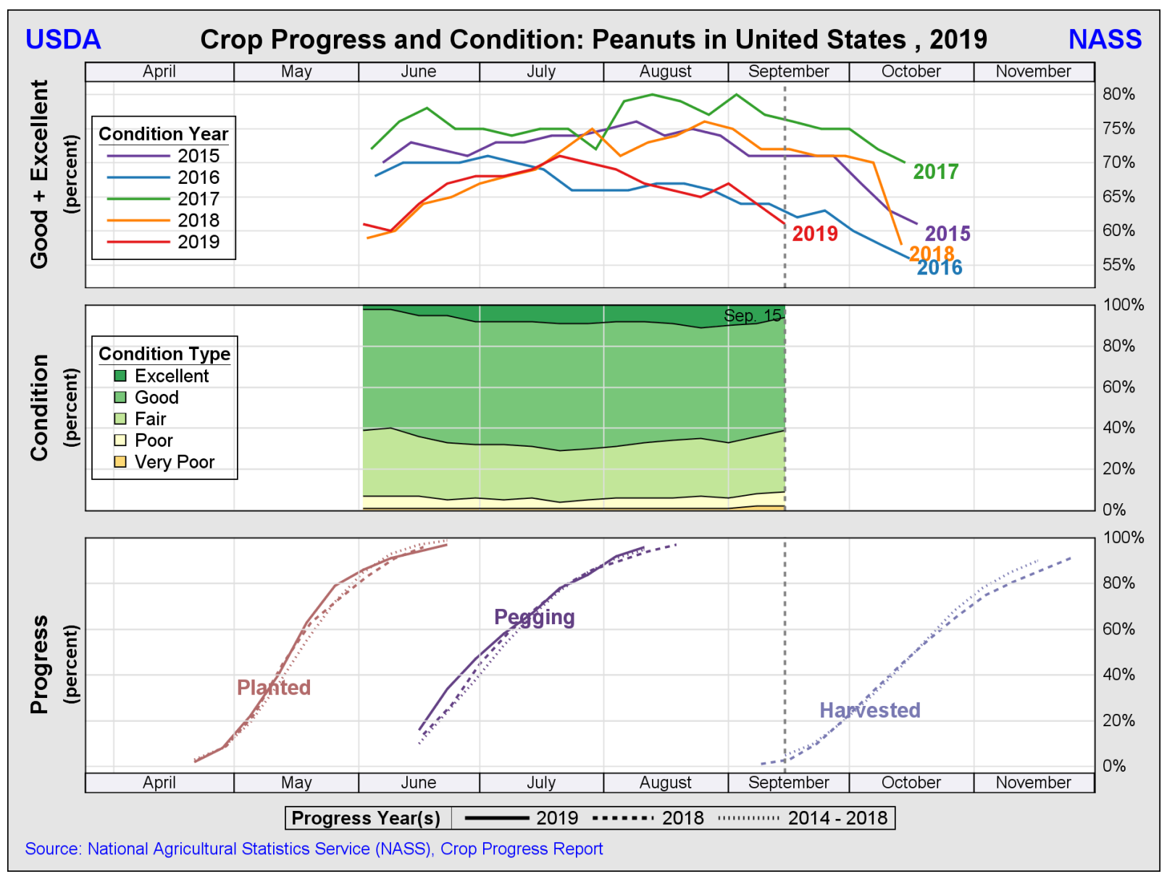

Slide 6
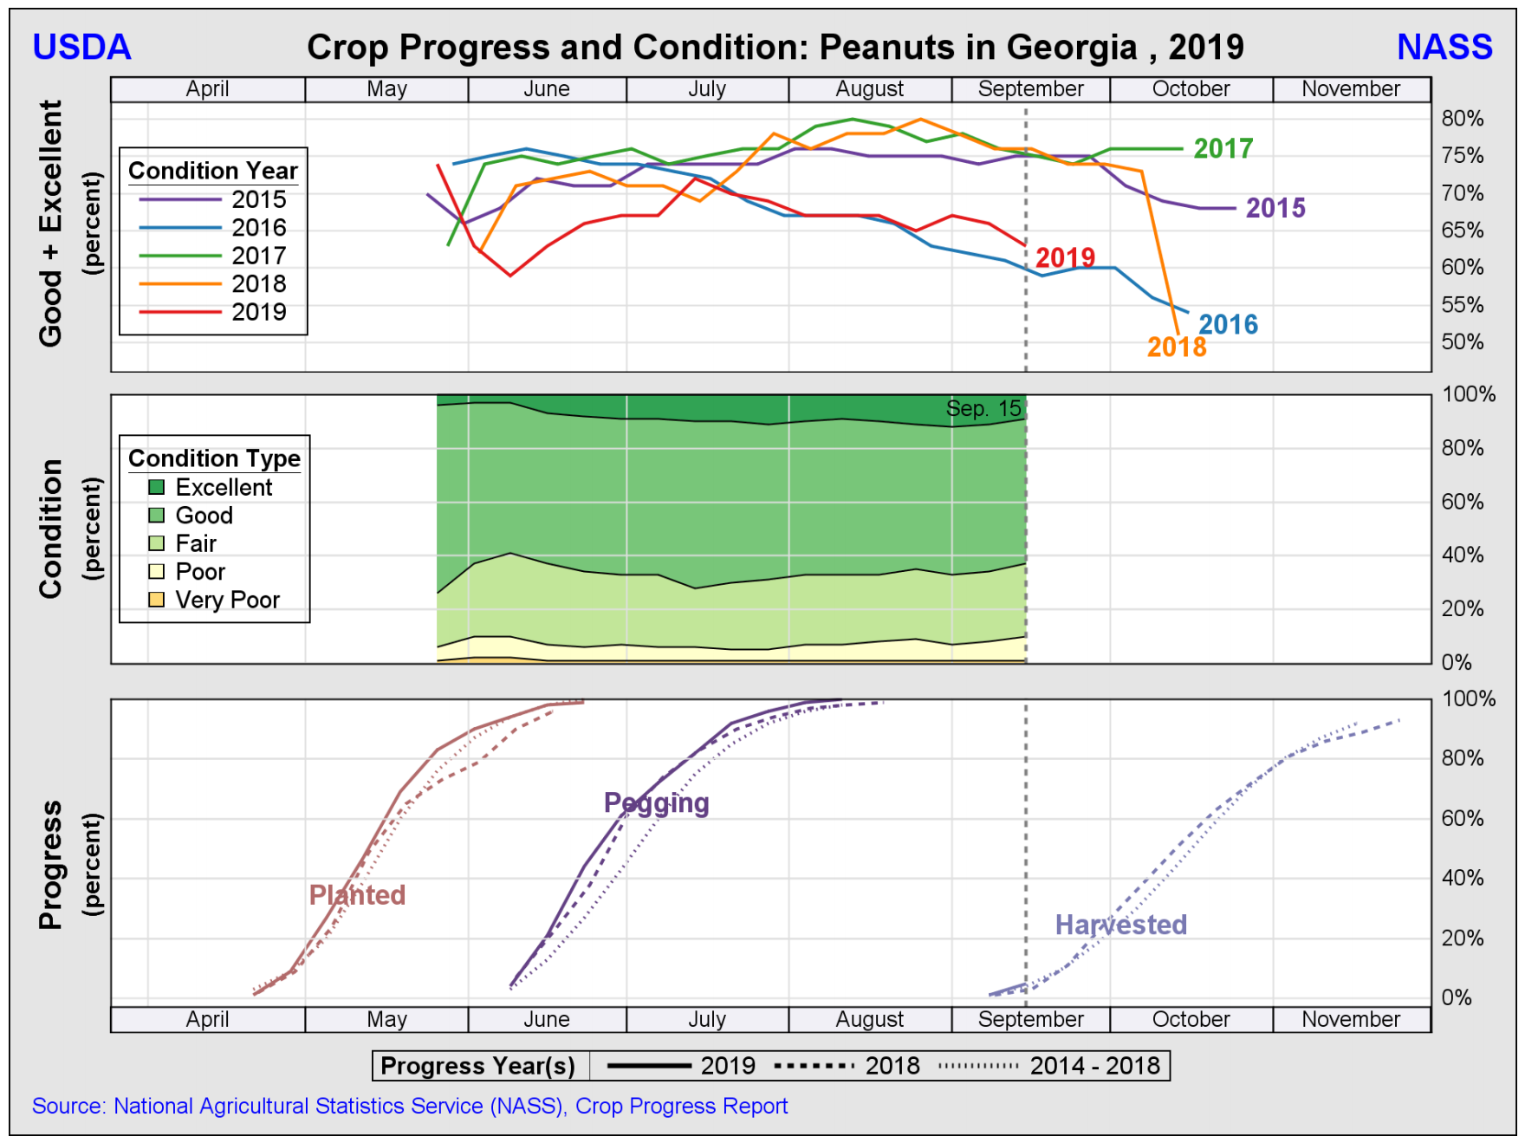

Slide 7
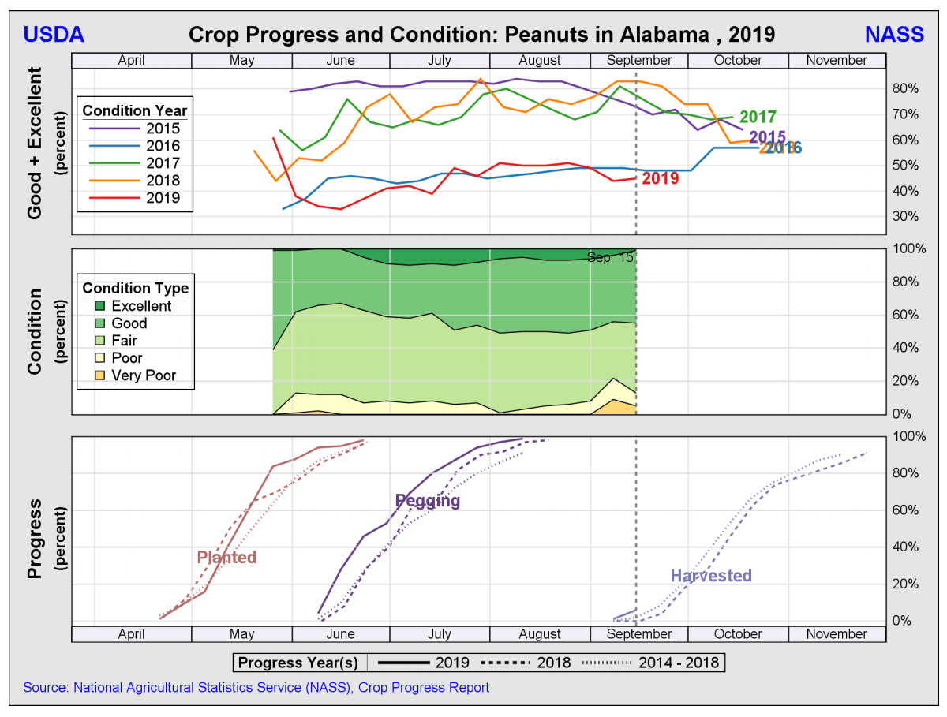

Slide 8
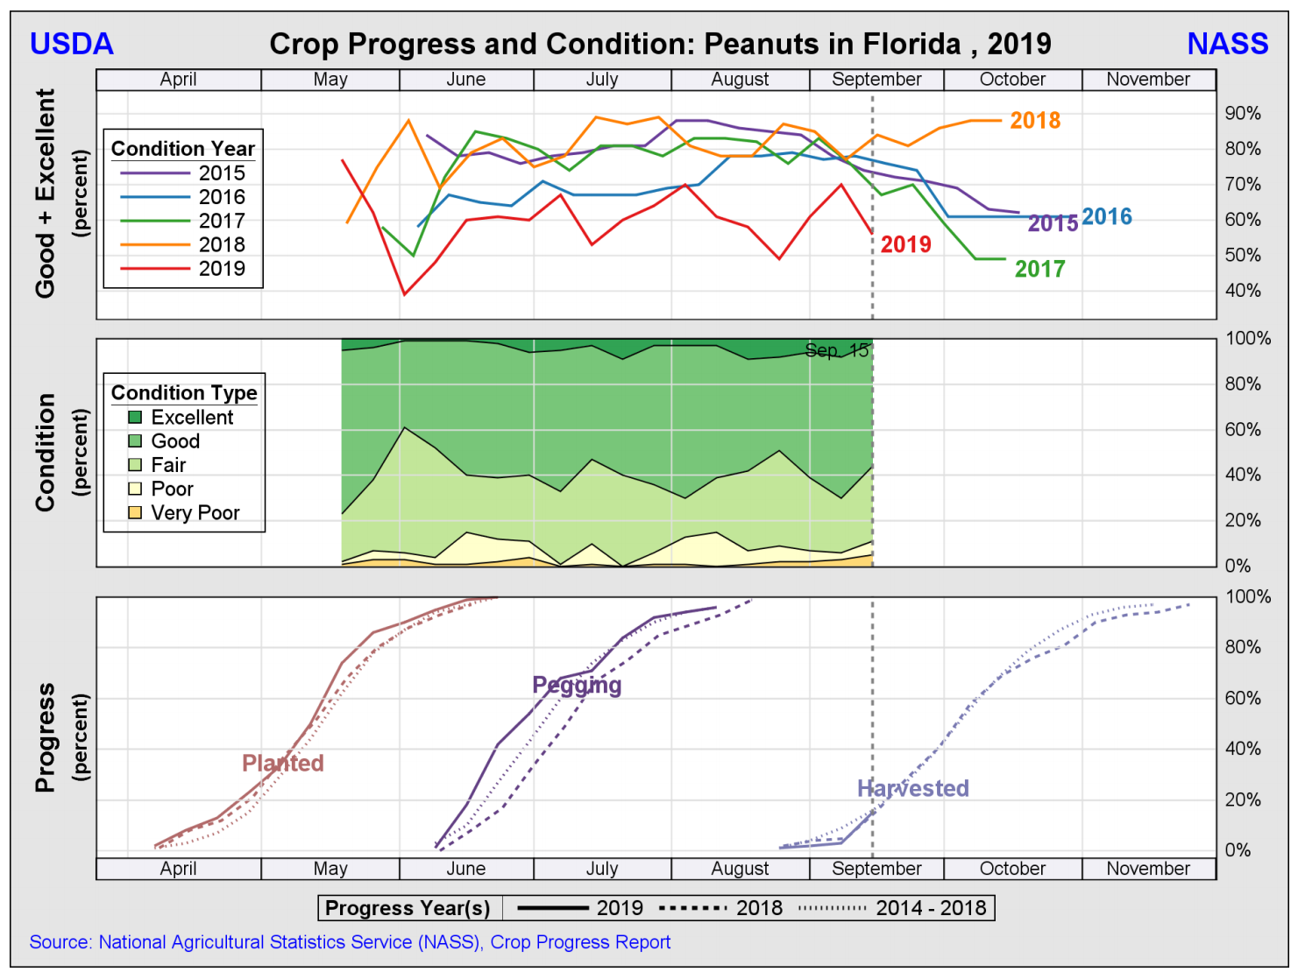

Slide 9
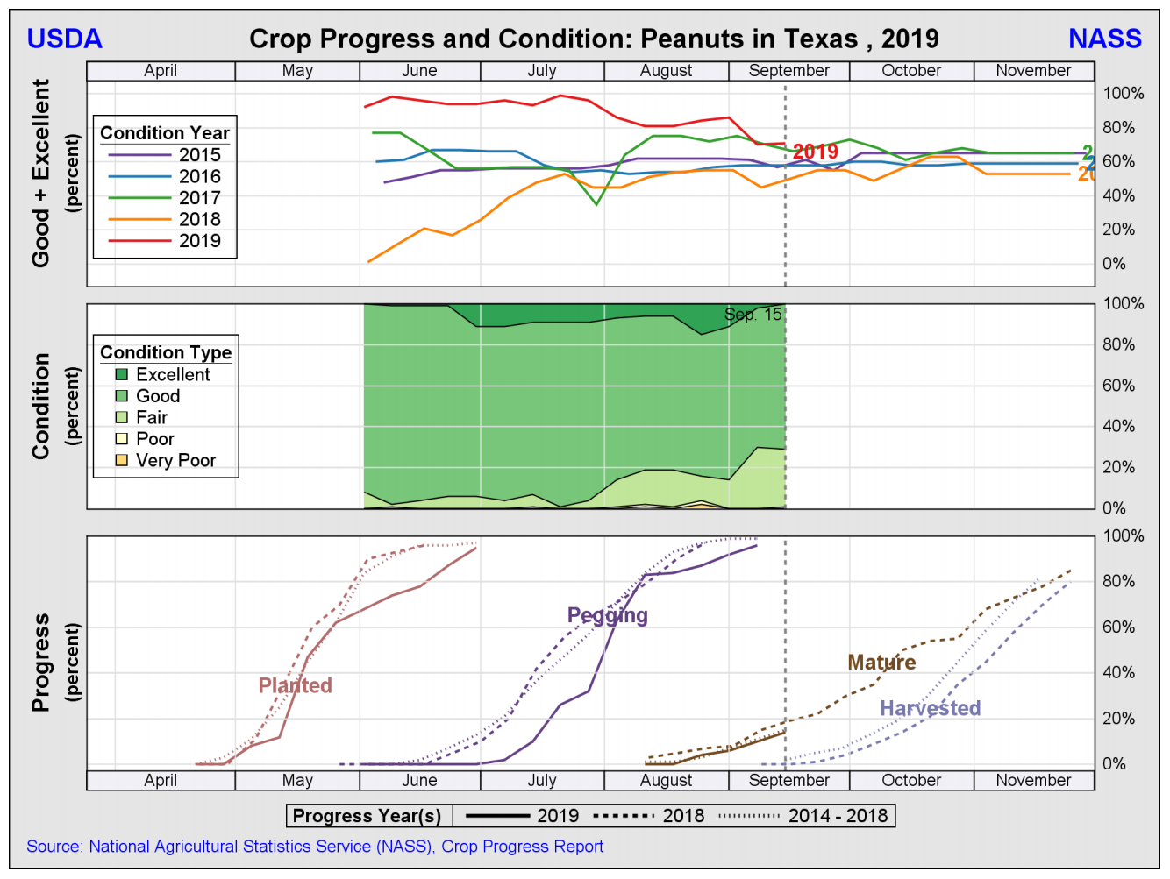

Slide 10
Peanut Yields
State | 2017 Actual (lbs) | 2018 Actual (lbs) | 2019 Forecasted (lbs) | Record Yield
AL | 3,650 | 3,400 | 3,400 | 4,000 (‘12)
AR | 5,300 | 5,000 | 5,000 | 5,300 (‘17)
FL | 3,550 | 3,600 | 4,000 | 4,000 (‘14)
GA | 4,380 | 4,450 | 4,400 | 4,580 (‘12)
MS | 4,100 | 4,000 | 4,300 | 4,400 (‘12)
NM | 3,500 | 3,000 | 3,200 | 3,600 (‘06)
NC | 4,100 | 3,900 | 4,200 | 4,320 (‘14)
OK | 3,700 | 3,100 | 3,700 | 4,000 (‘14)
SC | 4,000 | 3,400 | 3,600 | 4,000 (‘17)
TX | 3,600 | 3,300 | 3,500 | 3,750 (‘05)
VA | 4,550 | 4,200 | 3,900 | 4,550 (‘17)
Total | 4,074 | 3,991 | 4,086 | 4,211 (‘12)
Data Source: USDA-NASS – Last updated 9/12/19

Slide 11
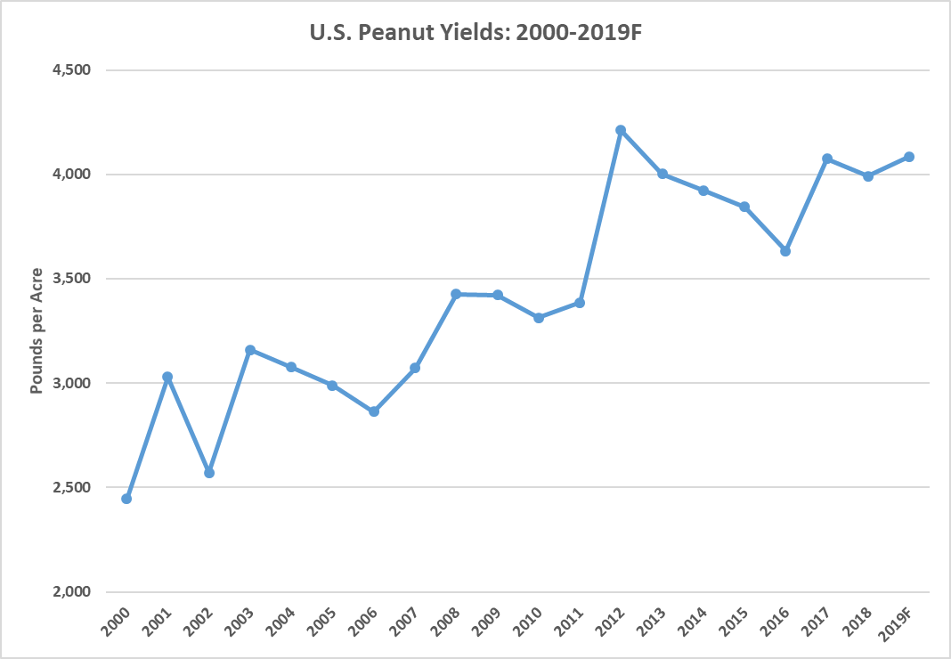
Data Source: USDA-NASS

Slide 12
Data Source: USDA-NASS

Slide 13
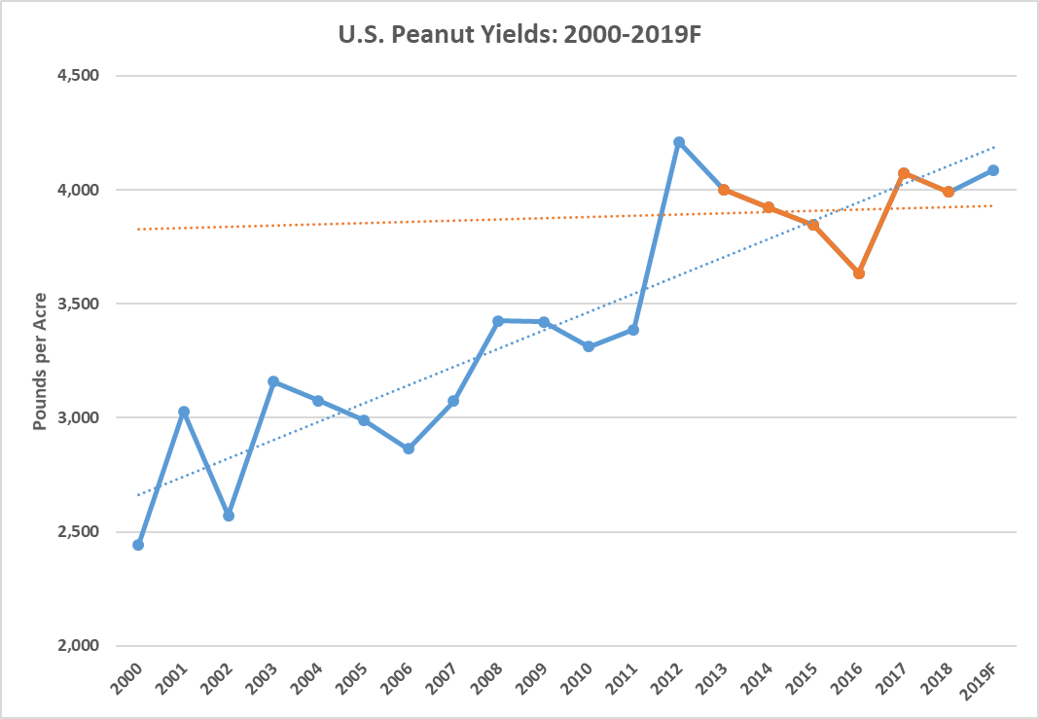
Data Source: USDA-NASS

Slide 14
Peanut Production
State | 2017 Actual (tons) | 2018 Actual (tons) | 2019 Forecasted (tons) | % Change
AL | 352,225 | 275,400 | 266,900 | -3.1%
AR | 76,850 | 57,500 | 85,000 | 47.8%
FL | 330,150 | 252,000 | 310,000 | 23.0%
GA | 1,806,750 | 1,446,250 | 1,452,000 | 0.4%
MS | 88,150 | 48,000 | 40,850 | -14.9%
NM | 13,300 | 8,250 | 8,000 | -3.0%
NC | 239,850 | 191,100 | 212,100 | 11.0%
OK | 37,000 | 23,250 | 27,750 | 19.4%
SC | 236,000 | 139,400 | 111,600 | -19.9%
TX | 378,000 | 239,250 | 262,500 | 9.7%
VA | 61,425 | 50,400 | 48,750 | -3.3%
Total | 3,616,800 | 2,730,800 | 2,825,450 | 3.5%
Data Source: USDA-NASS – Last updated 9/12/19

Slide 15
Peanut Demand

Slide 16
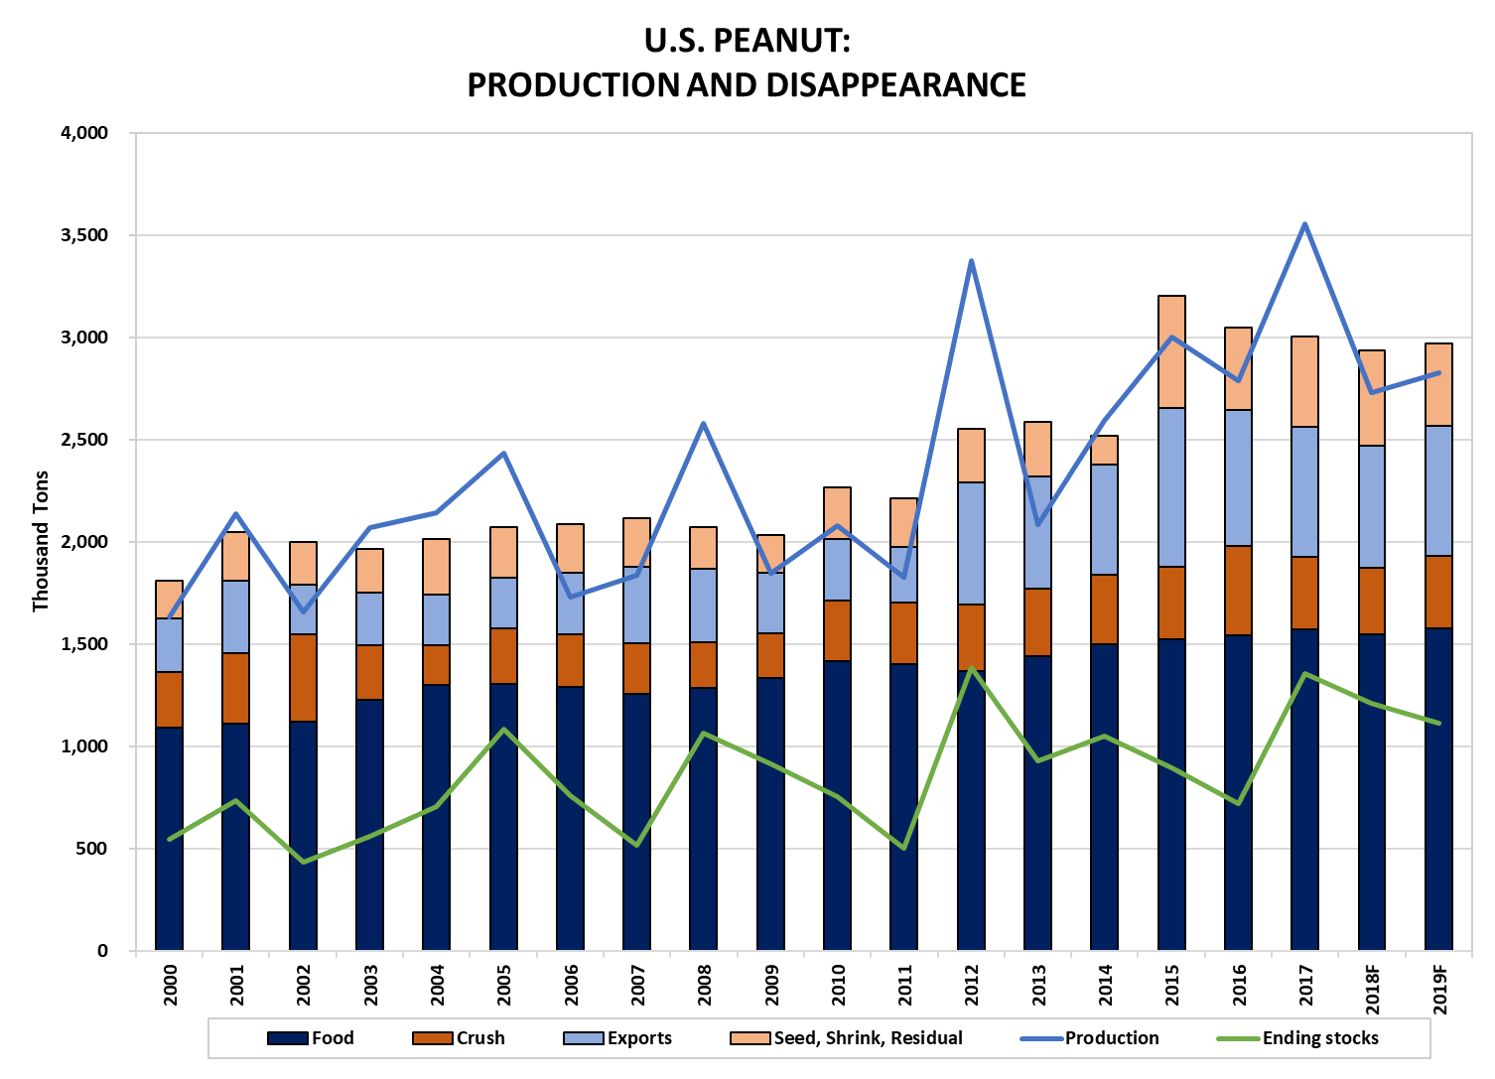
Data Source: USDA-ERS as of 9/12/19

Slide 17
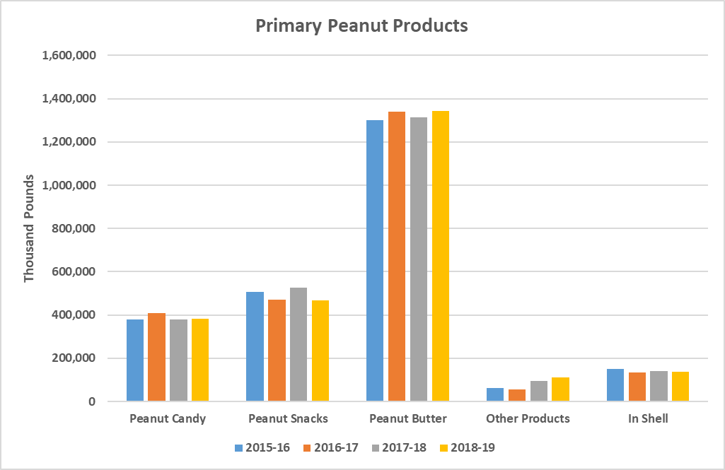
Shelled and In Shell Peanut Products
Data Source: USDA NASS as of 8/29/19

Slide 18
Peanut Trade

Slide 19
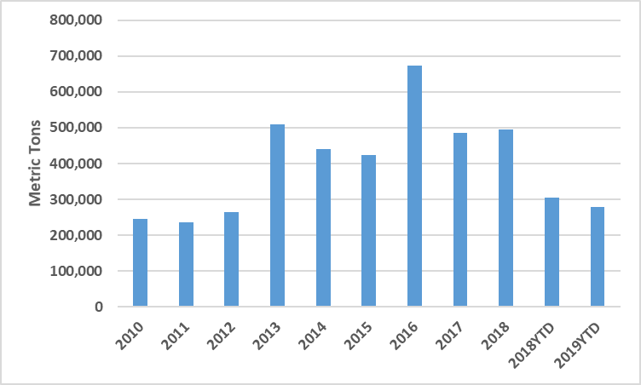
U.S. Peanuts and Peanut Products Exported to World Market
Exports range from 20%-24% of U.S. disappearance – average 22% from 2015-2019F.
Data Source: U.S. Department of Commerce, Bureau of Census as Collected by American Peanut Council through July 2019

Slide 20
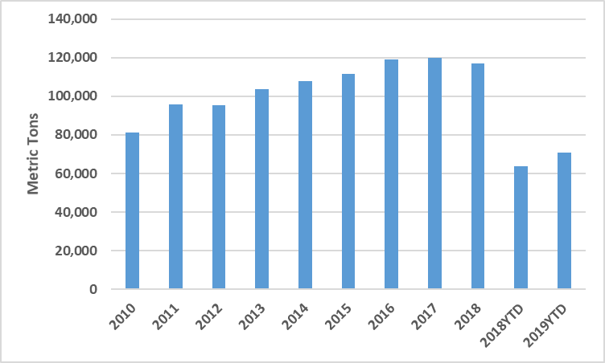
U.S. Peanuts and Peanut Products Exported to Canada
Data Source: U.S. Department of Commerce, Bureau of Census as Collected by American Peanut Council through July 2019

Slide 21
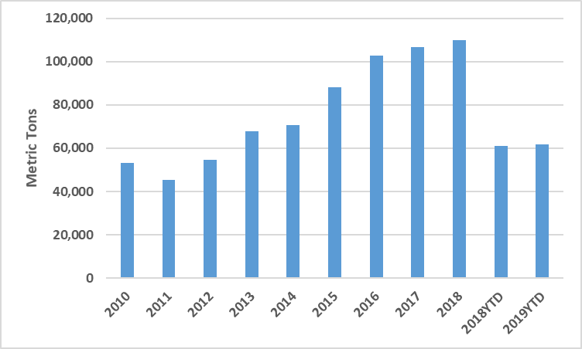
U.S. Peanuts and Peanut Products Exported to Mexico
Data Source: U.S. Department of Commerce, Bureau of Census as Collected by American Peanut Council through July 2019

Slide 22
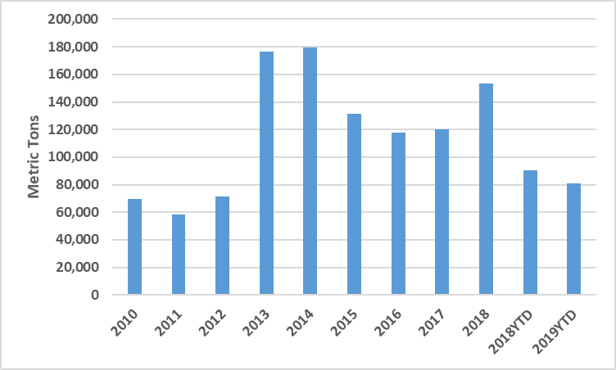
U.S. Peanuts and Peanut Products Exported to Europe
Data Source: U.S. Department of Commerce, Bureau of Census as Collected by American Peanut Council through July 2019

Slide 23
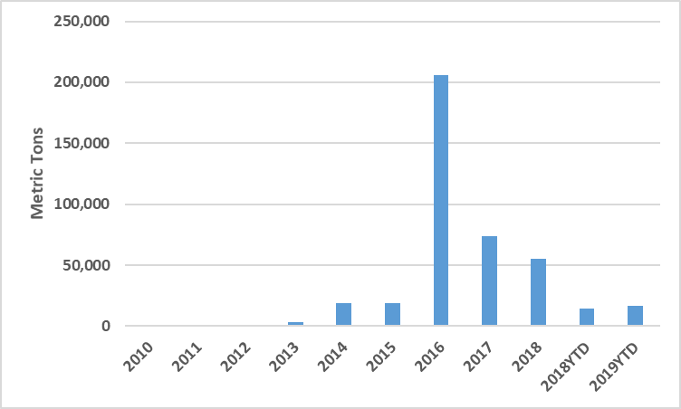
U.S. Peanuts and Peanut Products Exported to China
Data Source: U.S. Department of Commerce, Bureau of Census as Collected by American Peanut Council through July 2019

Slide 24
U.S. Government Response to Retaliatory Tariffs
Market Facilitation Program
2018: Nothing for peanuts
2019: $0.01/lb ($20/ton)
Food Purchase and Distribution Program
2018: $12.3 million for peanut butter
2019: Nothing for peanuts
Trade Promotion Program (American Peanut Council)
2018: $1,922,015
2019: $1,500,000

Slide 25
Peanut Policy/Legal

Slide 26
Farm Bill: Peanuts
No changes to peanut specific policy.
Maintains $355 marketing loan rate.
Maintains $535 reference price.
Maintains separate payment limits.
Maintains storage and handling provisions.
Increased peanut base acres from generic base conversion.

Slide 27
Price Loss Coverage
Marketing Year | Payment Rate | Pay Date
2014/15 | $0.0475/lb or $95/ton | October 2015
2015/16 | $0.0745/lb or $149/ton | October 2016
2016/17 | $0.0705/lb or $141/ton | October 2017
2017/18 | $0.0385/lb or $77/ton | October 2018
2018/19 | Projected: $0.0575/lb or $105/ton | October 2019
Data Source: USDA-FSA – Last updated 9/12/19

Slide 28
Peanut Legal Battle
Class-action lawsuit against Birdsong and Golden Peanut alleges price fixing of runner peanuts.
Claim:
Flat prices despite supply disruptions from Hurricane Michael
Over-reported peanut supply to USDA
Under-reporting of prices to USDA

Slide 29
Peanut Prices

Slide 30
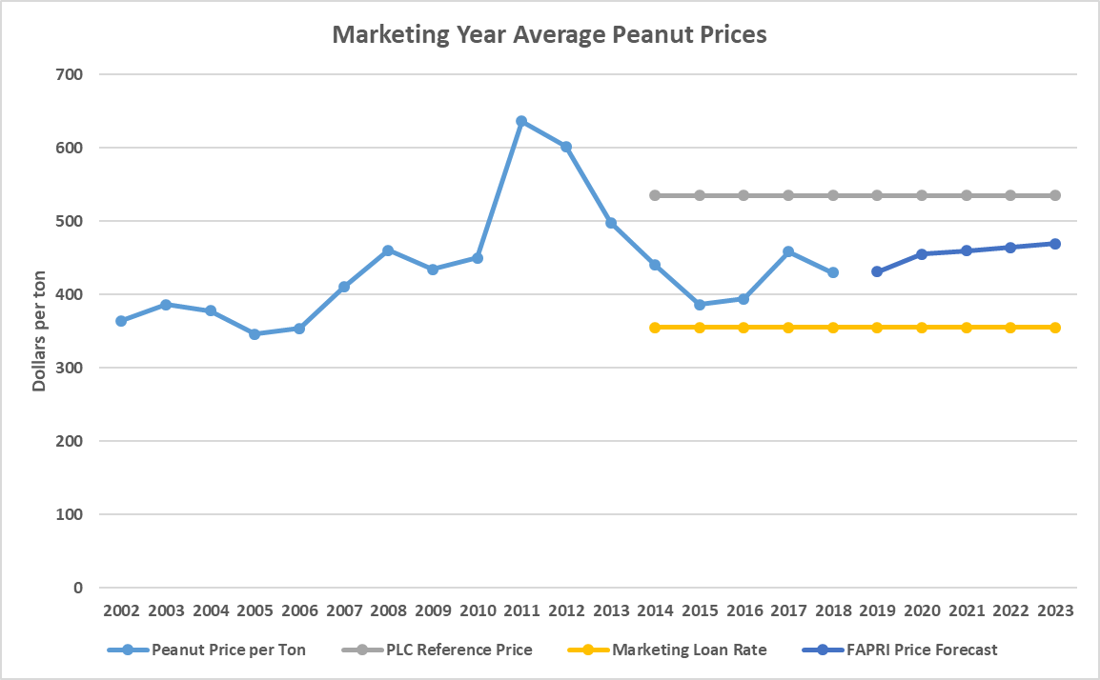
Peanut Prices with Forecasts
Data Source: USDA-NASS and FAPRI

Slide 31
Take a look into the crystal peanut…
Image Source: https://www.godinger.com/crystal-peanut.html

Slide 32
Peanut Outlook 2020
Unless yields drop significantly, production needs to decrease in 2020
How do we get below 2 billion pounds of an ending stock?
Need to cut 227 million pounds from production
2019 yield target: 3,921 from 4,086
or
2020 acreage target: drop 4% from 2019
Acreage should drop about 10%, but it likely will not
There are not any really good alternatives
Expect prices to continue around current levels

Slide 33
Thank You! Questions?
Contact Info: Adam N. Rabinowitz, Ph.D. Assistant Professor and Extension Economist Department of Agricultural and Applied Economics The University of Georgia – Tifton Campus 2360 Rainwater Rd., Tifton, GA 31793 Phone: (229) 386-3512 E-mail: adam.rabinowitz@uga.edu Webpage: http://agecon.uga.edu

