Slide 1
Cotton Fundamentals and Market Outlook
John Robinson Professor and Extension Economist-Cotton Marketing
http://cottonmarketing.tamu.edu
Department of Agricultural Economics
Texas A&M AgriLife Extension Service
Texas A&M University
College Station, Texas

Slide 2
Cotton Balance Sheet
 | 2017/18 Est. | 2018/19 Proj.
 | Area Million Acres
Planted | 12.61 | 14.04
Harvested | 11.10 | 10.55
 | Pounds
Yield/Harvested Acre | 905 | 895
 | Million 480 Pound Bales
Beginning Stocks | 2.75 | 4.30
Production | 20.92 | 19.68
Imports | 0.00 | 0.01
Supply, Total | 23.68 | 23.99
Domestic Use | 3.23 | 3.40
Exports, Total | 15.85 | 15.70
Use, Total | 19.07 | 19.10
Unaccounted | 0.30 | 0.19
Ending Stocks | 4.30 | 4.70
Ending Stks./Use (%) | 22.55 | 24.61
September 12, 2018 USDA Supply/Demand Report
Notes:
This shows USDA WASDE numbers for the current U.S. cotton balance sheet (18/19) as well as the previous marketing year (17/18).
The marketing year for U.S. cotton runs from August 1 through July 31.

Slide 3
Demand Influences
U.S. Economic Indicators
U.S. Exports
Speculative Money
Mill Fixations
Emerging Foreign Issues
Notes:
Here is a roadmap of where

Slide 4
Cotton Demand: Influence of Slow Global Economics Growth
Real GDP Growth, 1980 - 2023
World Economic Outlook, April 2018
http://www.imf.org/external/datamapper/NGDP_RPCH@WEO/OEMDC/ADVEC/WEOWORLD
Notes:
Cotton consumption typically rises in economic boom times (as reflected by higher GDP) and declines in recessions.

Slide 5
World Per Capita Cotton Use
Shaded bars represent periods of economic recession. Cotton consumption tends to drop during those periods due to fewer purchases of clothes, home furnishings, etc.
Source: USDA/ERS/WASDE
Notes:
This slide more clearly shows the correlation between declining per capita consumption of world cotton and recessionary periods (shown by the tan colored bars).

Slide 6
U.S. 2018/2019 Upland Cotton Net Export Sales and ICE Futures January 4, 2018 – September 13, 2018
Notes:
Weekly export sales are generally negatively correlated with cotton futures, as we would expect..
This chart can sometimes explain why the market remains stuck in a trading range. At the upper end of the range, export sales dry up. At the lower end of the range, export sales spike higher.

Slide 7
Cotton Export Total Commitments as a Percent of U.S. Cotton Exports, by Week
What is the risk of post-tariff cancellations?
Source: USDA/OCE/FAS
Notes:
This chart shows relatively high 2018/19 export total commitments (as a percent of the projected export total by USDA – in this case 15.7 million bales).
The implication is that, as during the 2017/18 marketing year, the seasonal pace of export sales has been relatively higher/earlier than in prior years. It is an indicator of stronger export demand.
The risk in 2018/19 is that some of the outstanding sales (exports sold but not yet shipped) to China might get cancelled as a result of tariff retaliations.

Slide 8
Cotton Demand: Mill Fixations
http://www.cftc.gov/marketreports/cottononcall/index.htm
Notes:
The first column of this report shows merchant:mill transactions that haven’t been finalized yet (which involves purchasing futures contracts).
The third column reflects merchant:supplier transactions that haven’t been finalized yet (usually with the selling of futures contracts).
For any given futures contract, large discrepancies between the first column and the third column imply excess buying of that futures contract, typically a month or two before it expires. In other words, these data can be an indicator of upward price volatilityin the spring time.

Slide 9
Hedge Fund Buying Has Supported the Price Rally
January 3, 2006 Through September 18, 2018
No. of Contracts
Cents/Lb.
Source: Commitment of Traders Supplemental Report (Futures and Options)
Notes:
This chart shows net long positions of index funds (in blue) and hedge funds (in green).
The hedge fund pattern in particular shows the influence of speculative buying and liquidating on price movements.

Slide 10
Two Emerging Issues Affecting U.S. Exports:
Indian Stocks?
Tariff malaise?
Directly on U.S. exports
Indirectly on global growth
3rd
1st
2nd

Slide 11
Timeline of U.S. Trade Dispute with China
April 2017
US opens investigation on illegal dumping of foreign steel and aluminum
August 2017
Unfair trade practices in China are targeted, alleged theft of intellectual property
January 2018
US announces tariffs on imported solar panels and washing machines.
February 4, 2018
April 2, 2018
March 9, 2018
China initiates anti-dumping investigation of US sorghum
US announces global tax on steel imports at 25%, aluminum at 10%
China announces tariffs on $3 billion of US imports including fruit, wine, nuts, and pork.
April 3-4, 2018
April 5, 2018
US threatens new wave of tariffs worth $100 billion.
Officials from US and China offer to launch trade talks.
April 16-17, 2018
Early May 2018
US bans China tech company ZTE from buying American components; China imposes 179% duty on imported sorghum.
Negotiations begin
US announces China has proposed to purchase $200 billion of American goods to reduce trade imbalance. China’s Foreign Minister says rumors are untrue. China removes import tax on sorghum.
US and China each threaten to target $50 billion in imports. China’s list includes soybeans, ddgs, beef, and cotton.
April 22, 2018
Mid-May 2018
May 19, 2018
May 29, 2018
US announces it will move ahead with 25% tariffs on $50 billion worth of goods from China.
China says it will follow through with 25% tariffs on soy, corn, wheat, cotton, rice, sorghum, beef, pork, poultry, fish, dairy products, nuts, and vegetables.
June 19, 2018
US announces $34 billion in tariffs starting July 6 and proposes new list of tariffs on $16 billion in products
President Trump threatens tariffs on another $200 billion in Chinese imports. China vows to retaliate with quantitative and qualitative measures.
Both sides agree to not impose new tariffs while talks continue.
June 16, 2018
June 15, 2018
June 20, 2018
President Trump threatens to tax the total value of goods from China, about $500 billion.
June 25, 2018
President Trump announces plans to restrict China’s ability to invest in the U.S. tech sector.
June 27, 2018
President Trump says he will not limit Chinese investment in US companies.
July 6, 2018
In response to US tariffs of 25% on $34 bil of Chinese products, China follows through with 25% tariffs on products identified in June 16 announcement.
September 17, 2018
The Trump administration will impose tariffs on $200 bil worth of imports from China, effective Sep 24. The tariff rate will start at 10%, go to 25% end of year
September 18, 2018
China announces tariffs on US goods worth $60 billion. Tariffs will be levied at 5% or 10% depending on the product.
August 23, 2018
US tariffs on $16 bil of Chinese imports begin.
China retaliation of tariffs on $16 bil of US imports begins.
CNN Money, Bloomberg, NY Times, AAEA Choices, FarmDocDaily, Financial Times
http://www.choicesmagazine.org/choices-magazine/theme-articles/us-china-trade-dispute-and-potential-impacts-to-agriculture/predicting-potential-impacts-of-chinas-retaliatory-tariffs-on-the-us-farm-sector
https://www.nytimes.com/interactive/2018/04/05/business/china-us-trade-conflict.html

Slide 12
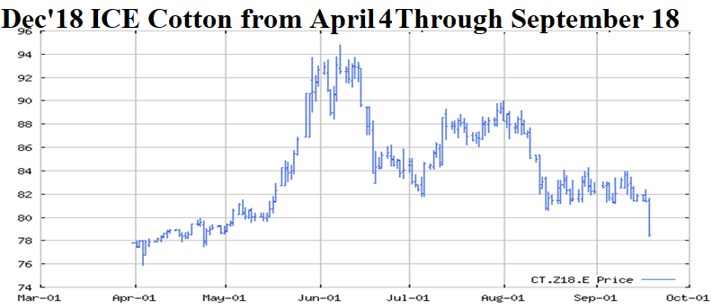
Timeline of U.S. Trade Dispute with China
April 2017
US opens investigation on illegal dumping of foreign steel and aluminum
August 2017
Unfair trade practices in China are targeted, alleged theft of intellectual property
January 2018
US announces tariffs on imported solar panels and washing machines.
February 4, 2018
April 2, 2018
March 9, 2018
China initiates anti-dumping investigation of US sorghum
US announces global tax on steel imports at 25%, aluminum at 10%
China announces tariffs on $3 billion of US imports including fruit, wine, nuts, and pork.
April 3-4, 2018
April 5, 2018
US threatens new wave of tariffs worth $100 billion.
Officials from US and China offer to launch trade talks.
April 16-17, 2018
Early May 2018
US bans China tech company ZTE from buying American components; China imposes 179% duty on imported sorghum.
Negotiations begin
US announces China has proposed to purchase $200 billion of American goods to reduce trade imbalance. China’s Foreign Minister says rumors are untrue. China removes import tax on sorghum.
US and China each threaten to target $50 billion in imports. China’s list includes soybeans, ddgs, beef, and cotton.
April 22, 2018
Mid-May 2018
May 19, 2018
May 29, 2018
US announces it will move ahead with 25% tariffs on $50 billion worth of goods from China.
China says it will follow through with 25% tariffs on soy, corn, wheat, cotton, rice, sorghum, beef, pork, poultry, fish, dairy products, nuts, and vegetables.
June 19, 2018
US announces $34 billion in tariffs starting July 6 and proposes new list of tariffs on $16 billion in products
President Trump threatens tariffs on another $200 billion in Chinese imports. China vows to retaliate with quantitative and qualitative measures.
Both sides agree to not impose new tariffs while talks continue.
June 16, 2018
June 15, 2018
June 20, 2018
President Trump threatens to tax the total value of goods from China, about $500 billion.
June 25, 2018
President Trump announces plans to restrict China’s ability to invest in the U.S. tech sector.
June 27, 2018
President Trump says he will not limit Chinese investment in US companies.
July 6, 2018
In response to US tariffs of 25% on $34 bil of Chinese products, China follows through with 25% tariffs on products identified in June 16 announcement.
September 17, 2018
The Trump administration will impose tariffs on $200 bil worth of imports from China, effective Sep 24. The tariff rate will start at 10%, go to 25% end of year
September 18, 2018
China announces tariffs on US goods worth $60 billion. Tariffs will be levied at 5% or 10% depending on the product.
August 23, 2018
US tariffs on $16 bil of Chinese imports begin.
China retaliation of tariffs on $16 bil of US imports begins.
CNN Money, Bloomberg, NY Times, AAEA Choices, FarmDocDaily, Financial Times
http://www.choicesmagazine.org/choices-magazine/theme-articles/us-china-trade-dispute-and-potential-impacts-to-agriculture/predicting-potential-impacts-of-chinas-retaliatory-tariffs-on-the-us-farm-sector
https://www.nytimes.com/interactive/2018/04/05/business/china-us-trade-conflict.html

Slide 13
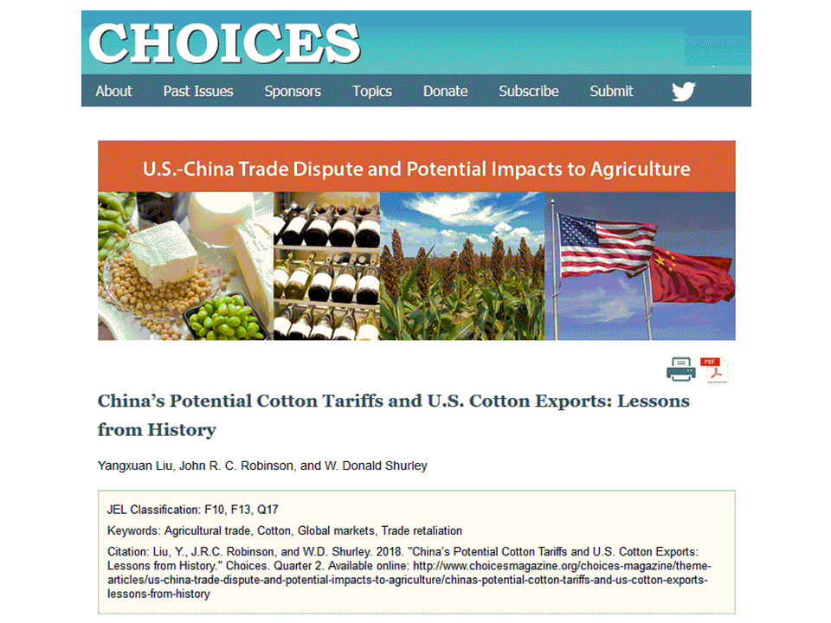

Slide 14
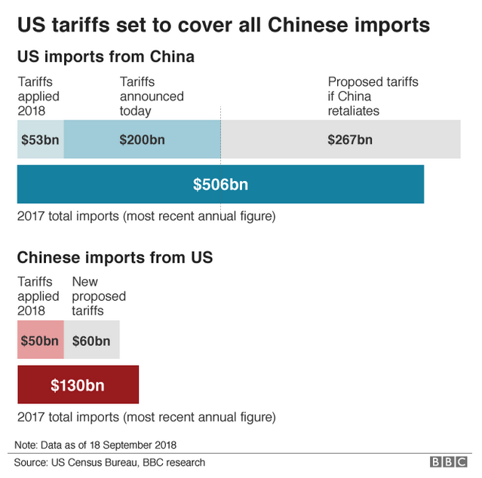
Chinese tariffs on U.S. cotton may only cause a re-shuffling of U.S. cotton exports (Liu, et al.)
But what of the effect of U.S. tariffs on imported Chinese apparel and home furnishings?
Do U.S. consumers have substitute sources of textile imports? (YES, BUT CHINA DOMINATES)
Effects likely complicated by simultaneous price increases for cars, electronics, etc.
Reduced purchases of non-discretionary, semi-durable goods?
Source: https://www.bbc.com/news/business-45555749

Slide 15
2019/20 Crop
Price ratios still favor cotton over wheat and feedgrains in the Southwest
Little reason to expect lower cotton acreage
Unlike 2018, there will be more moisture with mild El Nino conditions from Nov-May
Lower abandonment
Higher yields
Potentially excess production and weaker prices

Slide 16
Ratio of Dec Corn/Dec Cotton Futures, Three Month Average First Quarter, vs. June Cotton Planted Acreage Report → 13+ million acres in 2019
01
00
06
Note: Informa has already forecasted 14.6M acres.
02
05
04
11
03
12
17
10
07
16
08
09
(Ratio=5.1 on Jan. 12)
Notes:
The current ratio of CBOT Dec’19 corn to ICE Dec’19 cotton is 5.0, suggesting around 14 million planted acres.

Slide 17
The CFS.v2 ensemble mean (red line) favors El Nino forming in the next few months and continuing through winter 2018-19. Issued 16 September 2018
Oceanic Nino Index (ONI)
°C
National Centers for Environmental Prediction Climate Forecast System Version 2
El Nino
Neutral
La Nina
Latest actual weekly SST departure
El Niño/Southern Oscillation (ENSO) Diagnostic Discussion, September 17, 2018 http://www.cpc.ncep.noaa.gov/products/analysis_monitoring/enso_advisory/
Notes:
This chart reflects a longer term (through May 2019) forecast of mild El Nino conditions. The forecast implies wetter-than-normal weather.

Slide 18
Notes:
El Nino years are very influential on yield in the drier areas of the Cotton Belt. For example, record yields and very low abandonment in Texas happened in El Nino years like 2007 and 2010.

Slide 19
September 10, 2018
With at least average U.S. yields and abandonment, planting 13.5 million acres could produce a 21 million-bale crop, which implies a very healthy supply of 25+ million bales. Even assuming an increase in U.S. exports above 2018/19 levels, it would be easy to increase ending stocks under this scenario. Increasing ending stocks year-over-year is historically associated with price weakness. It has been a while since we’ve had futures below 70 cents, but I at least want to remind readers of the possibility of downside price risk.

Slide 20
Cotton Balance Sheet
 | 2017/18 Est. | 2018/19 Proj. by USDA | 2019/20 Proj. by JR
 | Area Million Acres
Planted | 12.61 | 14.04 | 13.50
Harvested | 11.10 | 10.55 | 12.15
 | Pounds
Yield/Harvested Acre | 905 | 895 | 850
 | Million 480 Pound Bales
Beginning Stocks | 2.75 | 4.30 | 4.70
Production | 20.92 | 19.68 | 21.53
Imports | 0.00 | 0.01 | 0.01
Supply, Total | 23.68 | 23.99 | 26.24
Domestic Use | 3.23 | 3.40 | 3.40
Exports, Total | 15.85 | 15.70 | 16.00
Use, Total | 19.07 | 19.10 | 19.40
Unaccounted | 0.30 | 0.19 | 0.00
Ending Stocks | 4.30 | 4.70 | 6.84
Ending Stks./Use (%) | 22.55 | 24.61 | 35.26
September 12, 2018 USDA Supply/Demand Report

Slide 21
Different Ways of Doing the Same Thing
CORE POSITION
COST SAVING MEASURES
Cash Contract with Merchant
Buy Call
Also Sell Call
Buy Put Hold Cash Open
Also Sell Put
Also Sell Call
Sell Futures
Buy Call
Also Sell Call

Slide 22
Dec‘19 ICE Cotton Futures vs. December 75¢ Put Option Contracts and 75¢-68¢ Put Spread
Cents/Lb.
Cents/Lb.
January 2, 2018 – September 21, 2018

Slide 23
“Cotton Spin” Column, Southwest Farm Press http://southwestfarmpress.com/author/john-robinson
CONTACT INFO
Phone: 979-845-8011
Email: jrcr@tamu.edu
The Cotton Marketing Planner Newsletter https://cottonmarketing.tamu.edu
Twitter: @aggie_prof
Facebook: https://www.facebook.com/AgriLifeMasterMarketer

