Slide 1
Sheep and Goats
Southern Outlook Conference
Atlanta, GA
September 26, 2017
David P. Anderson
Professor and Extension Economist

Slide 2
Overview
I Can Name That Tune in 5 Slides!
Structural Changes
Opportunities
Prices

Slide 3
Data Source: USDA-ERS & USDA-FAS
Livestock Marketing Information Center

Slide 4
Data Source: USDA-NASS
Livestock Marketing Information Center

Slide 5
Data Source: USDA-AMS & USDA-NASS
Livestock Marketing Information Center

Slide 6
Data Source: USDA-AMS
Livestock Marketing Information Center

Slide 7
Data Source: USDA-AMS
Livestock Marketing Information Center

Slide 9
Overriding Themes
Traditional and Non-Traditional Market
Smaller FI slaughter
Smaller share of lamb crop showing up in FI and commercial sltr
Could Threaten Infrastructure
Even More
Domestic vs Imports
Avoid Stocks!

Slide 10
Data Source: USDA-NASS
Livestock Marketing Information Center

Slide 11
Data Source: USDA-NASS
Livestock Marketing Information Center

Slide 12
Data Source: USDA-NASS
Livestock Marketing Information Center

Slide 13
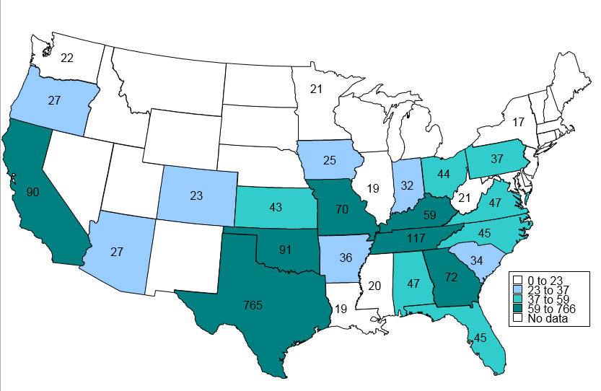
MEAT GOATS INVENTORY 2016 (1000 Head)
Livestock Marketing Information Center
Data Source: USDA-NASS
Other States: 180
US Total: 2095

Slide 14
Data Source: USDA-NASS
Livestock Marketing Information Center

Slide 15
Data Source: USDA-AMS & USDA-ERS, Compiled & Analysis by LMIC
Livestock Marketing Information Center
Notes:
5 year average with a lighter shade of red?

Slide 16
Summary
Local Opportunities
Traditional and Non-Traditional Markets
Growth in Meat and Milk
Prices in 2018 close to 2017
Small changes in production
More risk on lamb, imports and stocks

