Slide 1


Agricultural Lending and Credit
Bryon J. Parman, Ph.d.
Mississippi State University
Department of Agricultural Economics
Mississippi State Extension Service

Slide 2
From Reuters
Falling prices, borrowing binge haunt Midwest 'go-go farmers'
By PJ Huffstutter
Filed Oct. 31, 2016, 11:45 a.m. GMT
Some farmers loaded up on easy credit when grain prices were high - and kept borrowing after they crashed. Now debt and delinquencies are rising fast, raising fears of broader turmoil in U.S. agriculture.
………” new class of “go-go farmers,” a term coined by fellow Midwest growers and agricultural economists. Many, like the Gibsons, borrowed heavily to expand their farms, then borrowed more in an effort to plant their way out of a commodity price crash,…….”

Slide 6
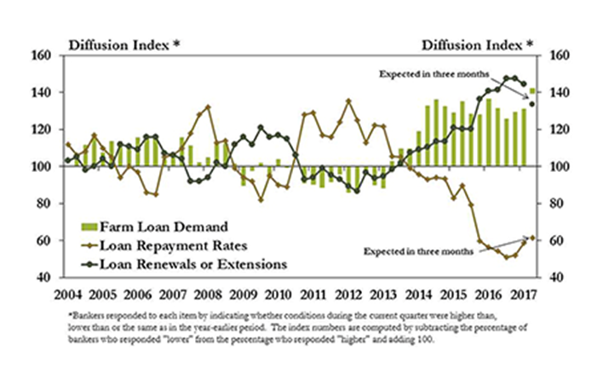
Farm Financial Stress/ Loan Repayment

Slide 9
Loan Repayment and Demand in the 11th Federal Reserve District

Slide 10
Collateral Lending
Mississippi Ag. Lender Survey Loan-to-Value Ratios 2017
 | Average | Minimum | Maximum
Land Or Real Estate | 0.74 | 0.55 | 0.85
Machinery or Equip | 0.73 | 0.40 | .90
Cattle Purchases | 0.67 | .50 | .80
The average loan to value in the 1980’s was 60% on Land prior to the crash
Loan to Value ratio’s reflect the amount of the purchase that the lender is willing to finance. For example if the borrower makes a 20% down payment, the loan to value ratio would be 0.80. Higher loan to value amounts reflect the lenders expectation that the asset is likely to appreciate

Slide 13
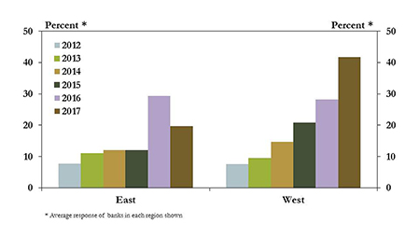
Farm Financial Stress/ Loan Repayment
Loan Carryover, Mississippi Lenders Survey
 | 2016 | 2017
Average | 20% | 18%
Min | 10% | 10%
Max | 40% | 70%
10th Federal Reserve District

Slide 14
Other Financial Considerations
* Percentage of Distressed Loans Has: Increased (40%) , Decreased (0.4%), No Change (59.5%)
*Equipment book value lenders will accept as collateral: Average (61%), Min (30%), Max (75%)

Slide 15
Interest Rates
…. “The Federal Reserve raised short-term interest rates by a quarter point on Wednesday (June 14 2017). It's the Fed's third rate hike since December. And it's a sign that the central bank believes the U.S. economy is on solid ground.
“The Fed's key interest rate will now hover in a range between 1% and 1.25%. Overall, rates are still very low compared to prior decades. The Fed also said it's planning to start gradually selling off the assets that it had bought during and after the financial crisis to boost the economy.”
“Traders Boost Odds of Third Rate Hike This Year as FOMC Meets
The likelihood of a rate increase by December has jumped to around 50 percent”

Slide 16
Mississippi Ag. Finance Surveys, Interest Rates 2017
 | Average | Minimum | Maximum
 | Variable Interest Rates
Operating Loans | 4.55% | 3.5% | 6.0%
Intermediate Loans | 4.55% | 4.0% | 6.0%
Long Term and Real Estate | 4.55% | 3.25% | 6.0%
 | Fixed Interest Rates
Operating Loans | 4.7% | 3.5% | 6.25%
Intermediate Loans | 4.85% | 4.0% | 6.5%
Long Term and Real Estate | 5.1% | 4.0% | 6.25%
Current Interest rates being Offered by
Lenders in Mississippi
 | Increase | Decrease | No Change
Operating Loans | 85% | 0% | 15%
Intermediate Loans | 95% | 0% | 5%
Long Term and Real Estate | 97% | 0% | 3%
Farm Incomes | 2% | 63% | 25%
Expectation of Interest Rate Movement
In the next 12 months

Slide 17
Table from St. Louis Federal Reserve
Ag. Finance Monitor, Q1 2017

Slide 20
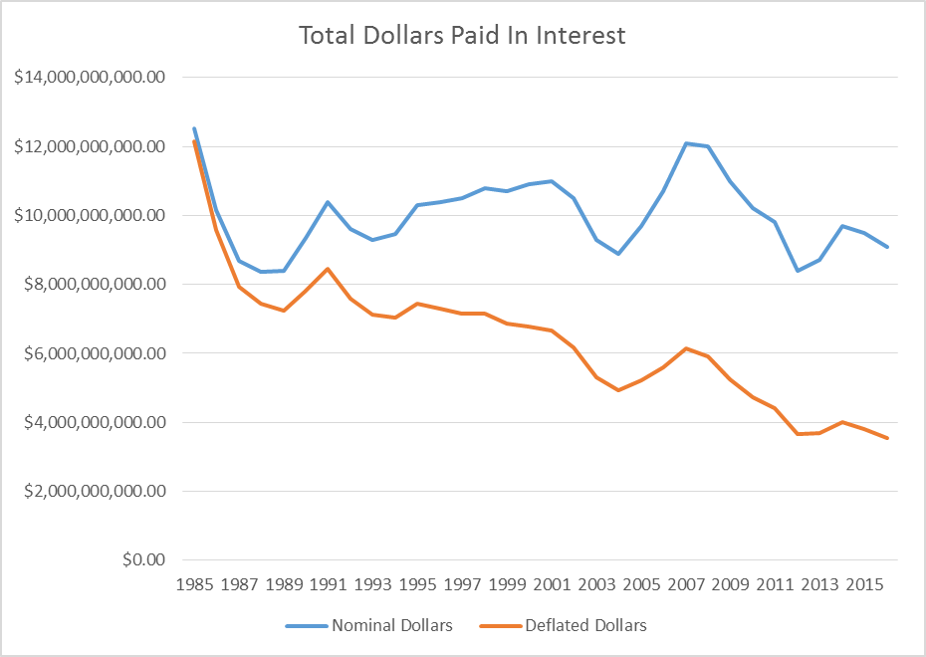

Slide 21
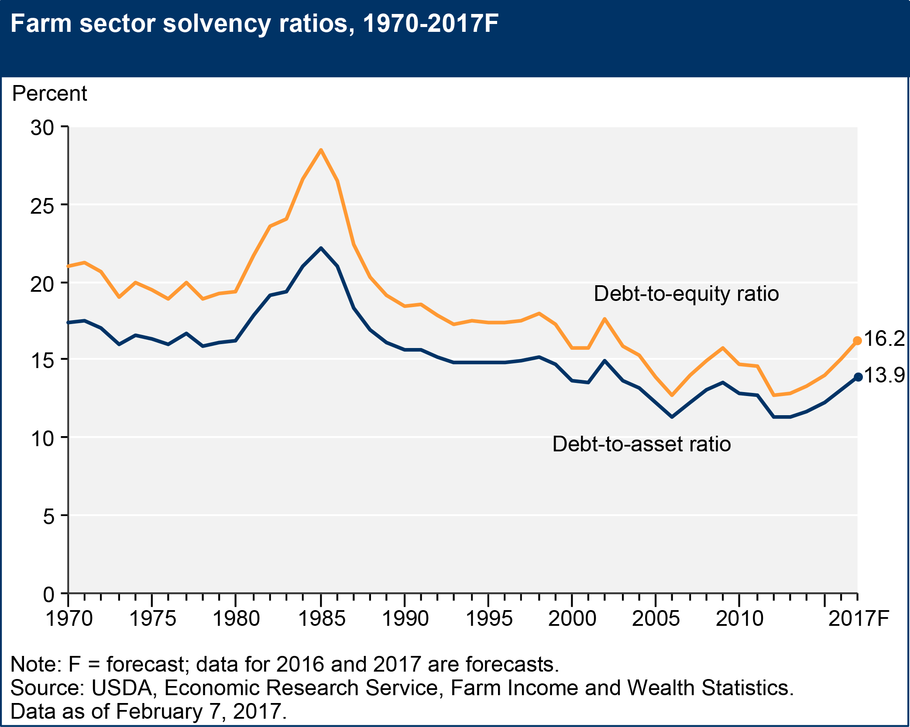

Slide 22
Recently in the News
From Ag Web August 18th 2018
“It’s been a tough year. The most recent years have all been tough. Low commodity prices cause decreased land values, tighter balance sheets and a high level of stress for producers across the country. As a result, they continue to take on more debt. In fact, the absolute amount of outstanding farm debt is likely to reach an all-time high this year.
“If debt were to increase 5% from current levels it will exceed 1980 levels,” says Brent Gloy of Agricultural Economic Insights.
While that’s true in terms of raw dollar figures adjusted for inflations, unlike the historic downturn of 1980, farm debt to asset ratios are still very low”

Slide 24
The Peak of the Farm Financial crises
of the 80’s occurred from 1984 – 1986.
84-86 was the period with the highest
Debt-Asset Ratio’s.
However, Peak Debt to EBITDA
occurred in the early 80’s signaling that
a problem existed before the actual
S&L crash. It is a much more useful
tool for evaluating actual financial
Stress.

Slide 25
Farmers Turning to Alternative Lenders
Headline from the Wall Street Journal

Slide 26
Summary
CAP rates and ROE is worsening implying over valued land
Non-performing loans are increasing nationwide, but much worse in the Midwest
Equity usage to cover losses coming back on strong again
Rising interest rates are expected, and will exacerbate the situation

Slide 27
Thank You
Bryon J. Parman
Mississippi State University
Department of Agricultural Economics
Mississippi State University Extension Service
662-325-2887
bparman@agecon.msstate.edu

