Slide 1

Peanut Outlook
Presented at the Southern Agricultural Outlook Conference
Atlanta, GA
September 27, 2017
Presented by Adam N. Rabinowitz, PhD
Assistant Professor and Extension Specialist
with Nathan Smith, PhD
Professor and Extension Economist

Slide 2
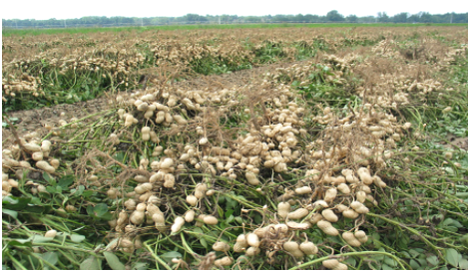
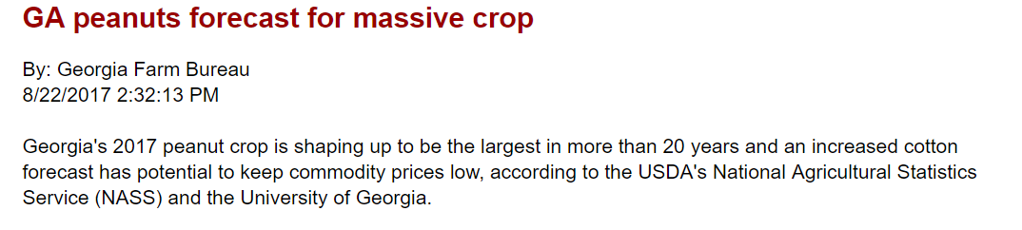
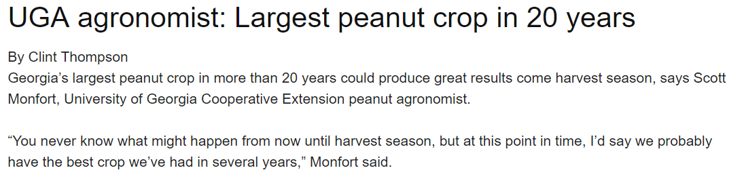
Peanut Headlines

Slide 3
Peanut Situation - Supply
2017 US Planted Acreage up over 12.6% to 1.88 million acres.
September US Yield projection of 4,254 lb/ac would be new record (2012 = 4,211)
Total Supply was down heading into 2017, bumper 2017 crop will result in a warehouse buster, 3.8-3.9 million ton crop (2012 record of 3.38 M tons).

Slide 4
Peanut Acreage*
State | 2013 | 2014 | 2015 | 2016 | 2017** | 2017 FSA Acreage
 | 1,000 acres
AL | 140 | 175 | 200 | 175 | 195 |  | 191.6
AR | - | 10.5 | 16.3 | 24 | 30 |  | 29.1
FL | 140 | 175 | 190 | 155 | 195 |  | 184.9
GA | 430 | 600 | 785 | 720 | 840 |  | 827.6
MS | 34 | 32 | 44 | 39 | 44 |  | 42.2
SE | 744 | 982 | 1,219 | 1,113 | 1,304 |  | 1,277
NM | 7 | 5 | 5 | 8 | 9 |  | 8.4
OK | 17 | 12 | 10 | 13 | 21 |  | 18.8
TX | 120 | 130 | 170 | 305 | 275 |  | 237.8
SW | 144 | 147 | 185 | 326 | 305 |  | 265
NC | 82 | 94 | 90 | 101 | 120 |  | 115
SC | 81 | 112 | 112 | 110 | 125 |  | 119.8
VA | 16 | 19 | 19 | 21 | 27 |  | 26.3
VC | 179 | 225 | 221 | 232 | 272 |  | 261
US | 1,067 | 1,354 | 1,625 | 1,671 | 1,881 |  | 1,808
Source: *USDA NASS Crop Production Reports
Notes:
TX acreage harvested in 2016 = 210
First time since 1940s that we have seen 3 consecutive years of > 700K acres in GA.

Slide 5
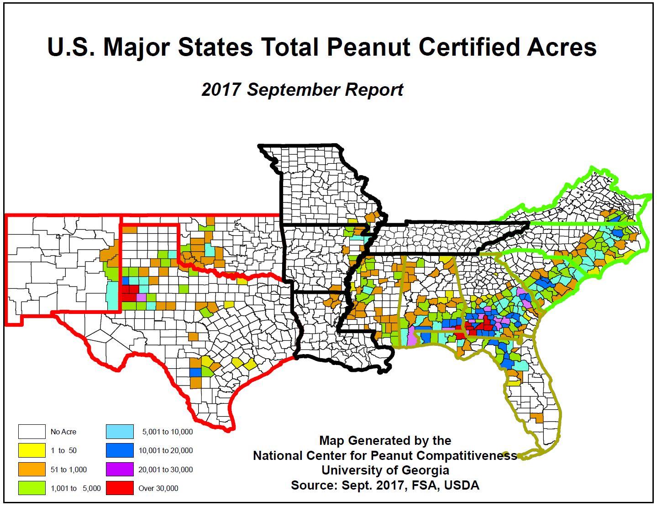
Source: *USDA NASS Crop Production Reports
Notes:
TX acreage harvested in 2016 = 210

Slide 7
Peanut Yields
State | 2016 Actual (lbs) | 2017 Forecast (lbs) | Percent Change
AL | 3,600 | 4,100 | 13.9%
FL | 3,900 | 3,700 | -5.1%
GA | 3,940 | 4,700 | 19.3%
MS | 4,100 | 4,500 | 9.8%
NC | 3,450 | 4,100 | 18.8%
OK | 3,800 | 3,600 | -5.3%
SC | 3,300 | 3,900 | 18.2%
TX | 2,800 | 3,600 | 28.6%
VA | 3,700 | 4,300 | 16.2%
AR&NM | 4,284 | 4,068 | -5.0%
Total | 3,675 | 4,254 | 15.8%
Data Source: USDA-NASS

Slide 8
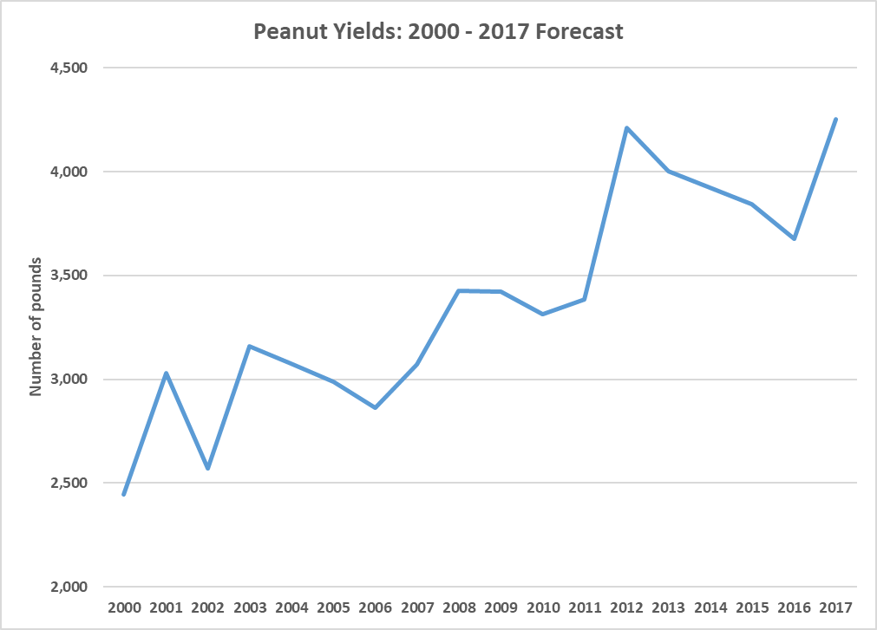
Peanut Yields

Slide 9
Peanut Production
State | 2016 Actual (tons) | 2017 Forecast (tons) | Percent Change
AL | 311,400 | 393,600 | 26.4%
FL | 286,650 | 338,550 | 18.1%
GA | 1,396,730 | 1,950,500 | 39.6%
MS | 77,900 | 94,500 | 21.3%
NC | 170,775 | 241,900 | 41.6%
OK | 24,700 | 34,200 | 38.5%
SC | 174,900 | 234,000 | 33.8%
TX | 294,000 | 468,000 | 59.2%
VA | 38,850 | 58,050 | 49.4%
AR&NM | 66,400 | 77,300 | 16.4%
Total | 2,842,305 | 3,890,600 | 36.9%
If realized, U.S. production 15% higher than record crop of 2012.
Data Source: USDA-NASS

Slide 10
Peanut Warehouse Capacity
State | CCC Approved (tons) | 2017 Forecast (tons) | Potential Shortage (tons)
AL | 433,960 | 393,600 | (40,360)
FL | 214,810 | 338,550 | 123,740
GA | 1,938,650 | 1,950,500 | 11,850
MS | 83,360 | 94,500 | 11,140
NC | 281,790 | 241,900 | (39,890)
OK | 34,950 | 34,200 | (750)
SC | 176,940 | 234,000 | 57,060
TX | 451,570 | 468,000 | 16,430
VA | 82,230 | 58,050 | (24,180)
AR&NM | 74,670 | 77,300 | 2,630
Total | 3,772,930 | 3,890,600 | 117,670
Data Source: USDA-FSA

Slide 11
Peanut Situation - Demand
USDA projects Total Use up 6% for 2017/18 crop year to 3.3 million tons.
Bump in exports projected to 750,000 tons, 2nd highest.
  China and Vietnam purchases of 2015 crop boosted exports, similar to after 2012 record crop.
Large crop expect to see shelled prices weaken.

Slide 12
Peanut Production, Use, Carryover

Slide 13
Shelled Peanuts
Used in Primary Products
 | August-July 2015/16 (tons) | August-July 2016/17 (tons) | Percent Change
Peanut Candy | 188,753 | 203,851 | 8%
Peanut Snacks | 252,846 | 235,146 | -7%
Peanut Butter | 649,817 | 669,098 | 3%
In Shell Peanuts | 75,133 | 67,037 | -10.8%
Data Source: USDA-FSA

Slide 14
International Markets
Production in India has been on a decline, mainly due to low prices.
China has had good growing conditions but recent bad weather has reduced some quality.
Argentina harvest has been challenging but reports are they have enough supply to satisfy demand.
There have been aflatoxin issues with U.S. exports to the E.U.
U.S. exports have been down, particularly to Mexico, China, and Vietnam, but still projected high.
Data Source: Peanut Farm Market News

Slide 15
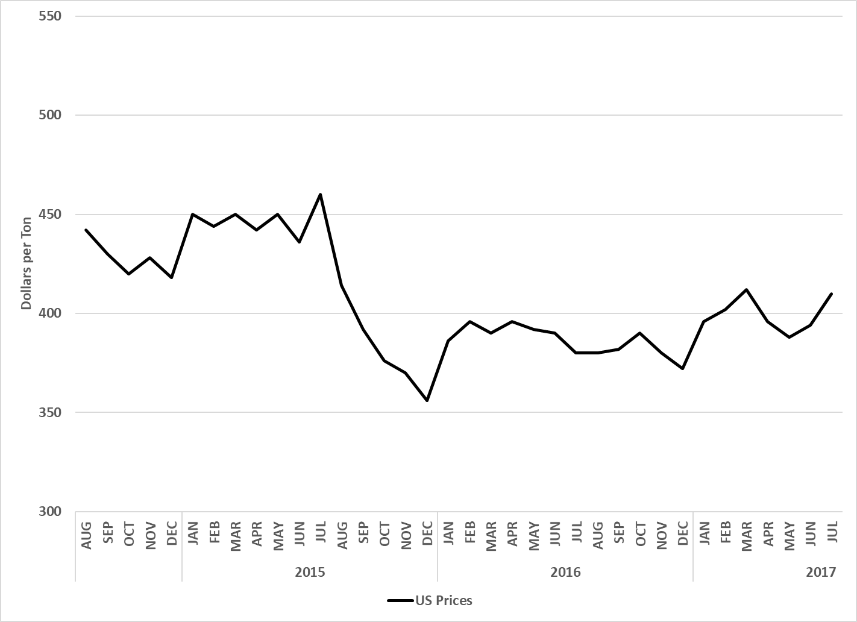
Monthly All Peanut Prices
Data Source: USDA-NASS
Notes:
Current low prices from low contracts signed as a result of USDA overstated peanut stocks.
2017 contracts higher but…if we have a record harvest that will impact prices of uncontracted peanuts.

Slide 16
Peanut Price Expectations
MARKET AT THE FARM – (BROKER REPORT) Shellers aren’t anxious sellers and buyers at this point. They are content to sit back and wait and see if this crop is indeed as big as the USDA purports it to be. It’s almost a Battle of Bunker Hill mentality where no one wants to fire “until you see the whites of their eyes.”
It’s still hard to make an argument as to why either side would want to participate in this market today. Shellers should have an opportunity to purchase un-contracted tons cheaper at a later date, at which point Buyers will most likely participate. When that could be is an unknown. Most Buyers have good coverage for 2018 so there is no urgency on the buy side regardless of how large this crop ends up being. There will no doubt be questions of forfeitures of 2018 crop and could that bring a return of Chinese buying interest into this market but suffice to say it is way too early to know when and if that will happen making it an additional unknown. So now we sit and wait and this market continues to largely just fill in holes where needed.
Data Source: Peanut Farm Market News

Slide 17
Price Loss Coverage
Marketing Year | Payment Rate | Pay Date
2014/15 | $0.0475/lb or $95/ton | October 2015
2015/16 | $0.0745/lb or $149/ton | October 2016
2016/17 | $0.0705/lb or $141/ton | October 2017
2017/18 Projected | $0.0725/lb or $145/ton | October 2018
Data Source: USDA-FSA
17/18 likely will be closer to $130-135/ton
Notes:
2016/17 is now a final number. Remember, payment is based on 85% of base acres and program yield plus any sequestration of funds and payment limits.

Slide 18
Rest of 2017 Outlook
Record crop but weather could have impact
Demand pace continues to be strong
Record Carryover Stocks into 2018
Shelled prices expected to drop with large surplus
Exports to Asia, Chinese interest to return with lower prices? Trade Agreements?

Slide 19
Contact Info:
Adam N. Rabinowitz, Ph.D.
Assistant Professor and Extension Specialist
Department of Agricultural and Applied Economics
The University of Georgia – Tifton Campus
2360 Rainwater Rd., Tifton, GA 31793
Phone: (229) 386-3512
E-mail: adam.rabinowitz@uga.edu
Webpage: http://agecon.uga.edu
Thank You!
Contact Info:
Nathan Smith, Ph.D.
Professor and Extension Economist Sandhill Research and Education Center
Clemson University
nathan5@clemson.edu
803-788-5700 (o)
229-392-3948 (m)

