Slide 1
Corn, Sorghum, and Wheat Outlook
Brian R. Williams
Department of Agricultural Economics
Mississippi State University
September 27, 2017

Slide 2
What Drives Commodity Markets? The fundamentals.
Supply
  Yields
  Ending Stocks
  Production
Demand
  Feed Use
  Exports
  Fuel
  More…

Slide 3
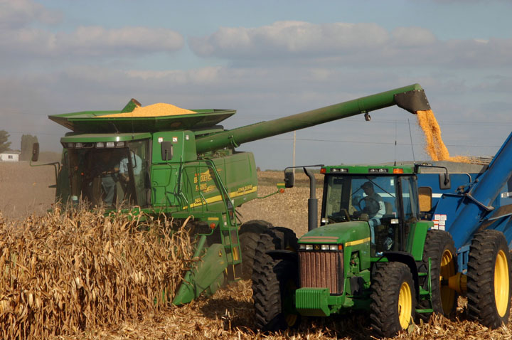
Corn

Slide 4
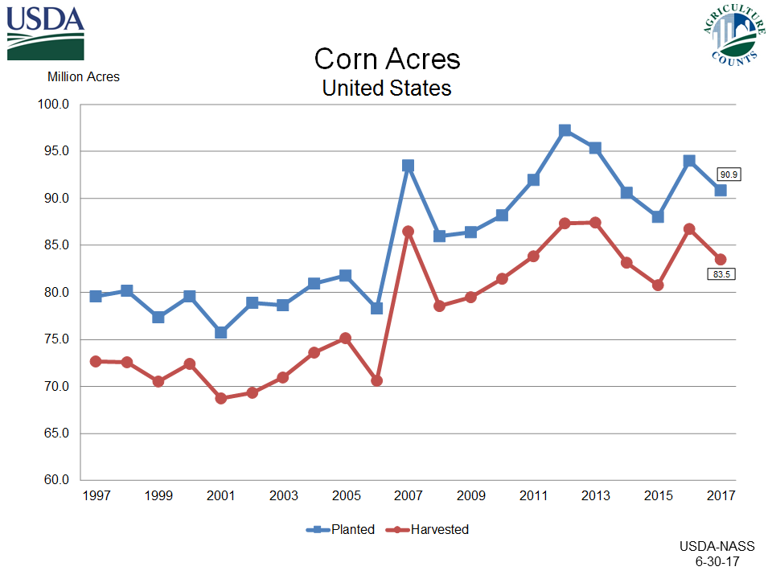

Slide 5
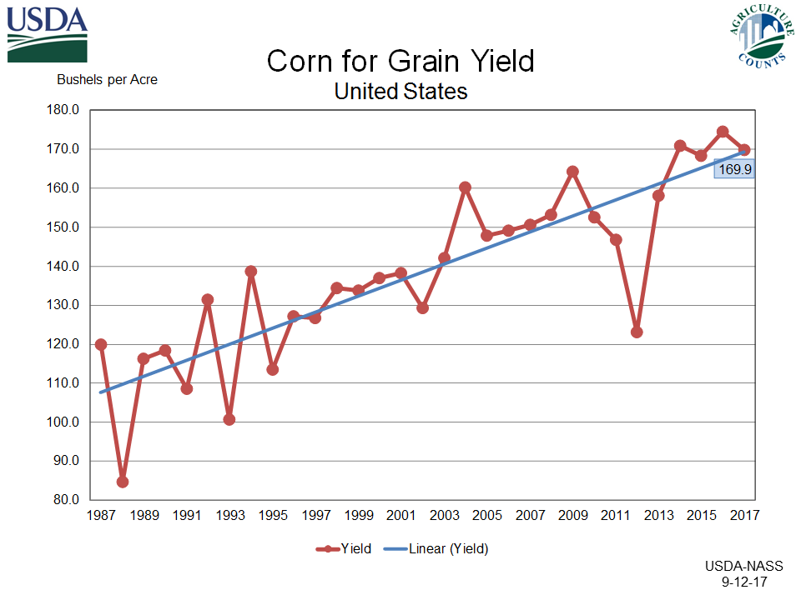

Slide 6
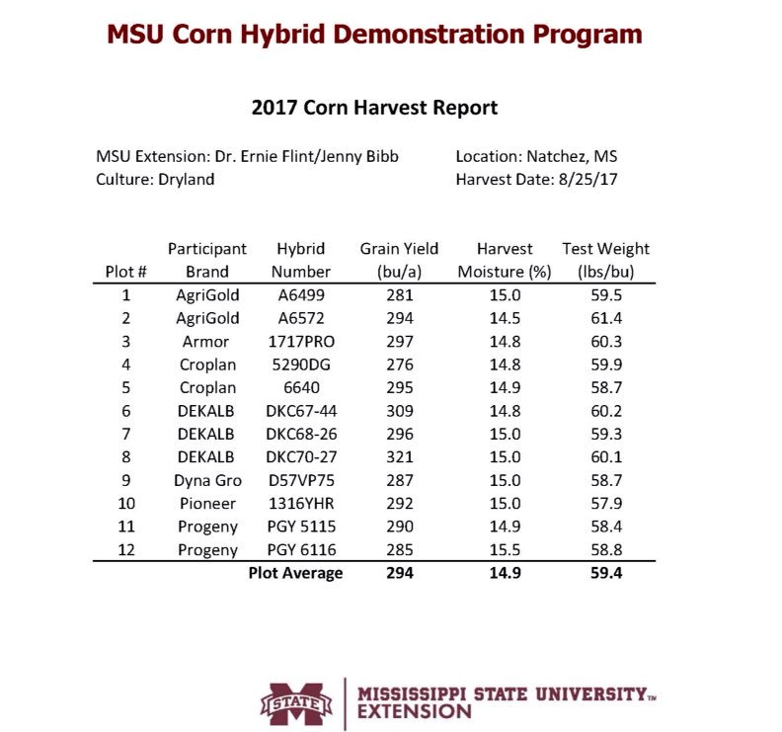

Slide 7
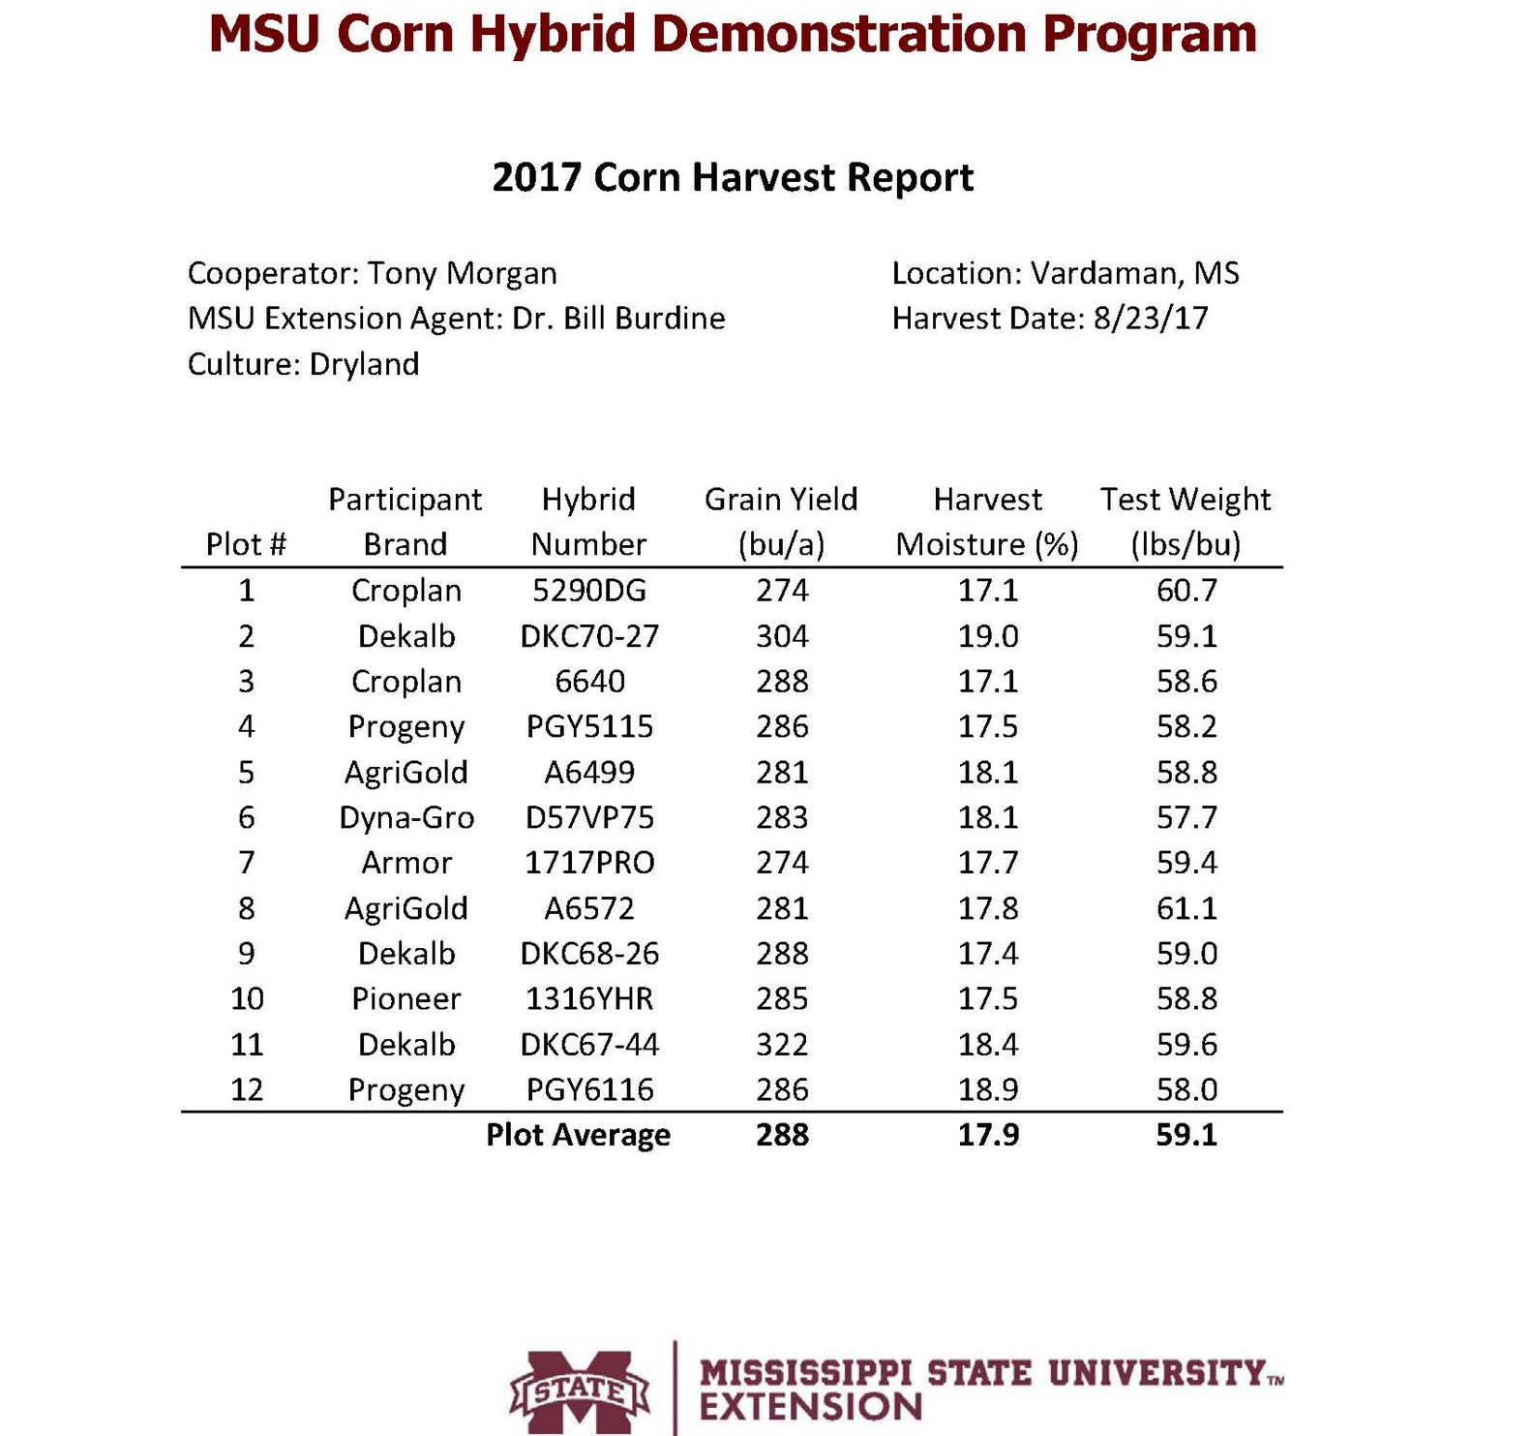

Slide 8
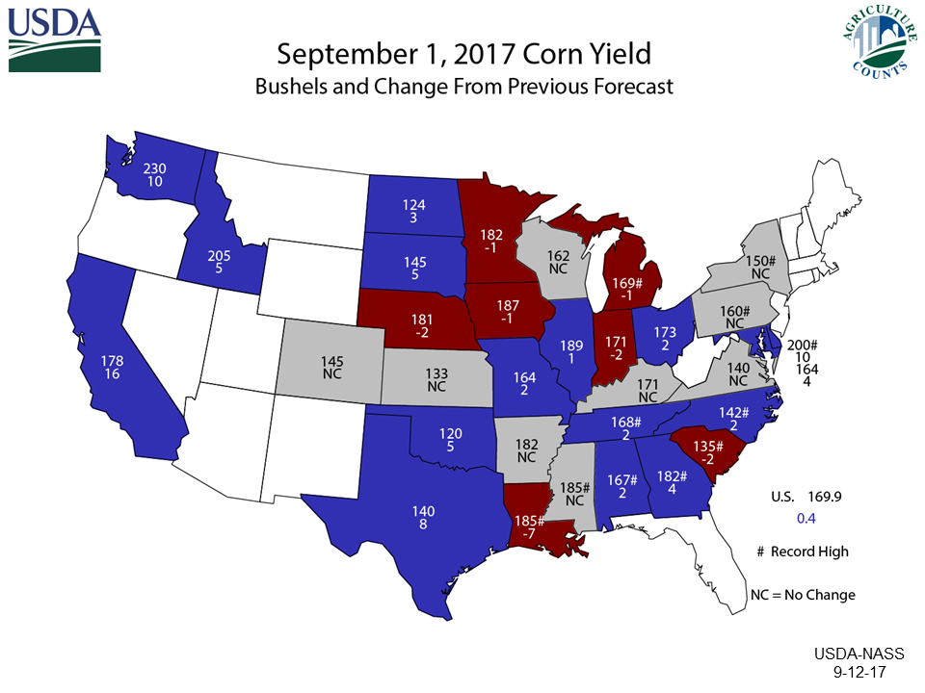

Slide 11
Data Source: USDA-NASS, Forecasts by LMIC
Livestock Marketing Information Center

Slide 13
Data Source: USDA-ERS and WAOB, Forecasts by LMIC
Livestock Marketing Information Center

Slide 14
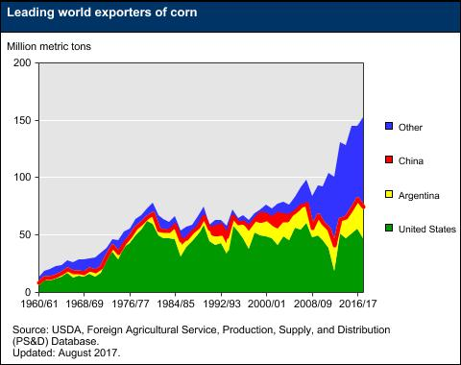

Slide 15
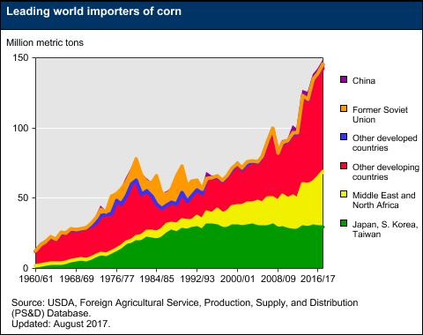

Slide 16
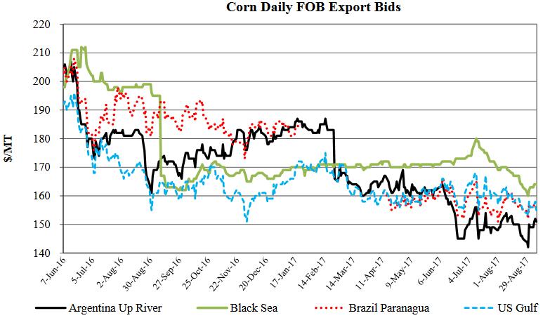

Slide 17
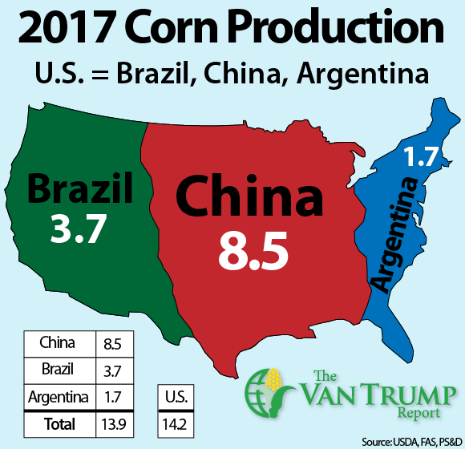

Slide 18
Data Source: USDA-NASS, Forecasts by LMIC
Livestock Marketing Information Center

Slide 19
Data Source: USDA-NASS
Livestock Marketing Information Center

Slide 20
Data Source: USDA-NASS, Forecasts by LMIC
Livestock Marketing Information Center

Slide 21
Data Source: USDA-AMS
Livestock Marketing Information Center

Slide 23
Data Source: USDA-NASS, Forecasts by LMIC
Livestock Marketing Information Center

Slide 24
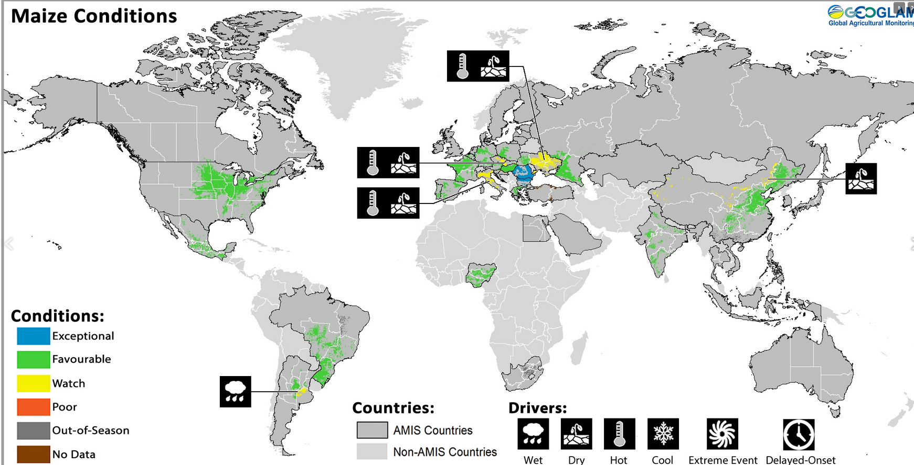

Slide 25
Data Source: USDA-FAS
Livestock Marketing Information Center

Slide 26
Data Source: USDA-AMS
Livestock Marketing Information Center

Slide 27
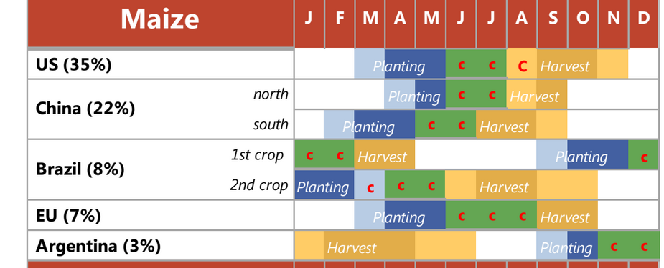

Slide 29
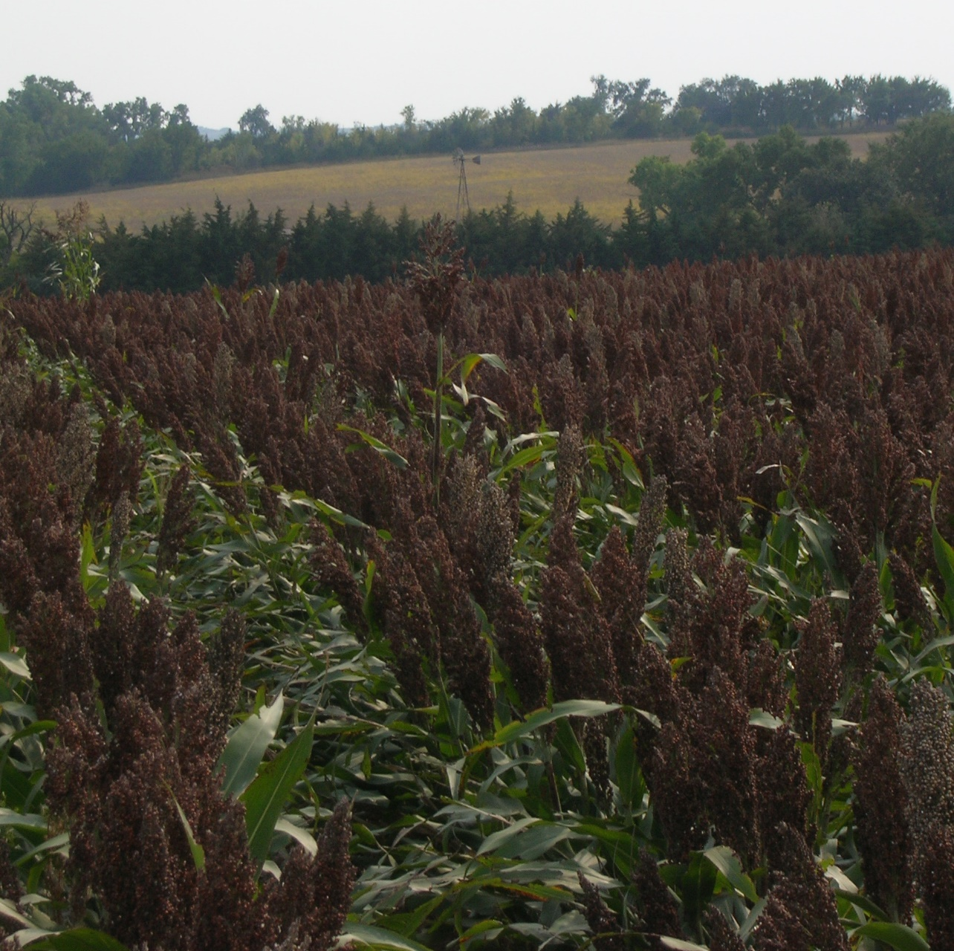
Sorghum

Slide 30
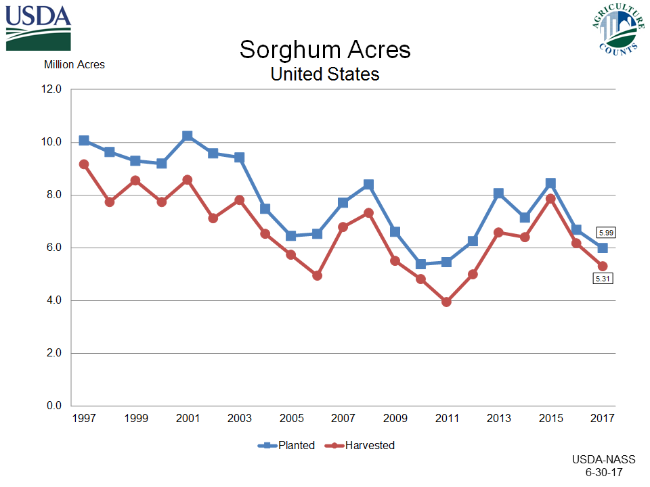

Slide 31
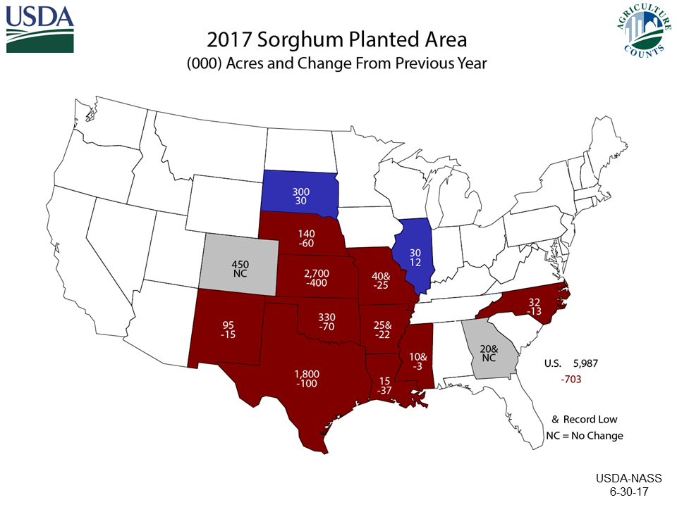

Slide 32
Data Source: USDA-AMS
Livestock Marketing Information Center

Slide 33
Sorghum Cost and Revenue vs. Soybean or Corn
Sorghum Costs: $375
  Revenue (100 bu@ $3.05) $305
Soybean Costs: $367
  Revenue (40 bu @ $9.00) $360
Corn Costs: $454
  Revenue (150 bu @ $3.00) $450
  Assuming a terrible marketer (Greenville corn is $3.31)

Slide 34
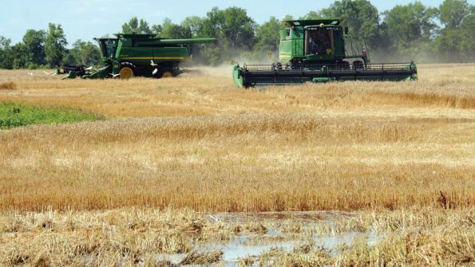
Winter Wheat

Slide 35
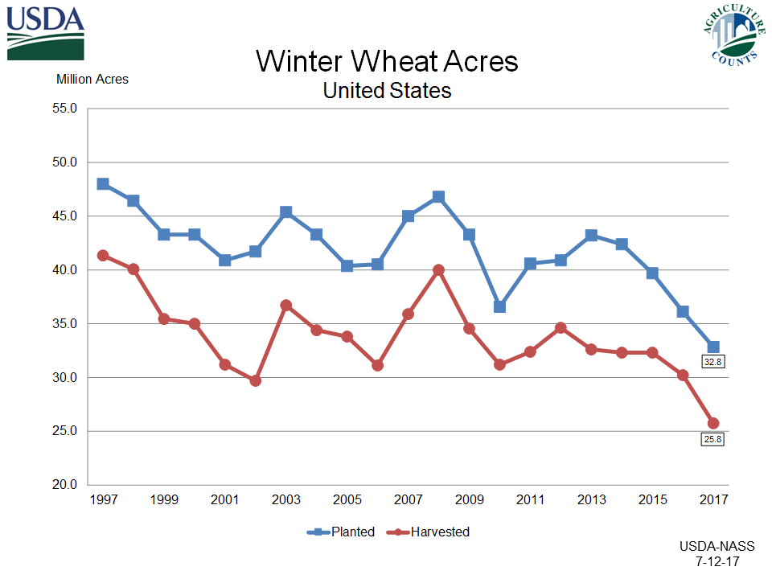

Slide 37
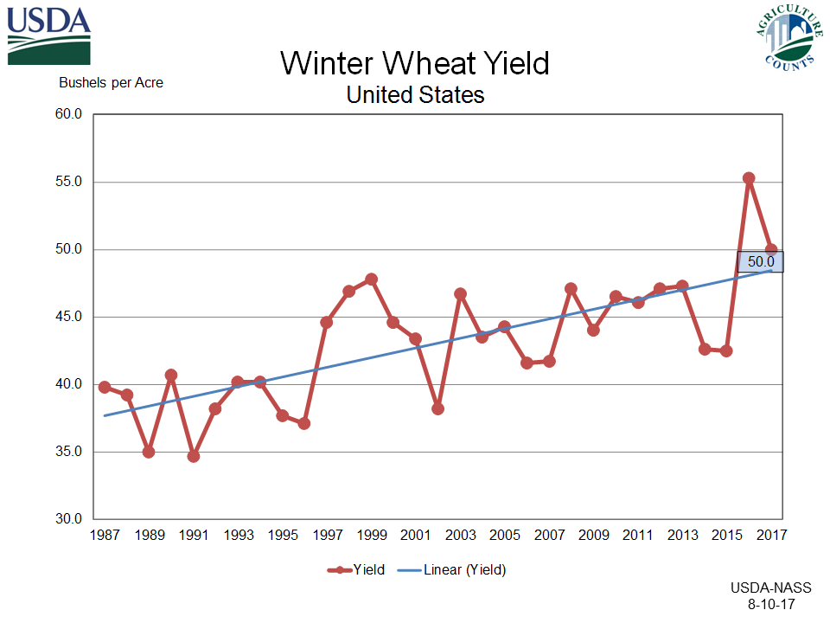

Slide 38
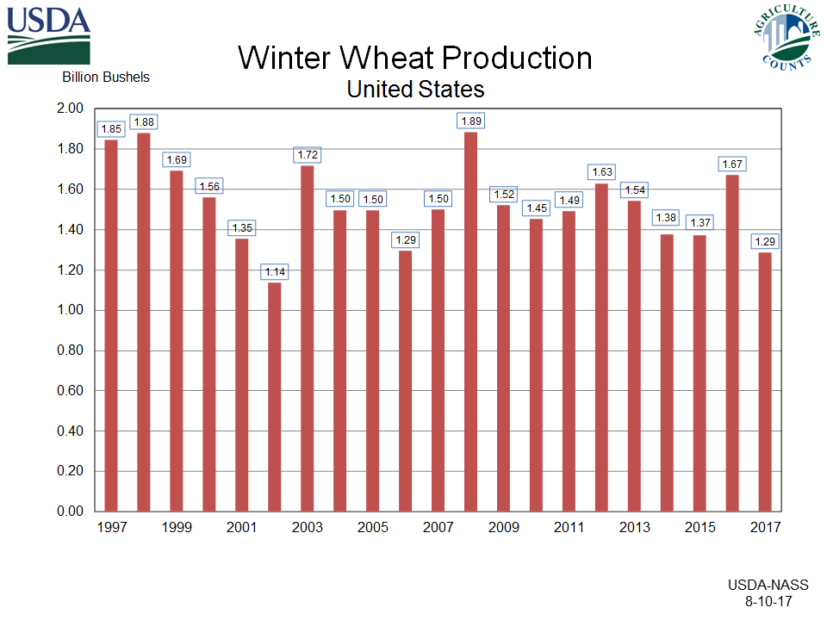

Slide 39
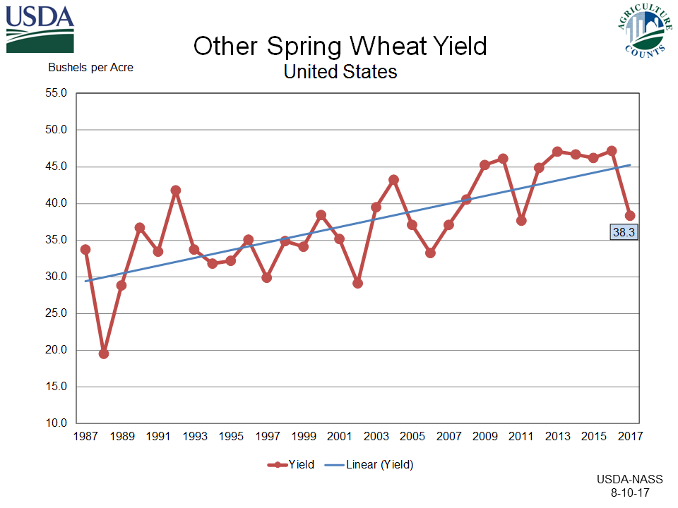

Slide 40
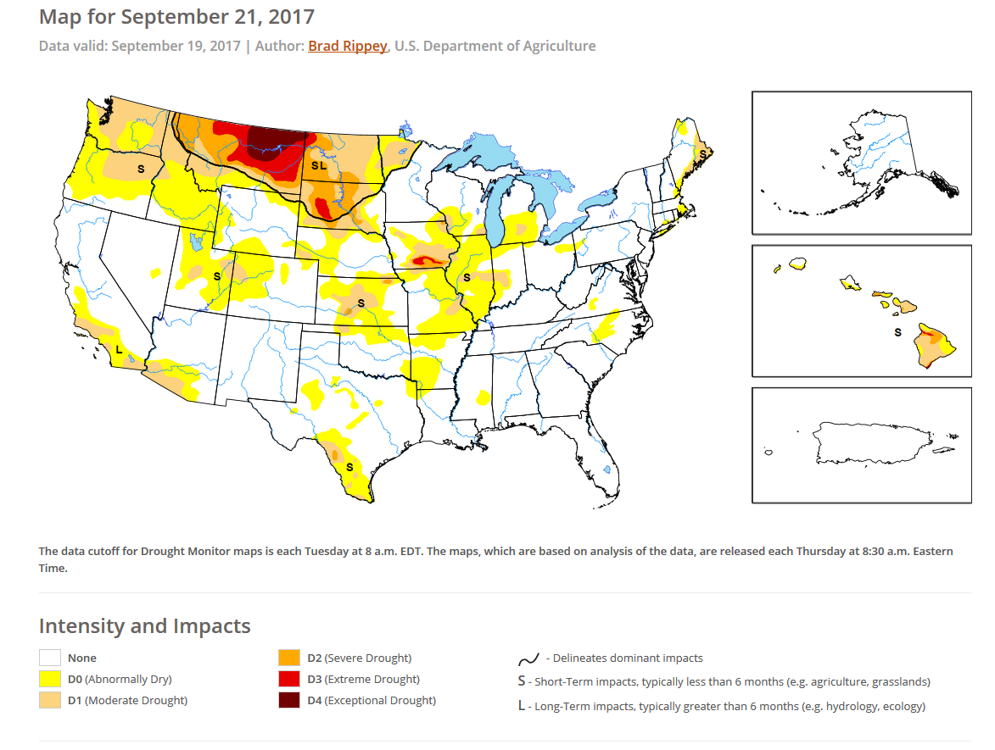

Slide 41
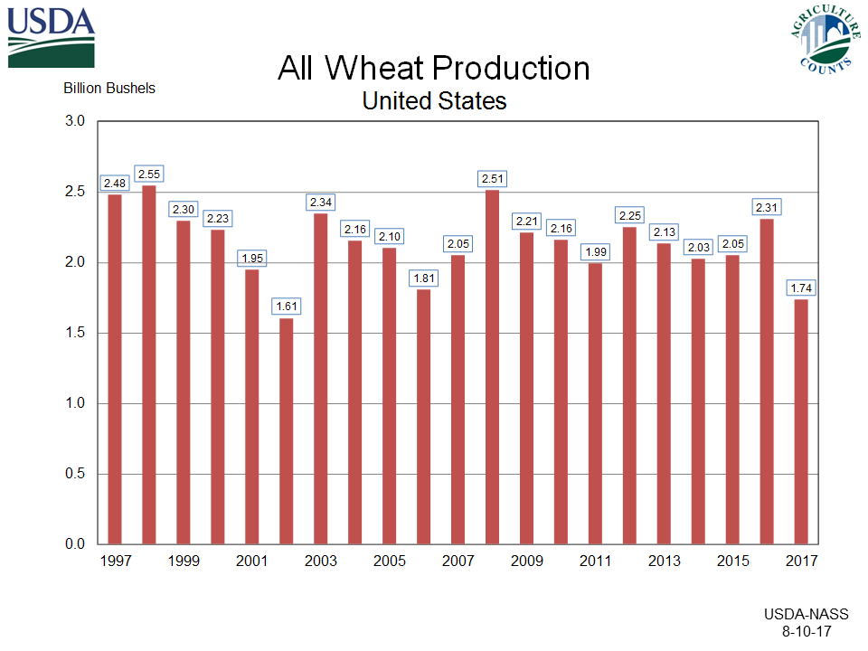

Slide 43
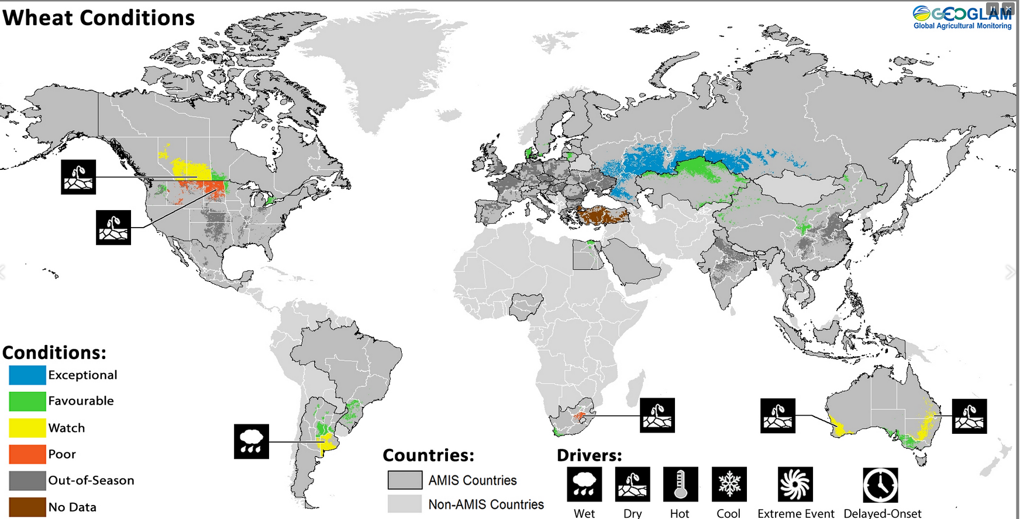

Slide 44
U.S. Wheat Exports

Slide 45
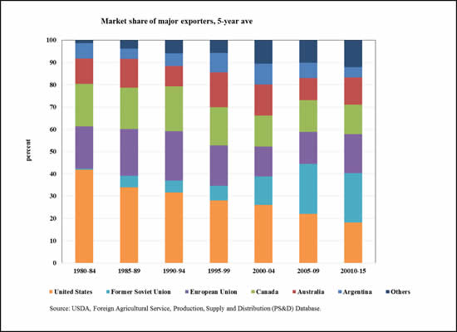

Slide 46
Domestic Disappearance

Slide 47
U.S. Wheat Ending Stocks

Slide 49
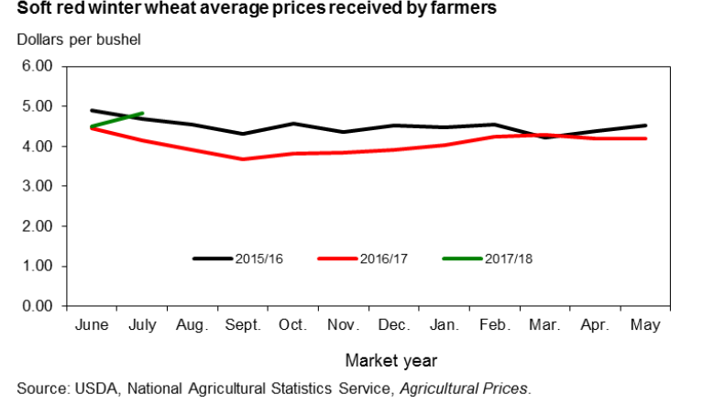

Slide 50
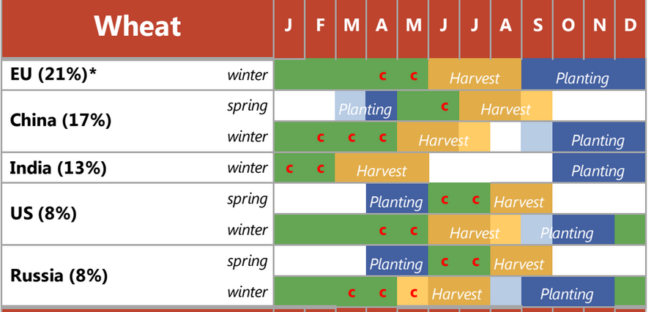

Slide 51
Other thoughts on wheat
Will we see more acreage this fall/next year?
  Stockers in Southern Plains
Weed management?
  Glyphosate resistance…looking for alternatives
  Could include wheat back into rotation

Slide 52
Thank You!
Brian R. Williams
Assistant Extension Professor
(662) 325-2676
Brian.williams@msstate.edu
Twitter: @BrianRWilliams

