Slide 1
Forage and Hay Outlook
Chris Prevatt
University of Florida, Extension Economist
Range Cattle Research and Education Center
2017 Southern Region Outlook Conference
September 25, 2017
Notes:
Thank you for the opportunity to talk with you today about the Forage and Hay Outlook.

Slide 2
Forage and Hay Outlook
The Southern Region covers a large area with wide climate, soil, terrain, forage species, and livestock system differences that influence the production and harvest of forage and hay crops.
Notes:
Now, this is my first time to attend the Southern Region Outlook Conference.
And this is my first Forage and Hay Outlook Presentation.
So please help fill-in anything that I might miss.

Slide 3
Forage and Hay Outlook
U.S. Pasture and Range Conditions
Weather Outlook
U.S. Forage Supply
Value of Forage Production
Notes:
Next, we need to discuss The Weather Outlook for our 2015-2016 Cool-Season Grazing Season.

Slide 4
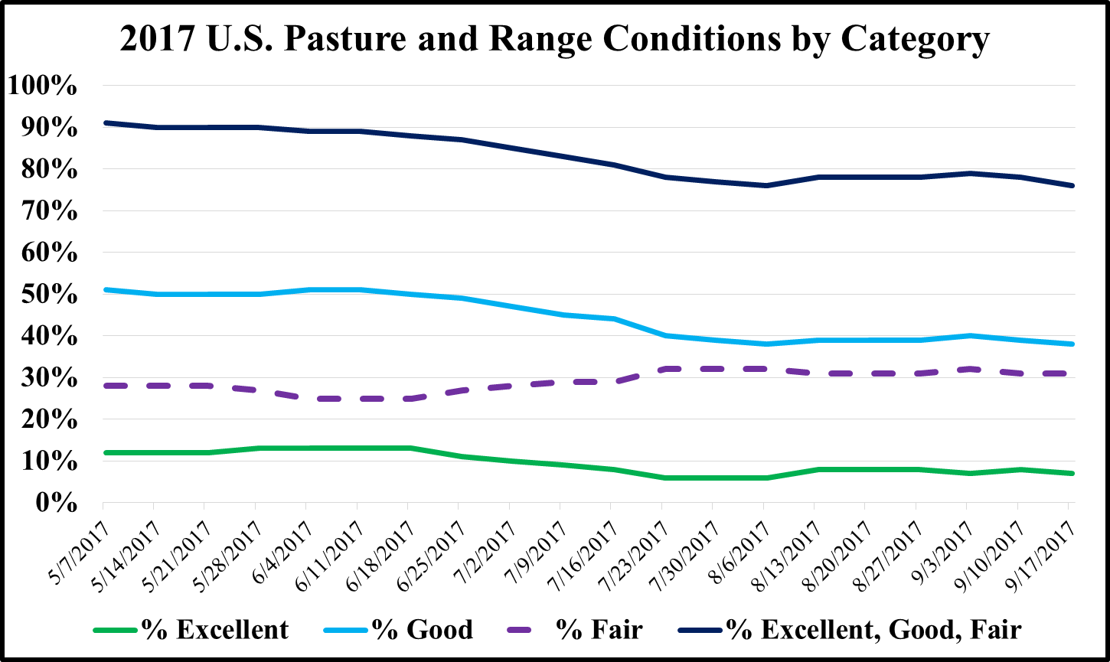

Slide 5
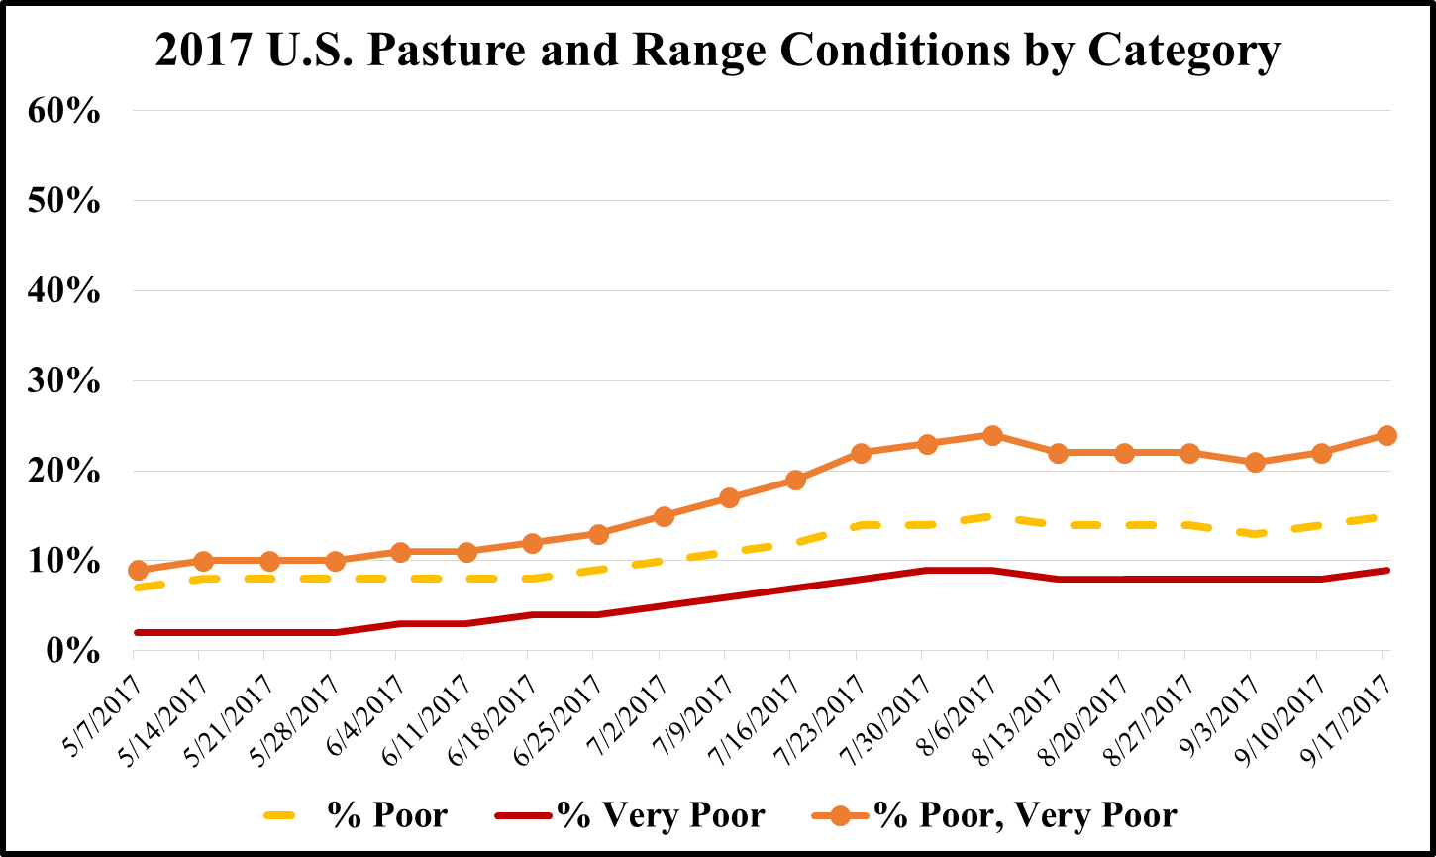

Slide 6
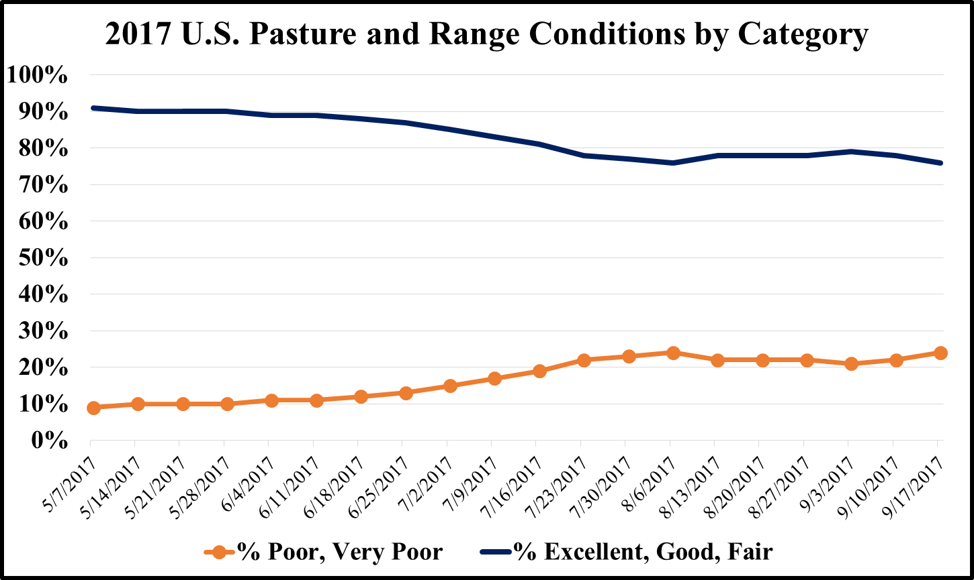

Slide 7
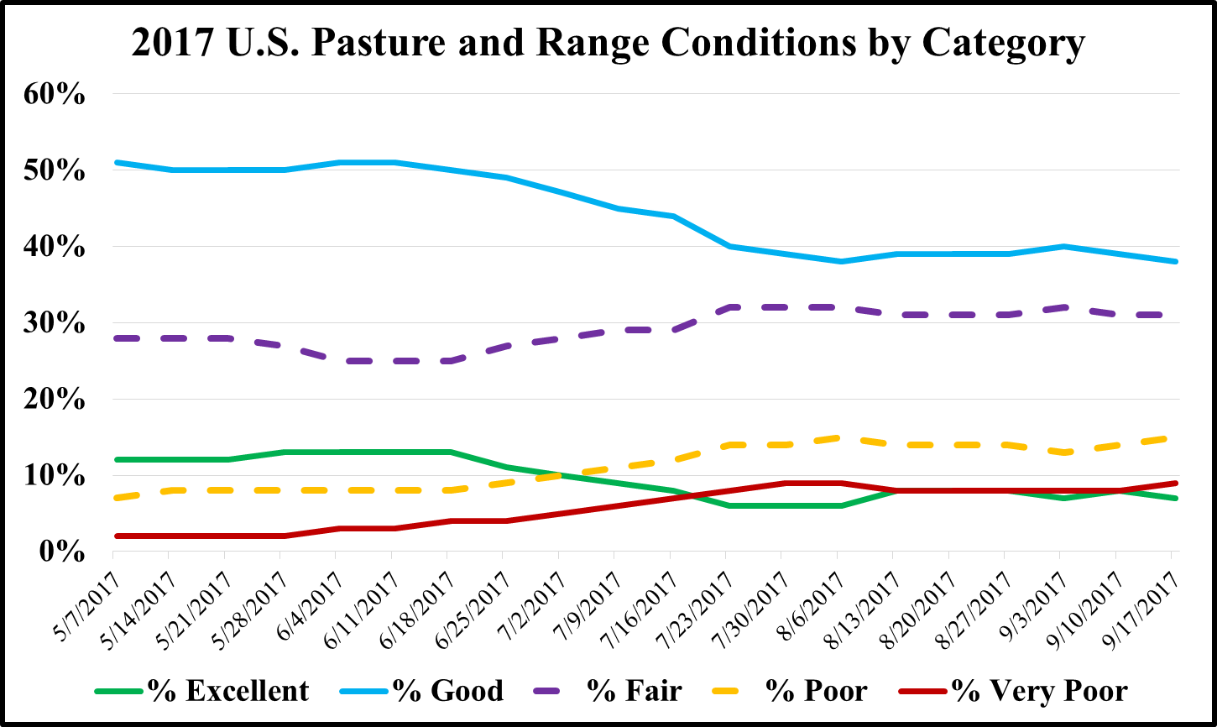

Slide 8
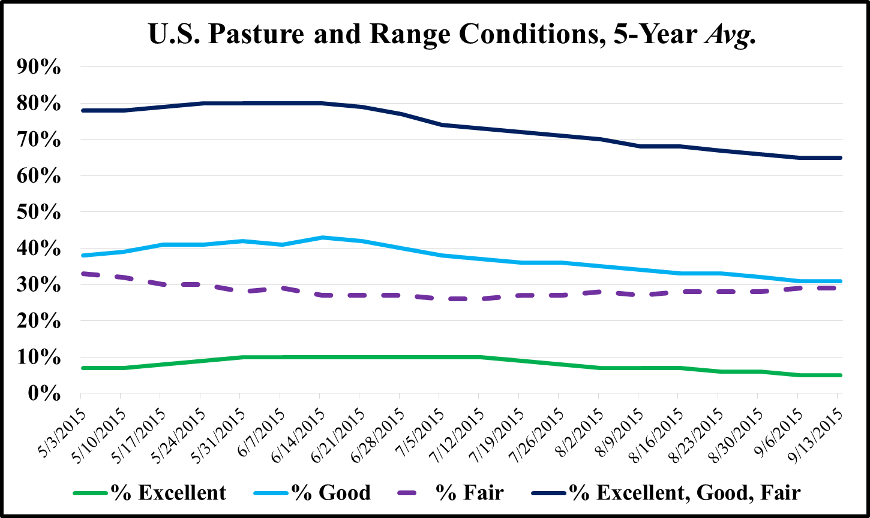

Slide 9
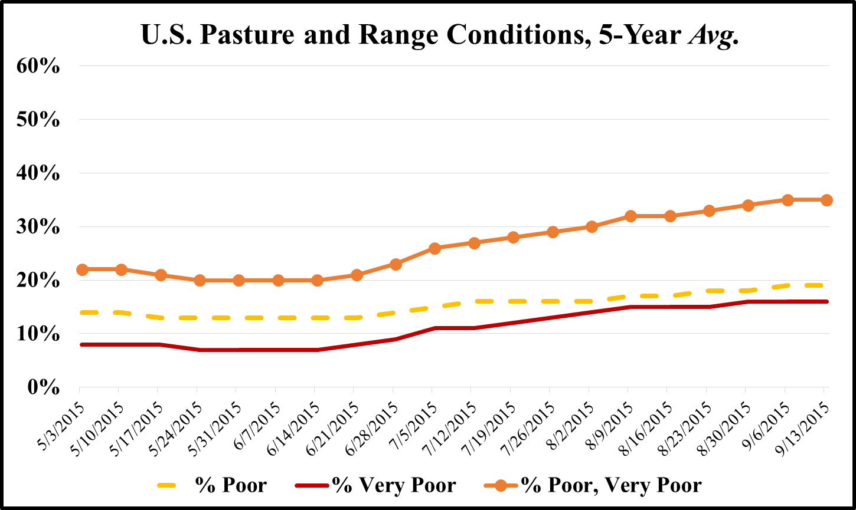

Slide 10
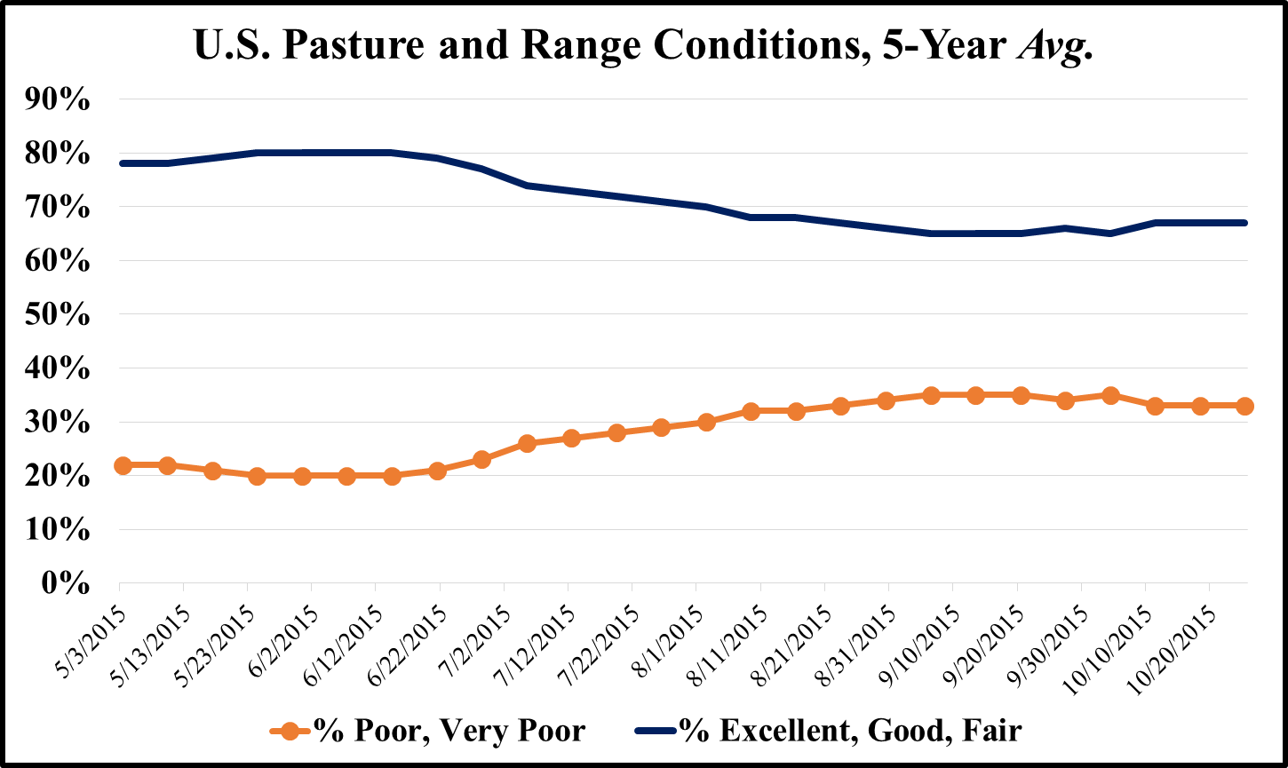

Slide 11
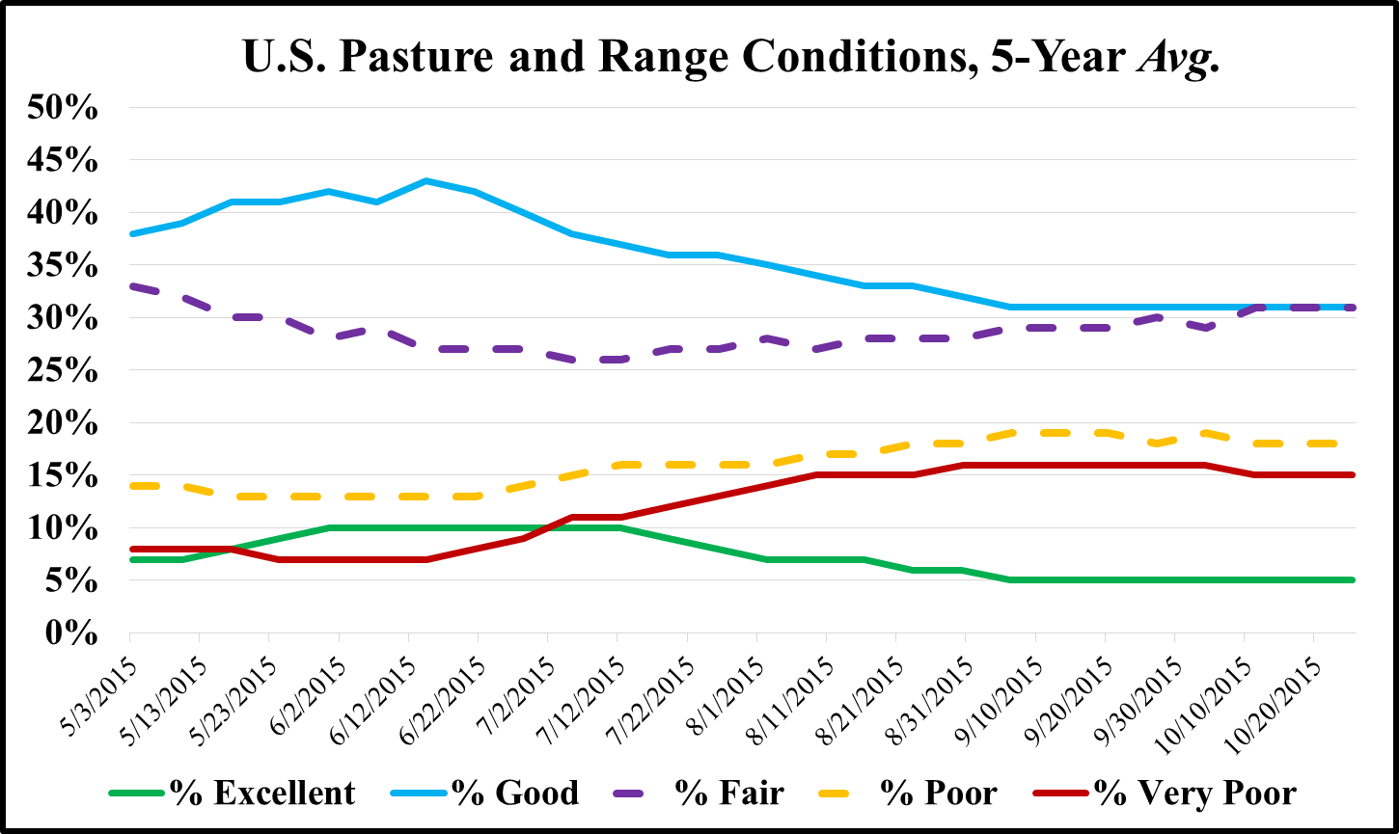

Slide 12
Forage and Hay Outlook
U.S. Pasture and Range Conditions
Weather Outlook
U.S. Forage Supply
Value of Forage Production
Notes:
Next, we need to discuss The Weather Outlook for our 2015-2016 Cool-Season Grazing Season.

Slide 13
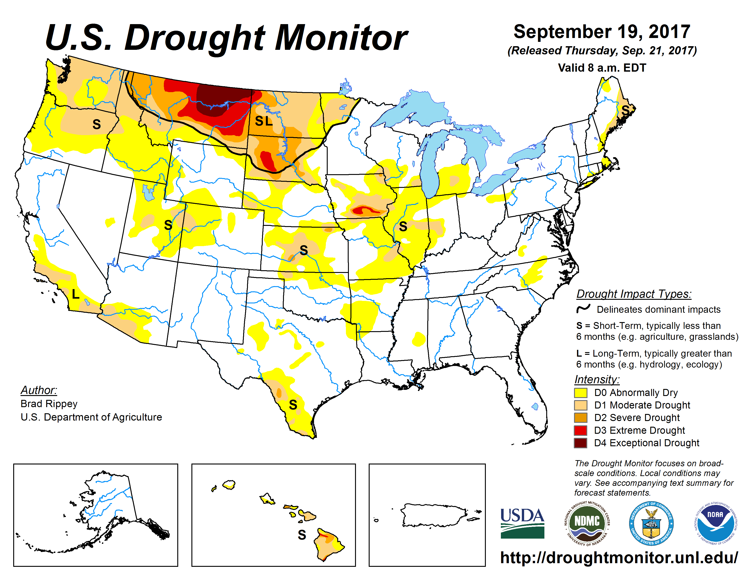
Notes:
Based on the September 15, 2015 U.S. Drought Monitor, severe to exceptional drought continues in the Southwest and Northwest.
In addition, Texas, Louisiana, and North & South Carolina are showing areas of moderate to severe drought.

Slide 14
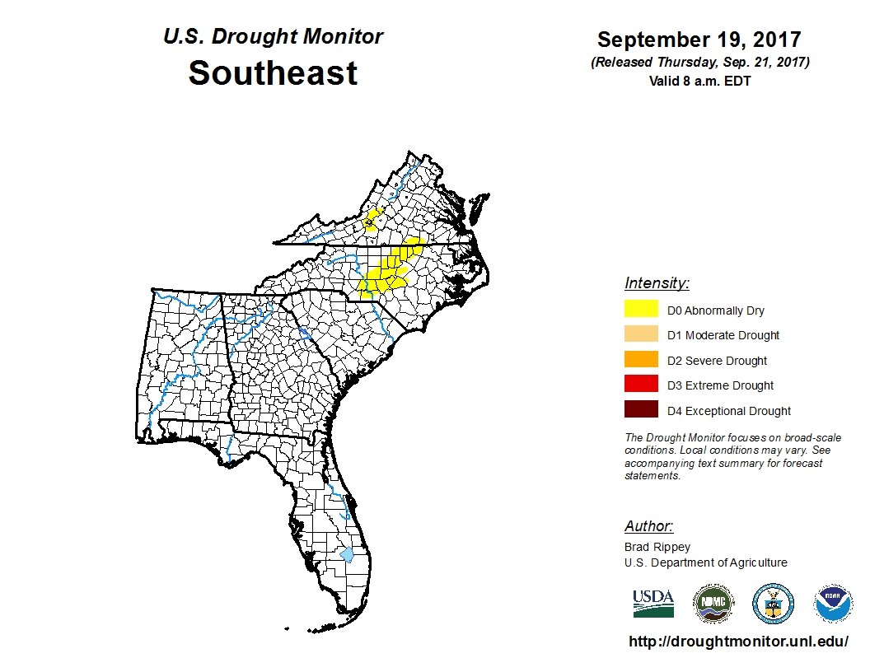

Slide 15
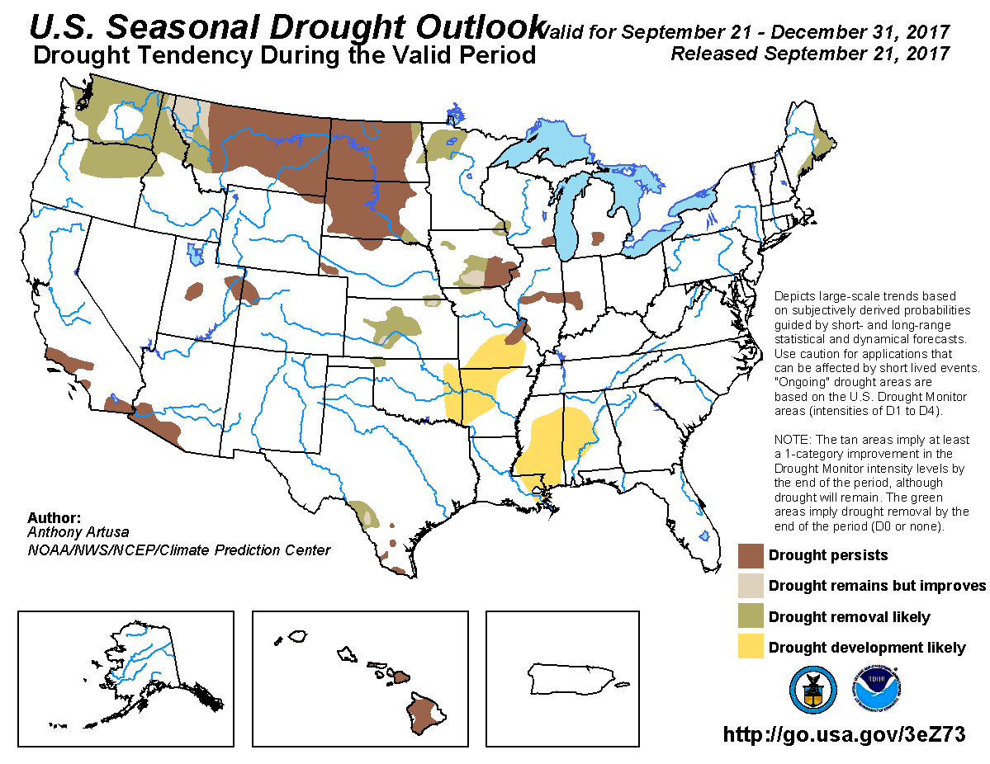
Notes:
Based on the September 15, 2015 U.S. Drought Monitor, severe to exceptional drought continues in the Southwest and Northwest.
In addition, Texas, Louisiana, and North & South Carolina are showing areas of moderate to severe drought.

Slide 16
2016-2017 Drought Monitor
Fall 2016
Winter 2016-2017
Spring 2017
Summer 2017
Fall 2017

Slide 17
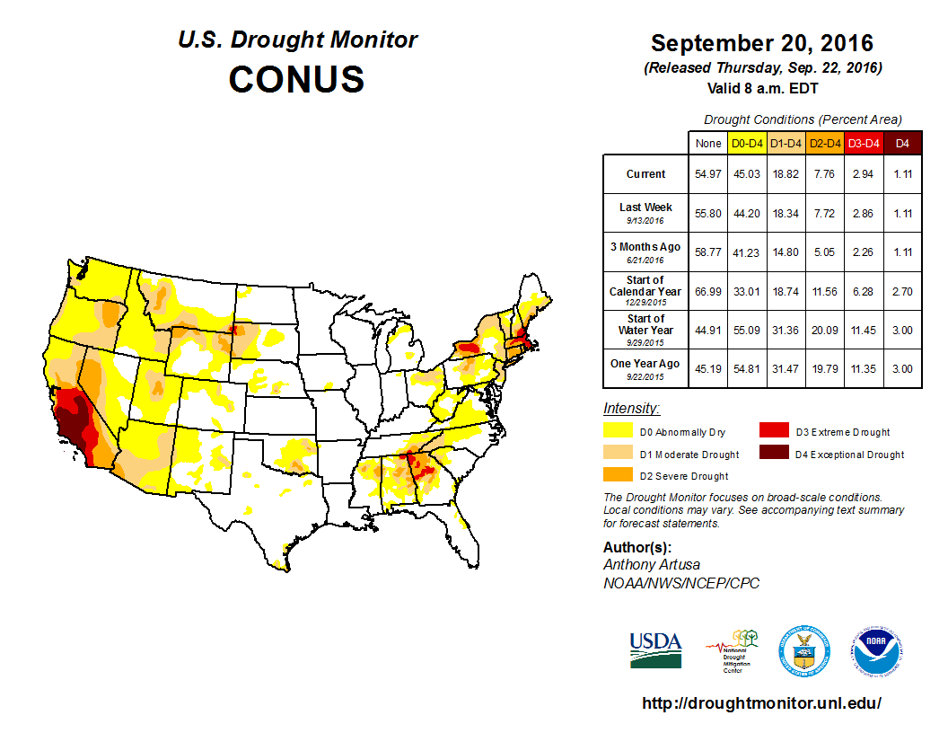
Notes:
Based on the September 15, 2015 U.S. Drought Monitor, severe to exceptional drought continues in the Southwest and Northwest.
In addition, Texas, Louisiana, and North & South Carolina are showing areas of moderate to severe drought.

Slide 18
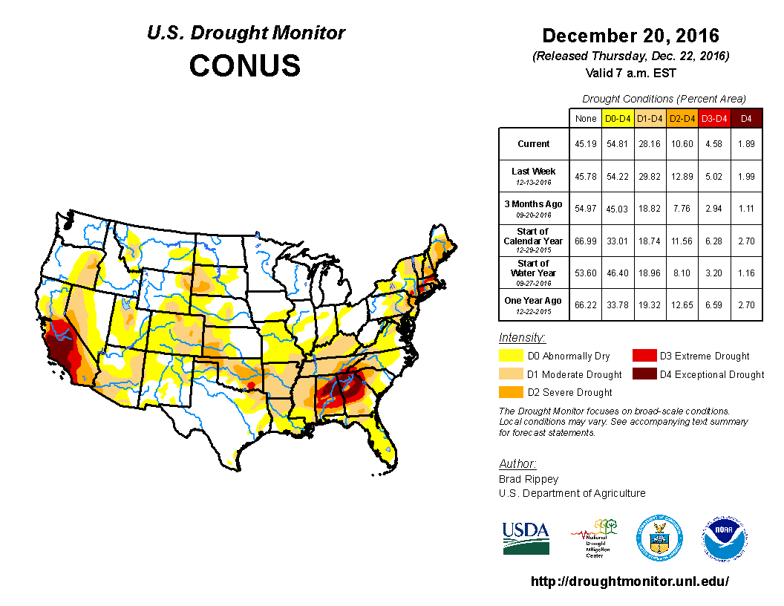
Notes:
Based on the September 15, 2015 U.S. Drought Monitor, severe to exceptional drought continues in the Southwest and Northwest.
In addition, Texas, Louisiana, and North & South Carolina are showing areas of moderate to severe drought.

Slide 19
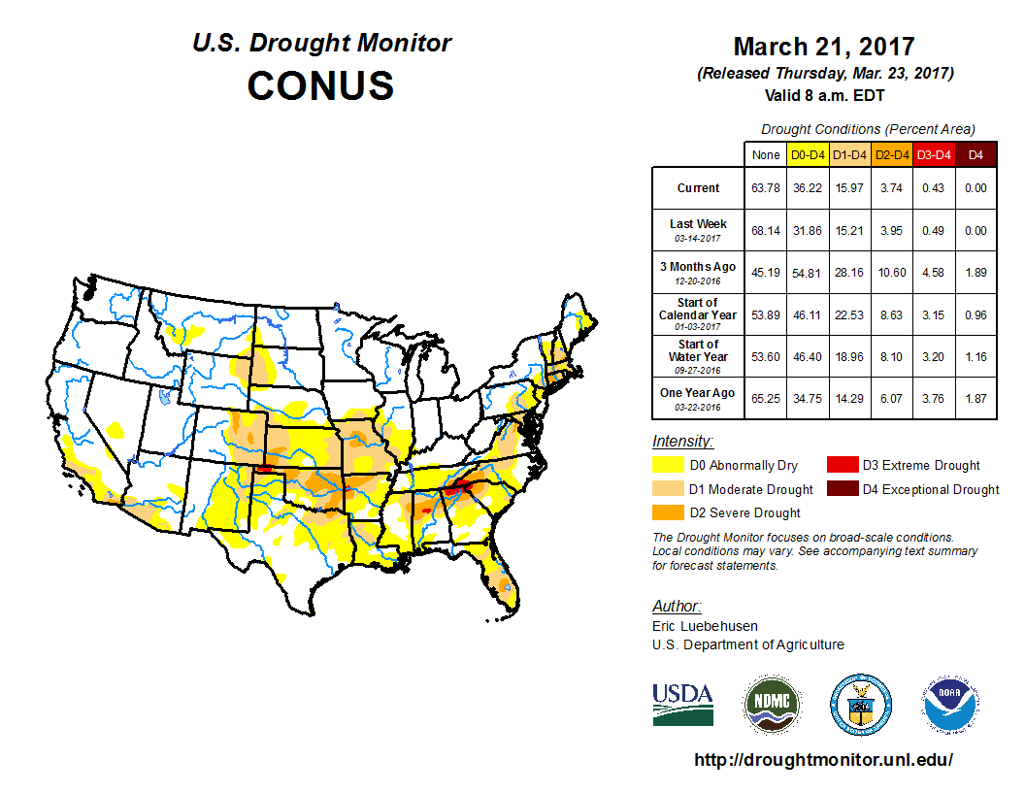
Notes:
Based on the September 15, 2015 U.S. Drought Monitor, severe to exceptional drought continues in the Southwest and Northwest.
In addition, Texas, Louisiana, and North & South Carolina are showing areas of moderate to severe drought.

Slide 20
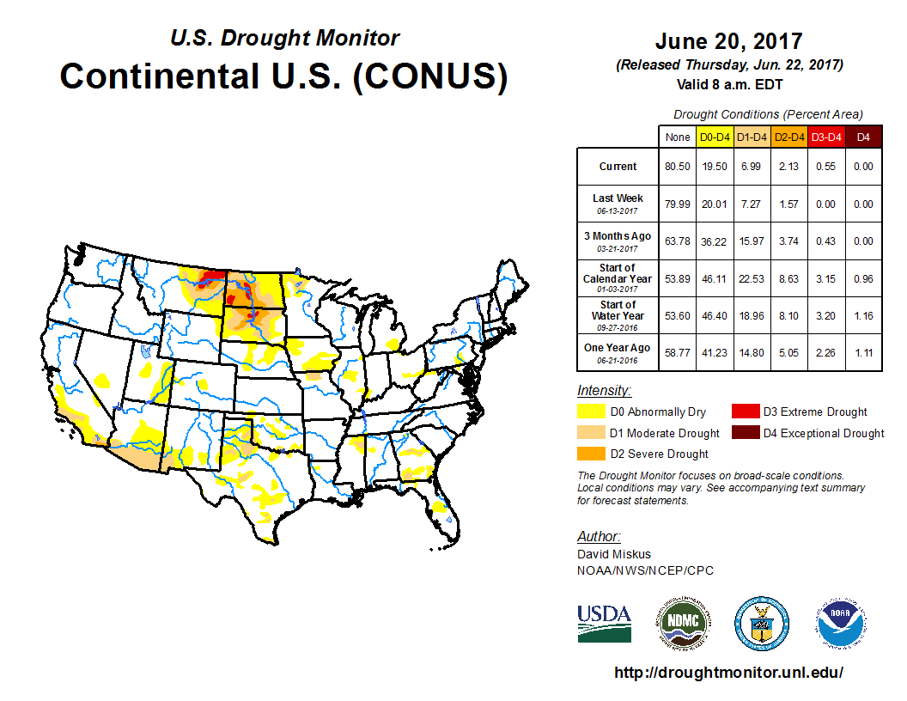
Notes:
Based on the September 15, 2015 U.S. Drought Monitor, severe to exceptional drought continues in the Southwest and Northwest.
In addition, Texas, Louisiana, and North & South Carolina are showing areas of moderate to severe drought.

Slide 21
Notes:
Based on the September 15, 2015 U.S. Drought Monitor, severe to exceptional drought continues in the Southwest and Northwest.
In addition, Texas, Louisiana, and North & South Carolina are showing areas of moderate to severe drought.

Slide 22
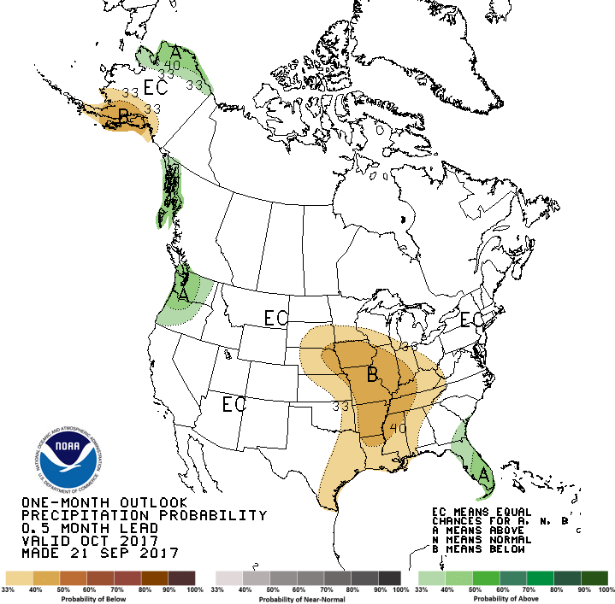
One-Month Precipitation Outlook,
October
Notes:
This chart shows the three-month U.S. Precipitation Outlook for January – March.
The green area in the Southern U. S. shows above average precipitation for the Winter months.
This should help with Wheat and Winter Annual Pastures in the Southern U.S.

Slide 23
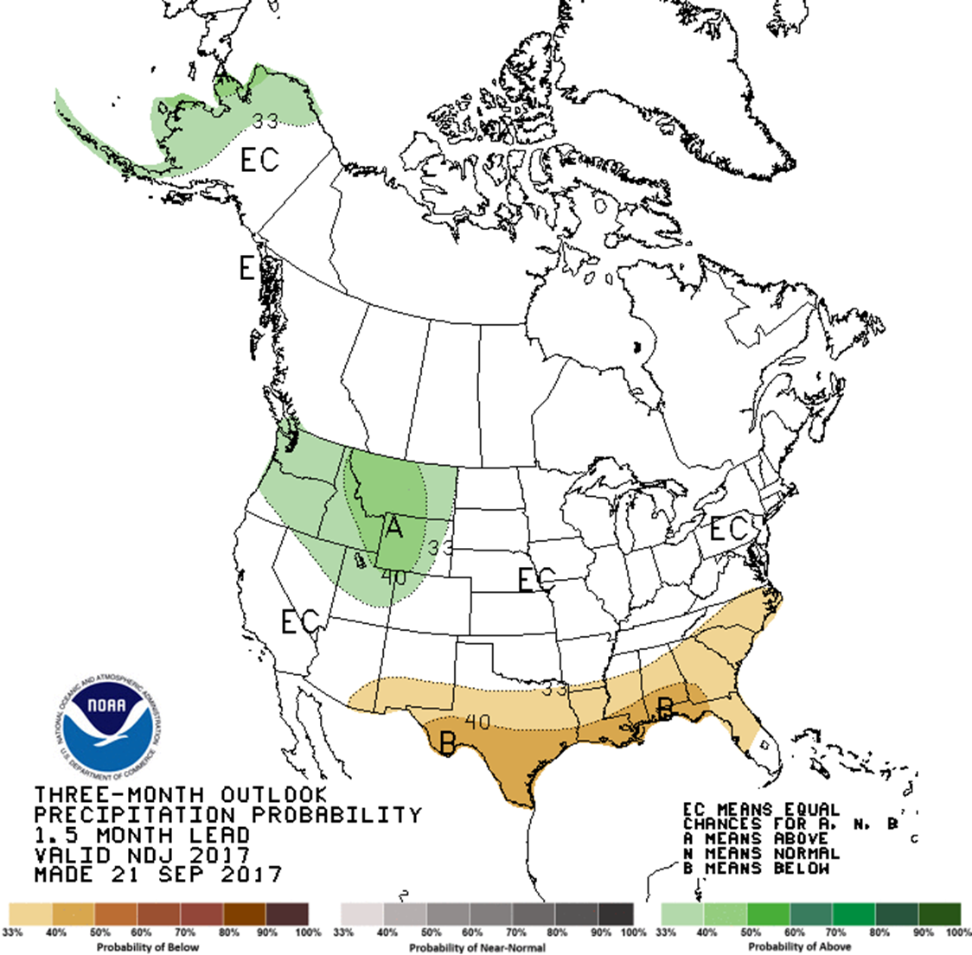
Three-Month Precipitation Outlook,
November - January
Notes:
This chart shows the three-month U.S. Precipitation Outlook for January – March.
The green area in the Southern U. S. shows above average precipitation for the Winter months.
This should help with Wheat and Winter Annual Pastures in the Southern U.S.

Slide 24
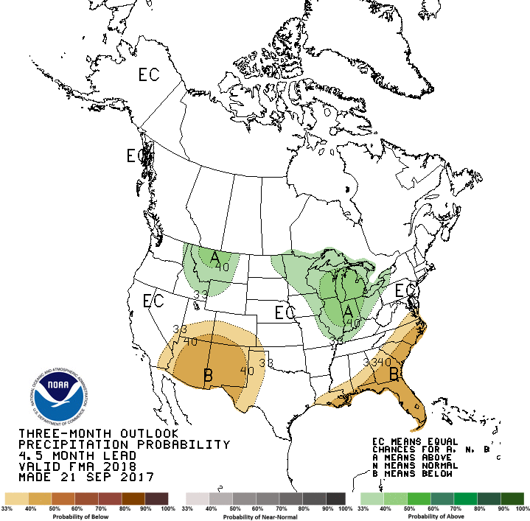
Three-Month Precipitation Outlook,
February - April
Notes:
This chart shows the three-month U.S. Precipitation Outlook for January – March.
The green area in the Southern U. S. shows above average precipitation for the Winter months.
This should help with Wheat and Winter Annual Pastures in the Southern U.S.

Slide 25
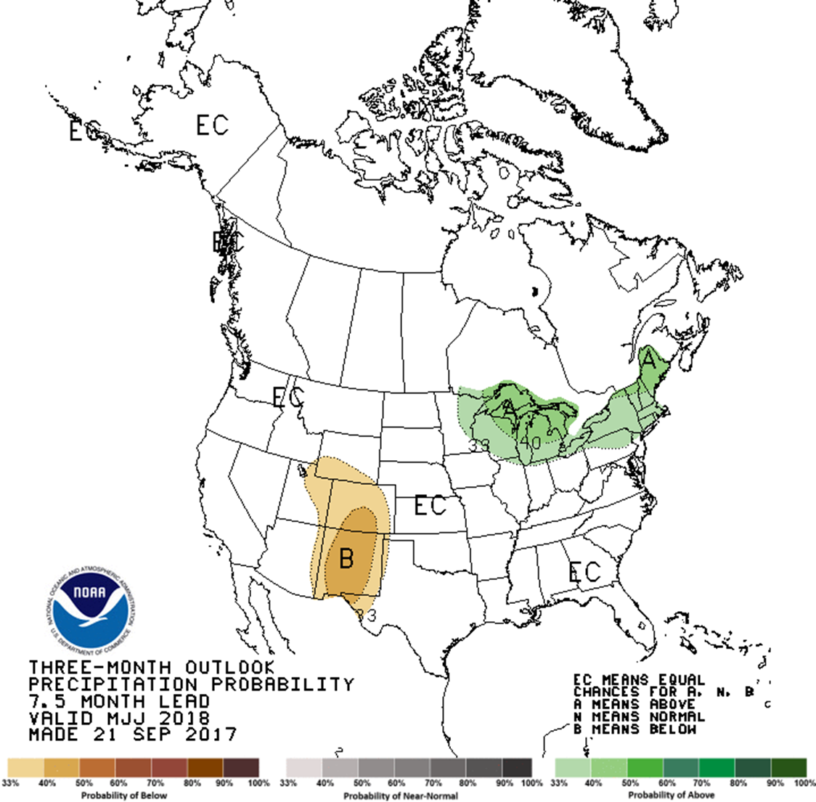
Three-Month Precipitation Outlook,
May - July
Notes:
This chart shows the three-month U.S. Precipitation Outlook for January – March.
The green area in the Southern U. S. shows above average precipitation for the Winter months.
This should help with Wheat and Winter Annual Pastures in the Southern U.S.

Slide 26
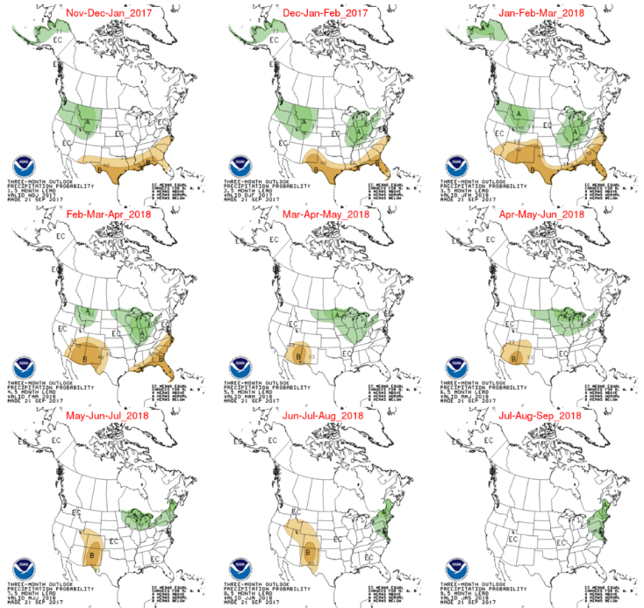

Slide 27
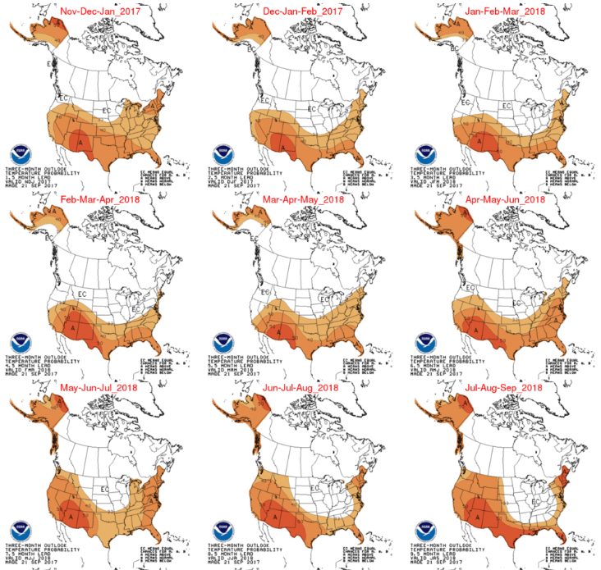

Slide 28
Forage and Hay Outlook
U.S. Pasture and Range Conditions
Weather Outlook
U.S. Forage Supply
Value of Forage Production
Notes:
Next, we will look at our U.S. Forage Supply.

Slide 29
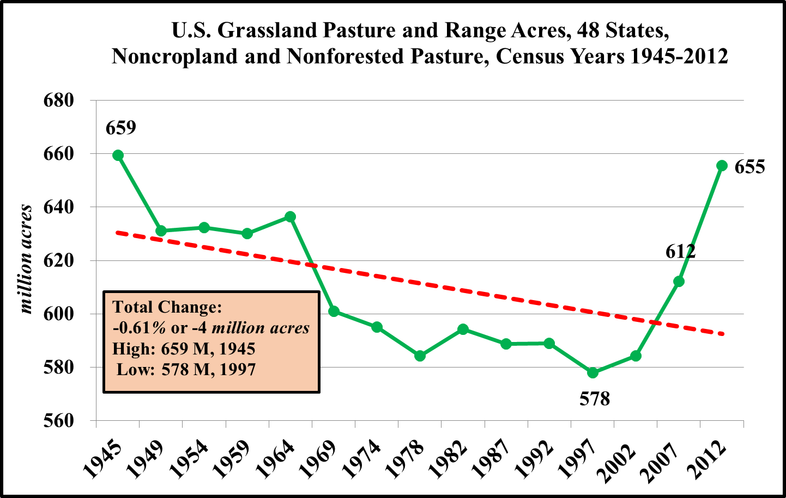
Notes:
This chart presents the U.S. Grassland Pasture and Range Acres for the contiguous 48 states for census years 1945 – 2007.
There has been a 7% reduction in U.S. pasture acres for the contiguous United States between 1945 and 2007.
The pasture and range acres declined from approximately 659 million acres in 1945 to about 612 million acres in 2007.
This amounts to a decline of about 47 million pasture acres.

Slide 30
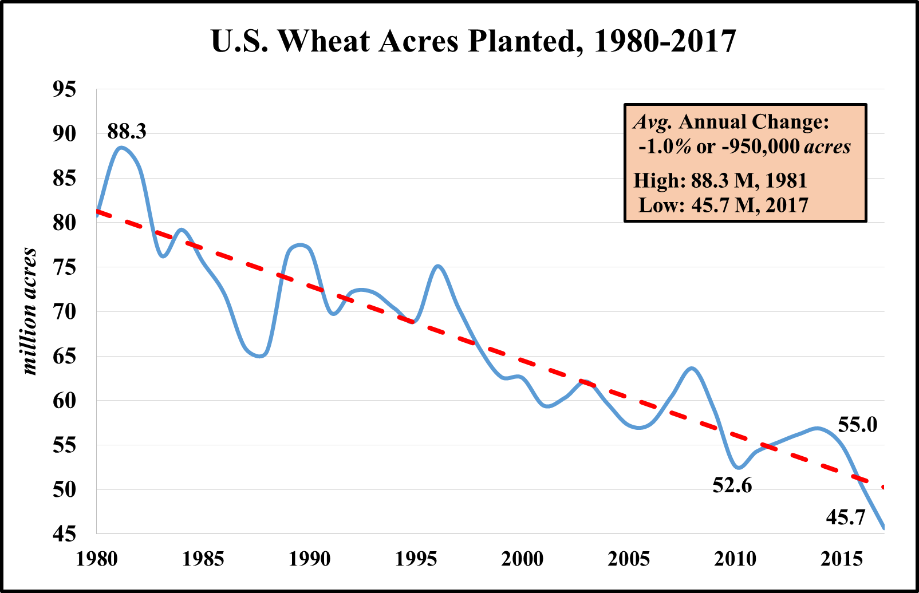
Notes:
This slide presents the U.S. Wheat Acres Planted between 1980-2015.
Since 1980, we have seen a decrease of approximately 24 million acres, which is an average annual decrease of 0.5%
I don’t know how many Wheat Acres are grazed but you can see, that their has been a large decrease in the number of potential acres that could be grazed.

Slide 31
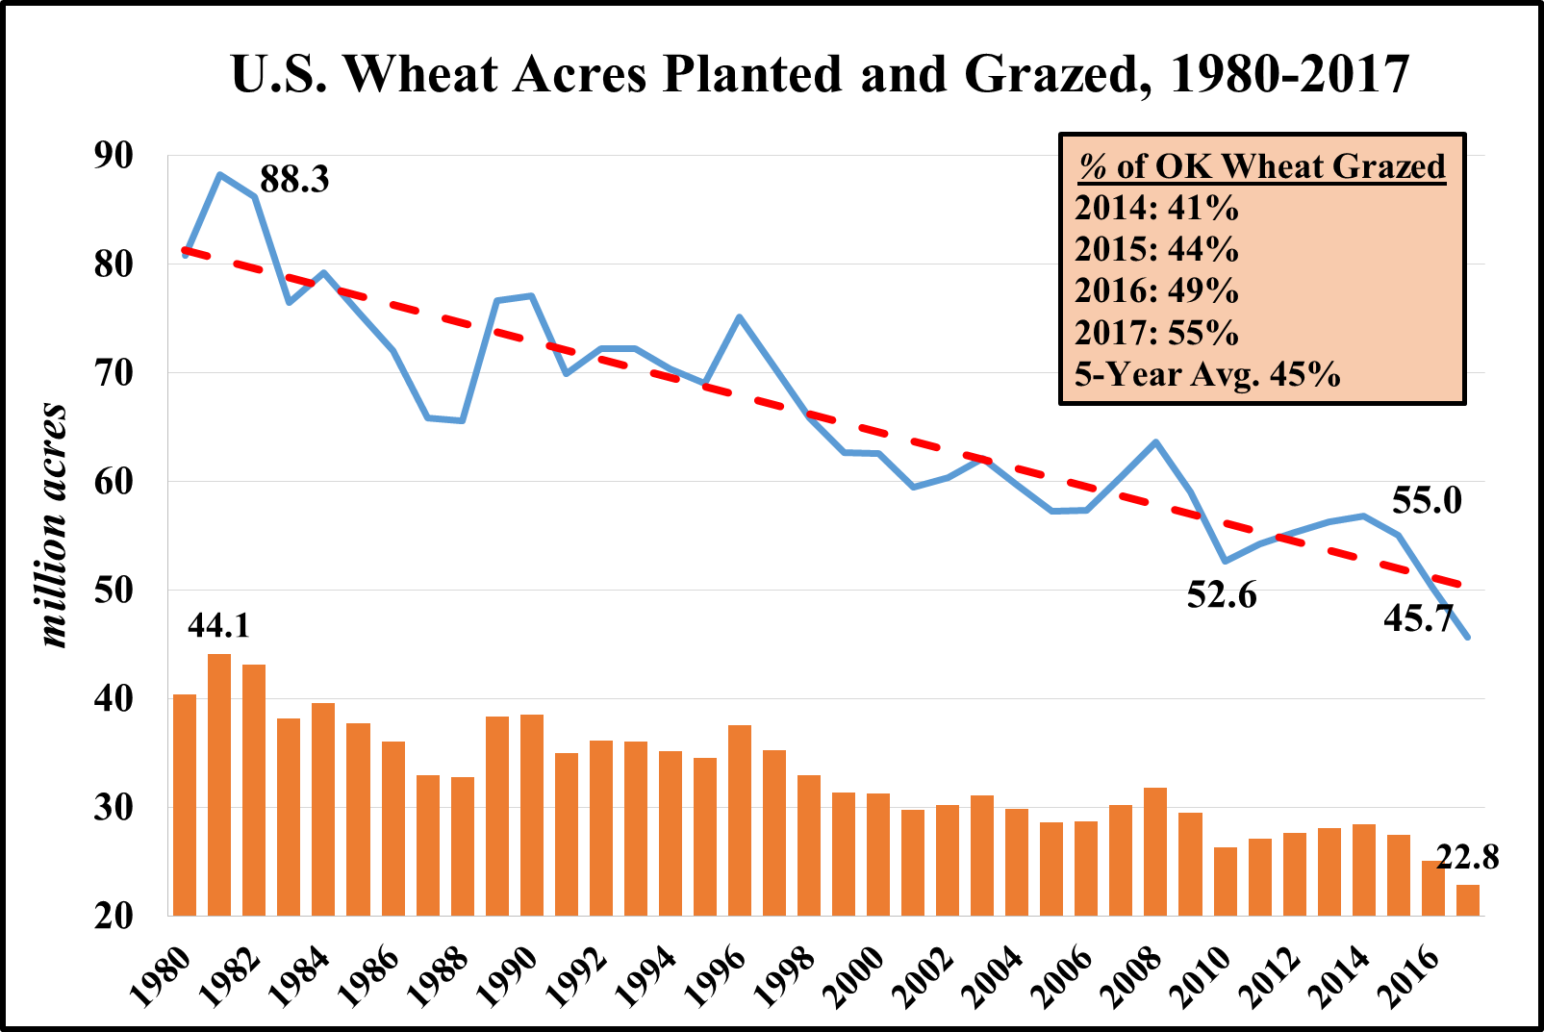
Notes:
This slide presents the U.S. Wheat Acres Planted between 1980-2015.
Since 1980, we have seen a decrease of approximately 24 million acres, which is an average annual decrease of 0.5%
I don’t know how many Wheat Acres are grazed but you can see, that their has been a large decrease in the number of potential acres that could be grazed.

Slide 32
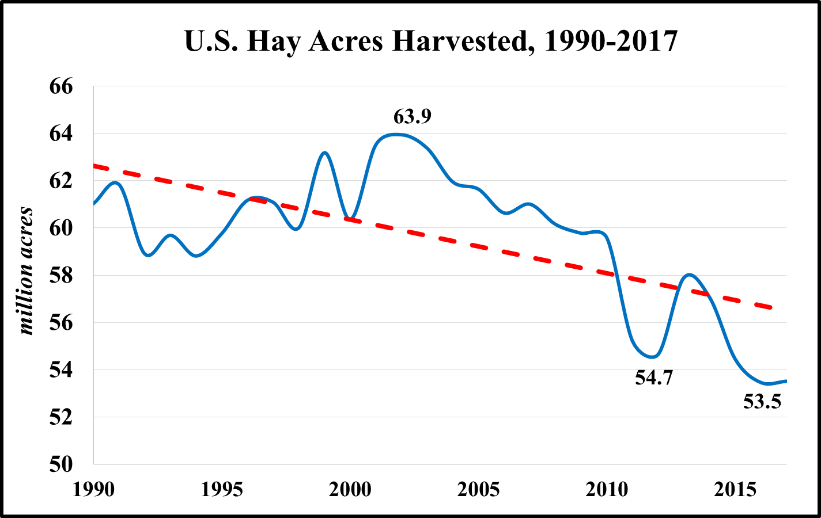
Avg. Annual Decrease:
-0.5% or -329,000 acres
High: 63.9 M, 2002
Low: 53.5 M, 2016
Notes:
This slide presents the U.S. Hay Acres Harvested between 1909 – 2015.
As the trend-line indicates their has been a steady decline in hay acres harvested during this time period. Hay acres harvested has an average annual decrease of 0.1%.
My expectations are for a continued decrease in U.S. acres harvested due to competing uses for land.

Slide 33
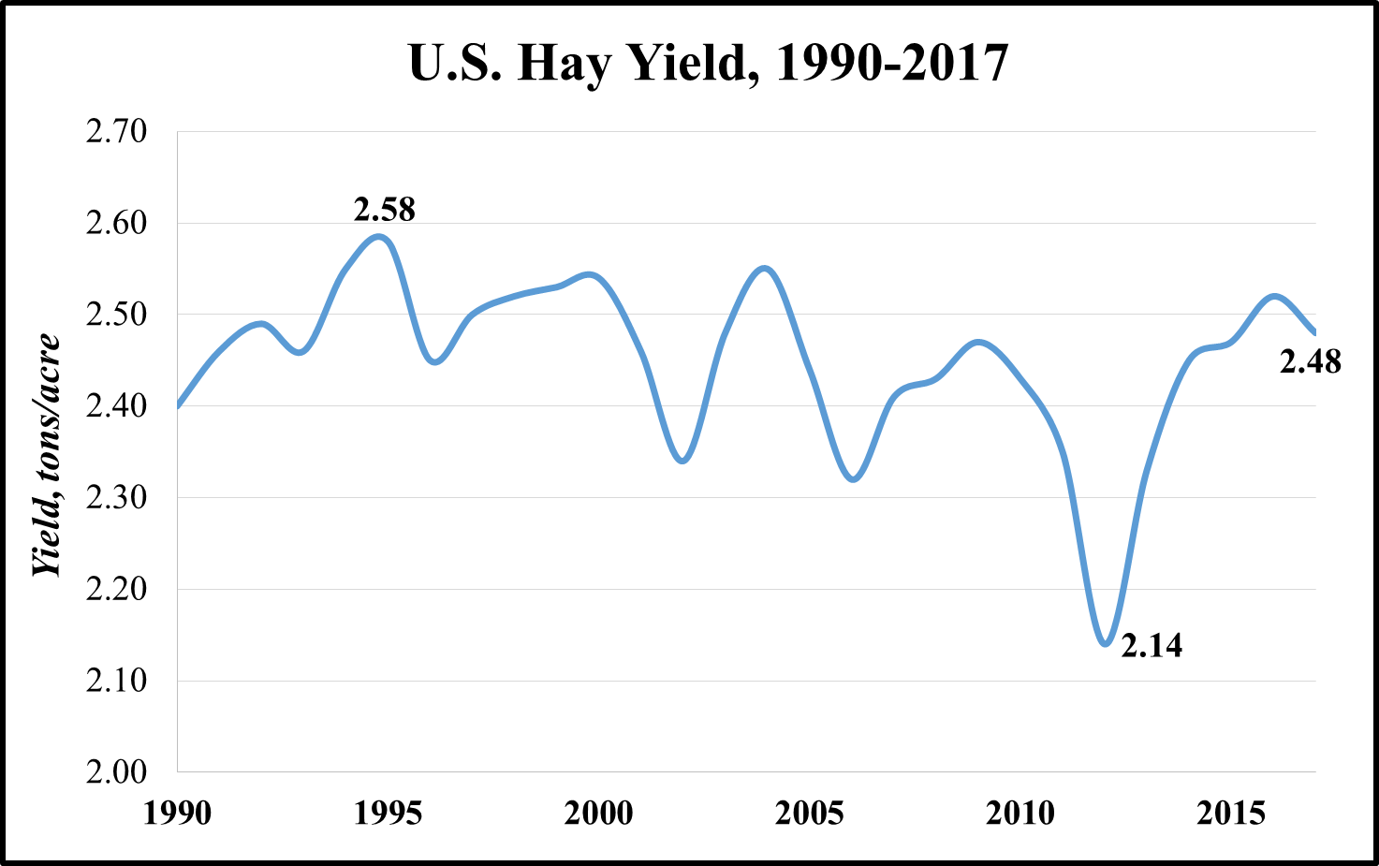
Avg. Annual Change:
.33% or 12 lbs./acre
High: 2.58, 1995
Low: 2.14, 2012
Notes:
This slide presents the U.S. Average Hay Yield between 1909 and 2015.
The trend-line denotes an average annual increase of 1% over the last ~100 years which shows hay yields moving from 1.27 tons/acre in 1909 to 2.51 tons/acre in 2015.

Slide 34
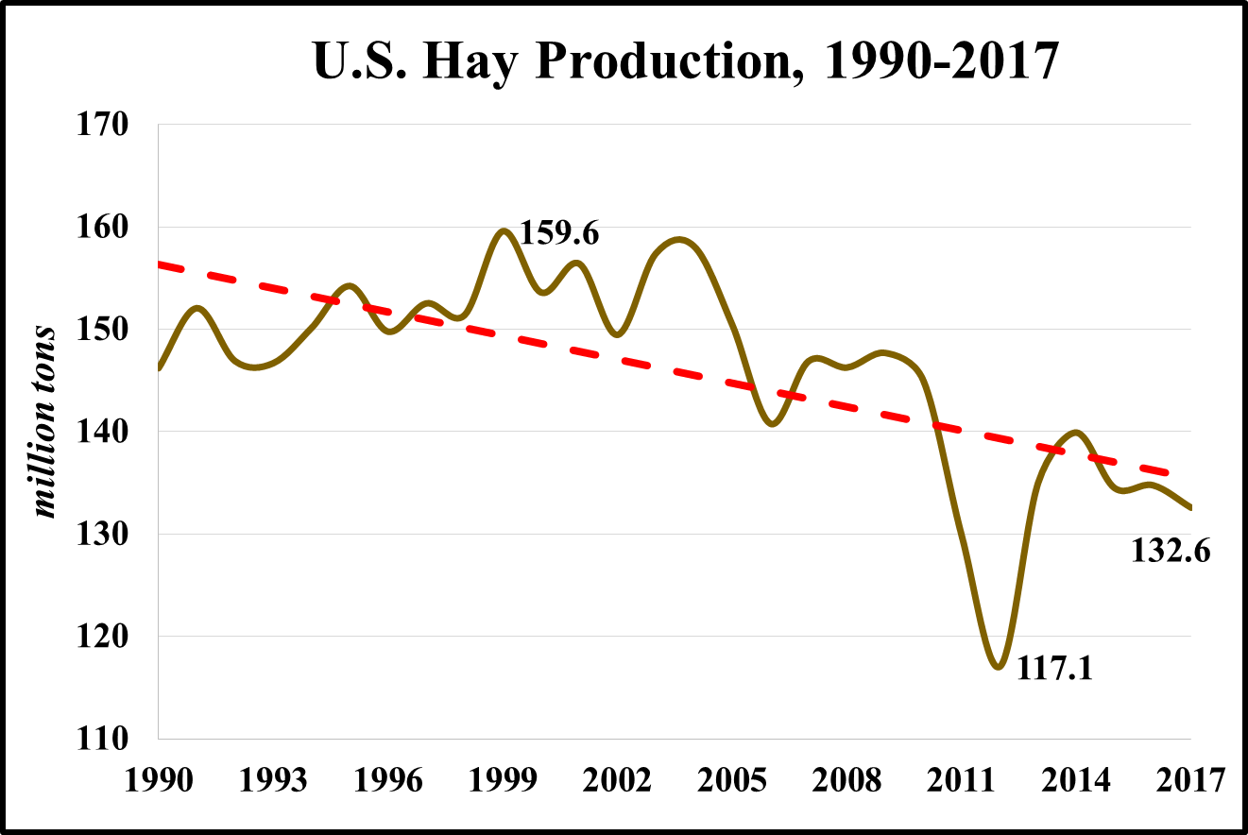
Avg. Annual Change:
-0.19% or -432,000 tons
High: 159.6 M, 1999
Low: 117.1 M, 2012
Notes:
This chart shows the total U.S. Hay production in million tons between 1909 and 2015.
The annual average rate of increase over this time period has been 0.9%.
As you might remember we had decreasing acres of U.S. Hay Harvested and increasing hay yields over this time period.
Overall, this has resulted in greater levels of production.
The higher rate of increase in yield per acre more than offset the slower rate of decrease in the number of acres harvested.
So, those higher levels of yield per acre more than made up for the decline in hay acres harvested.

Slide 35
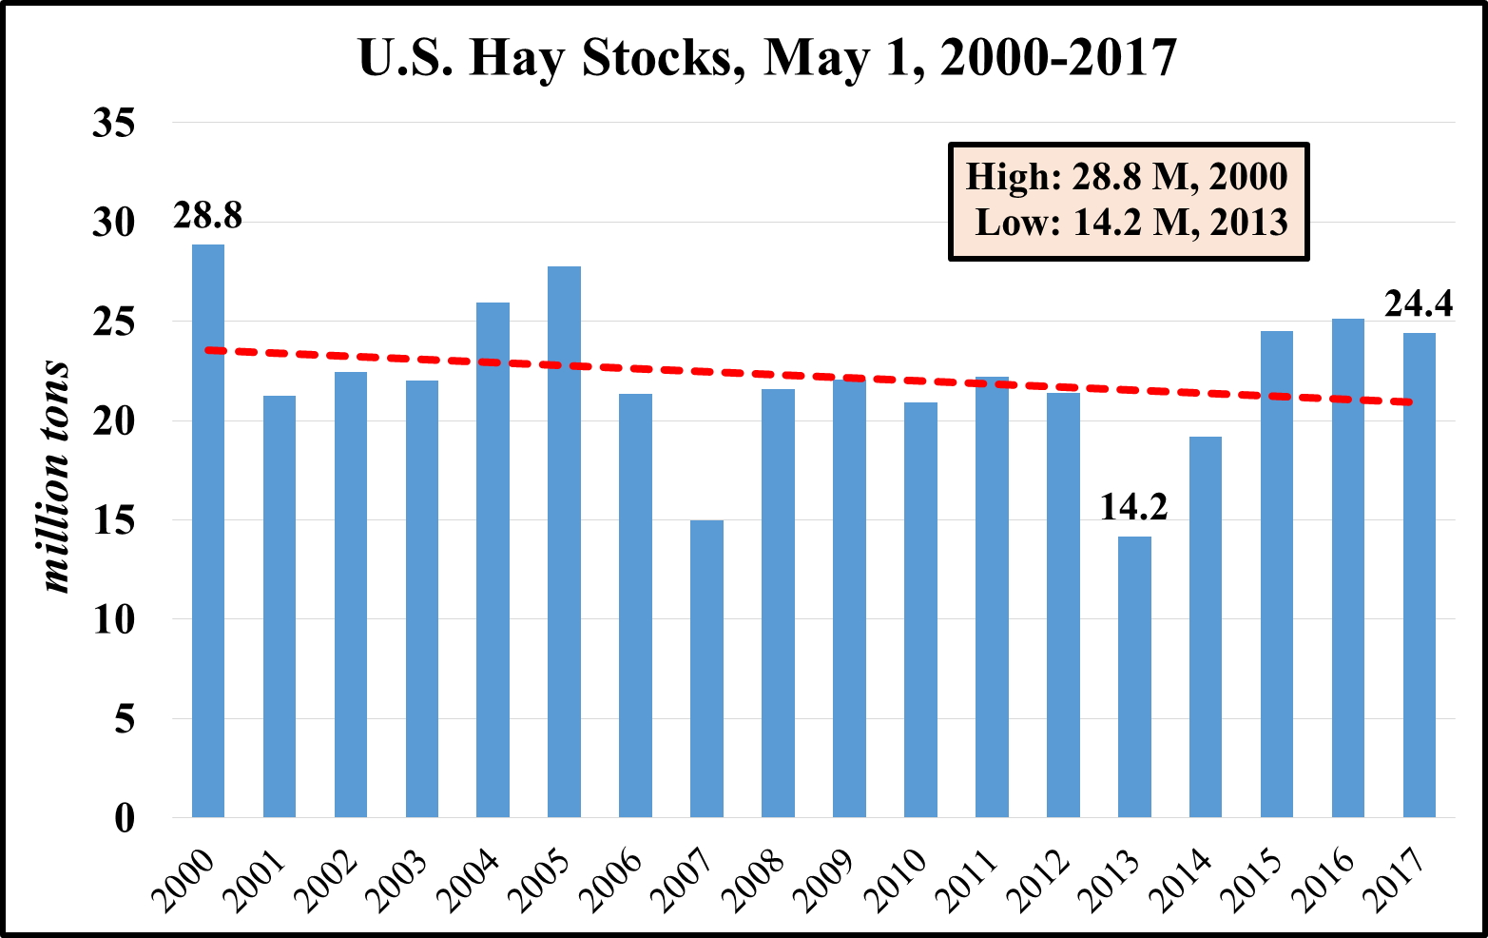
Notes:
This chart shows the U.S. Hay Stocks as of May 1st between 1990 and 2015.
The trend-line shows a slight decline in hay stocks over time.

Slide 36
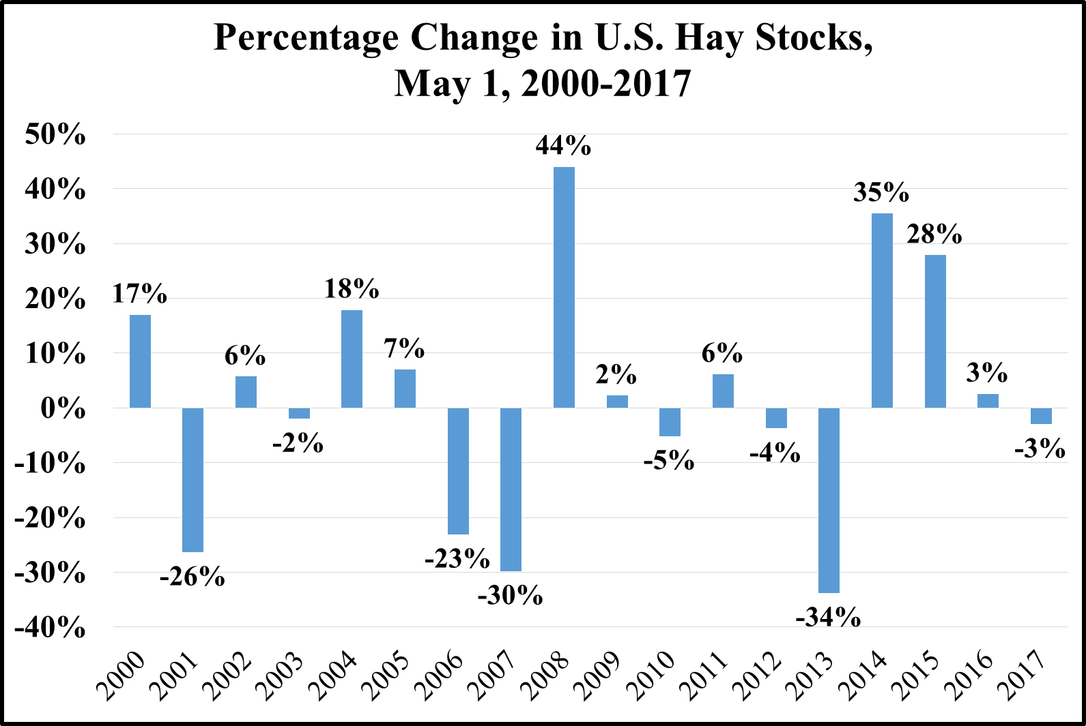
Notes:
This chart shows the percentage change in U.S. Hay Stocks as of May 1st between 1990 and 2015.
There appears to be an improvement in May 1st Hay stocks during the last two years.

Slide 37
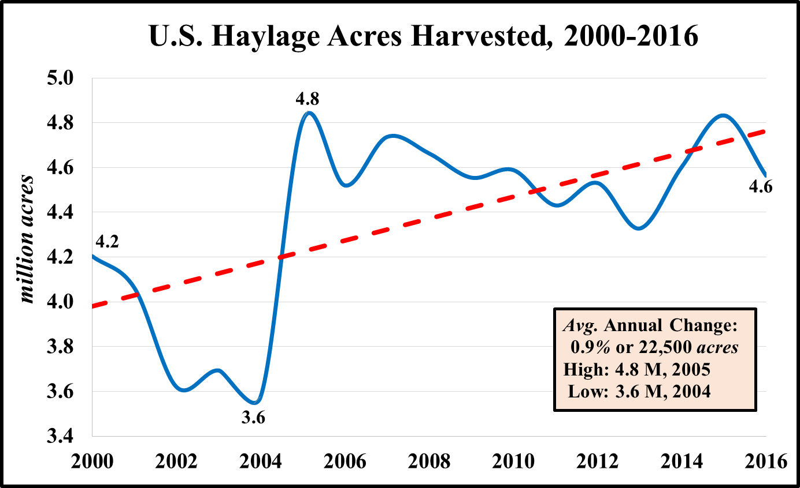
Notes:
Another use of forage that is needs to be mentioned is Haylage.
This chart presents the U.S. Haylage Acres between 2000 and 2014.
Since 2000, U.S. Haylage acres have increased at an average annual rate of 1.1%.
However, since 2005 we have seen a modest decline in U.S. Haylage Acres.
I am not sure why we saw the decline between 2000 and 2004 or the modest decline between 2005 and 2014.
If anyone wants to comment on what is going on with Haylage acres please help me out.
In order for haylage acres to increase in the future I would think that the cost of putting forage up in this manner needs to decrease for it to become more competitive with hay (quality, waste, cost, etc.).

Slide 38
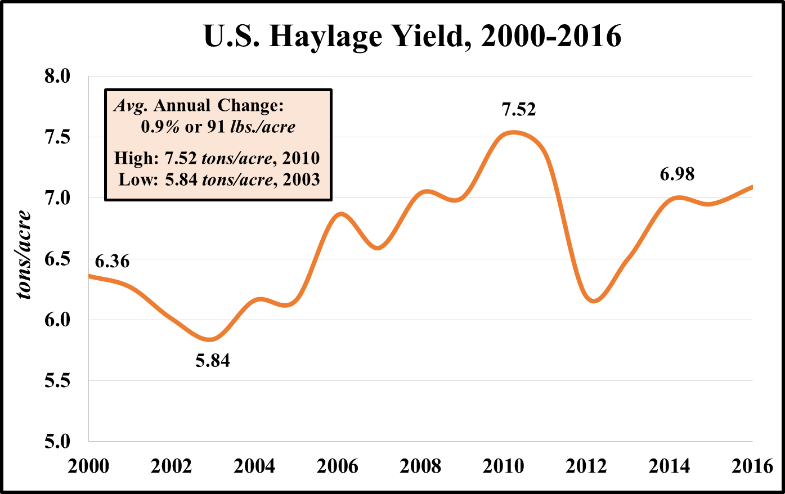
Notes:
This chart presents the U.S. Haylage Yield between 2000 and 2014.
The trend-line shows an average annual increase of 0.9 percent over this time period.

Slide 39
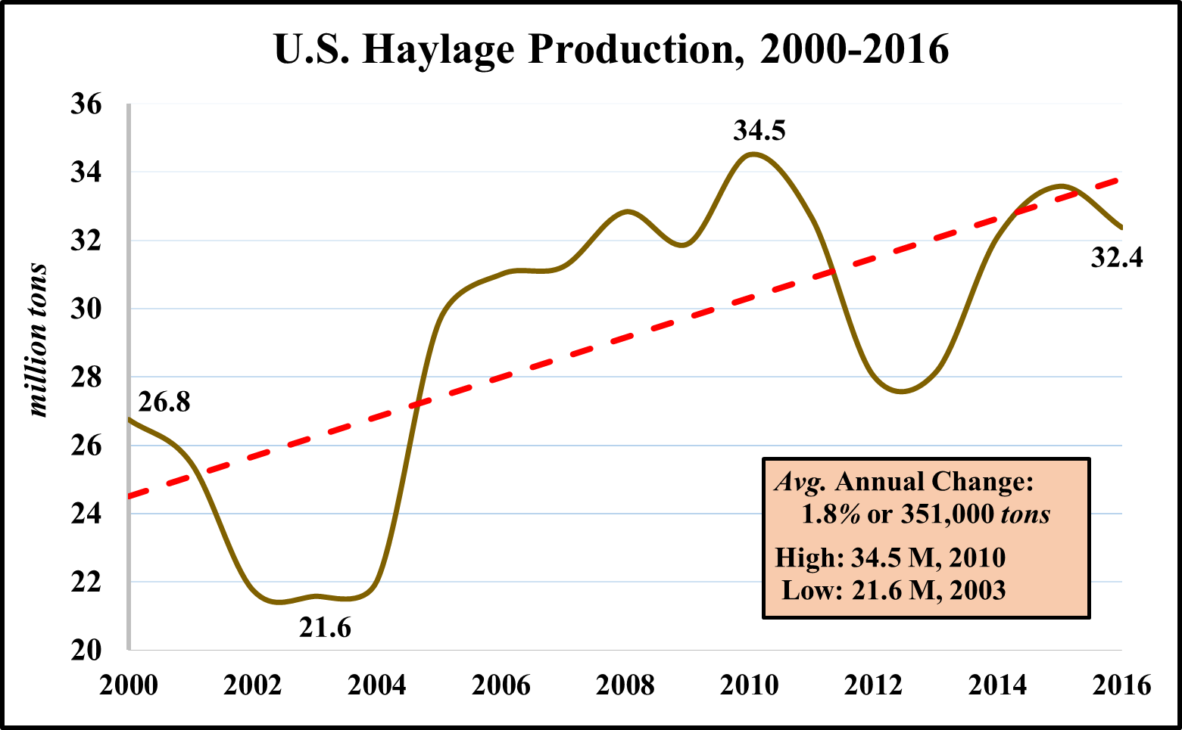
Notes:
This chart shows the total U.S. Haylage Production in million tons between 2000 and 2014.
The annual average rate of increase over this time period has been 1.9%.
We had increasing Haylage Acres and increasing Haylage Yield Per Acre which has resulted in increased U.S. Haylage Production.
Overall, this has resulted in greater levels of production.

Slide 40
Forage and Hay Outlook
U.S. Pasture and Range Conditions
Weather Outlook
U.S. Forage Supply
Value of Forage Production
Notes:
Lastly, we need to discuss the “Value of Forage Production.”

Slide 41
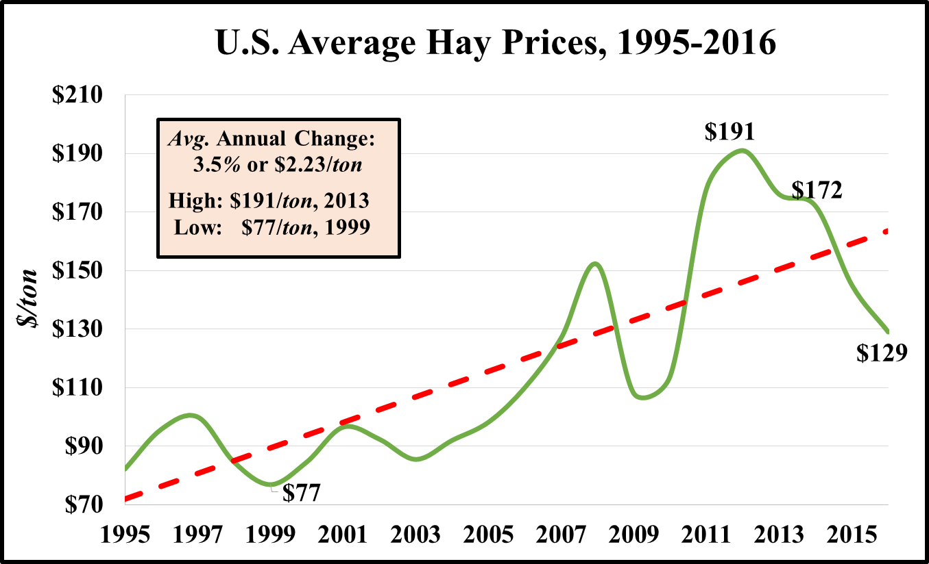
Notes:
This chart shows the U.S. Average Hay Prices between 1995 and 2014.
U.S. Hay prices increased by about $90/ton or 109% over this 20-year period.
The average annual increase was approximately 5.3% over this time period.
Hay prices will continue to be influenced by livestock numbers, level of hay production, and prices of hay substitutes.

Slide 42
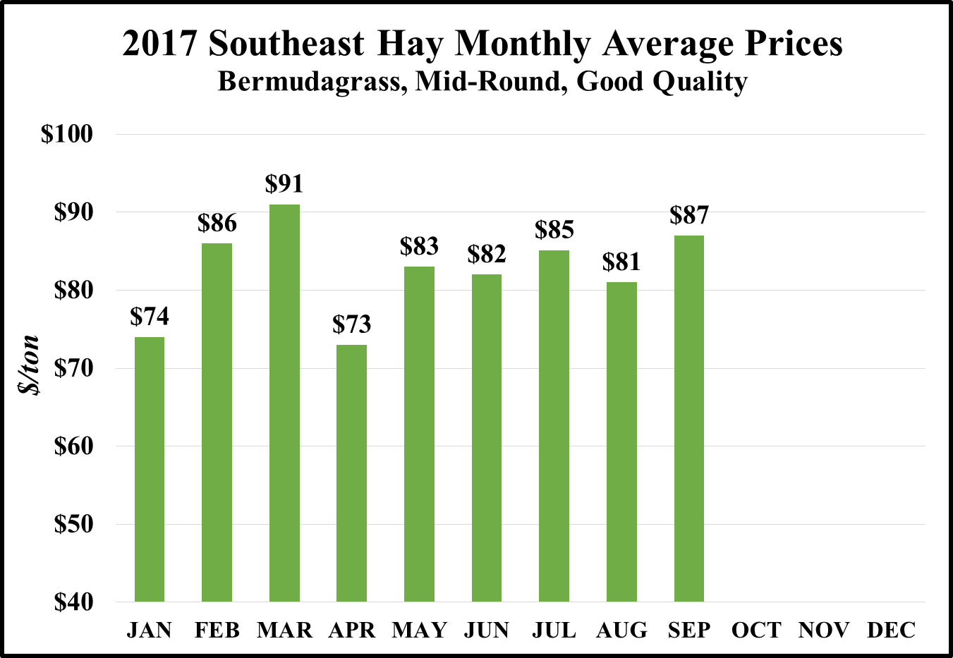
Notes:
This charts shows the U.S. Monthly Average Hay Prices by Month for 2015 and the five-year average.
Basically, 2015 monthly hay prices which are denoted by the green bars are following the 5-year average monthly hay prices.
However, the June and July U.S. average hay prices are lower, most likely to due to higher levels of production.

Slide 43
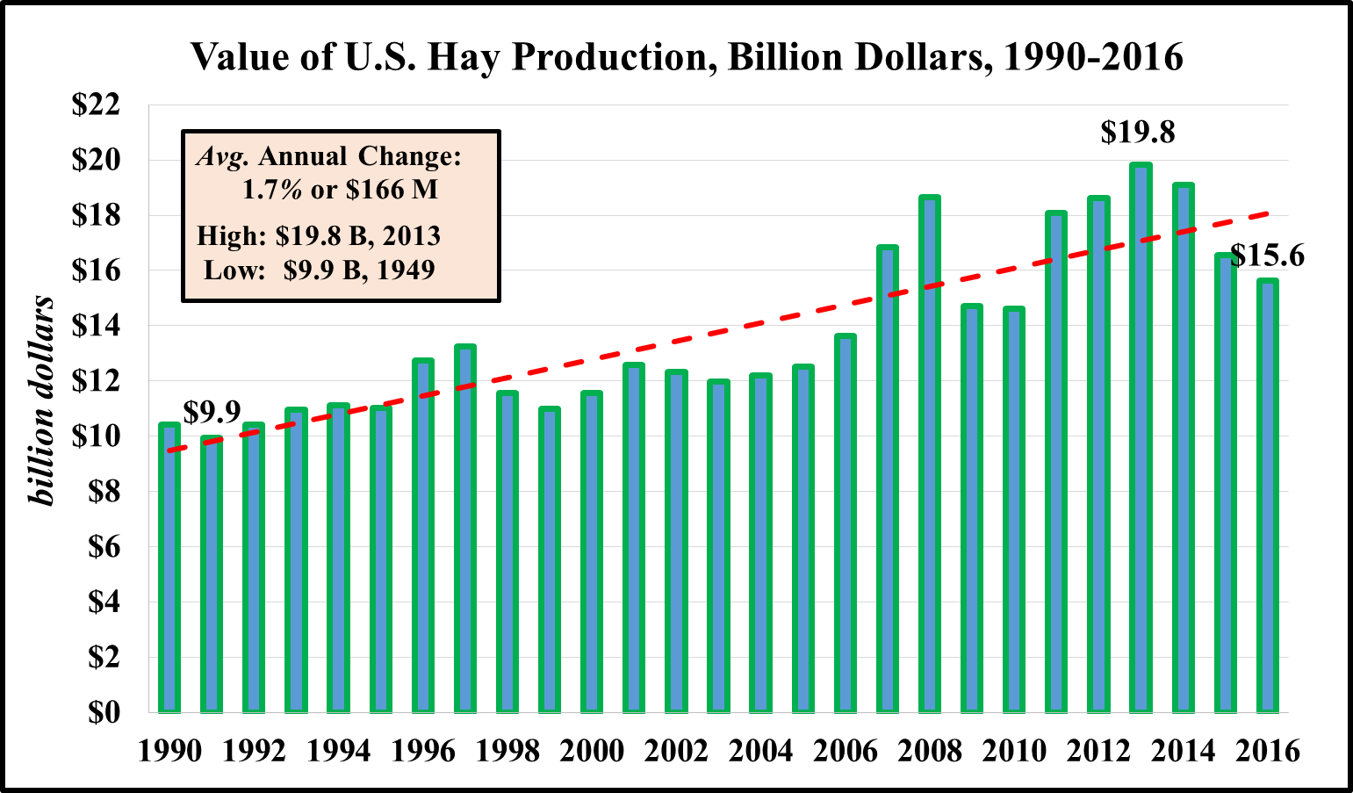

Slide 45
Major Factors Affecting 2017 Hay Production In The Southern 14 States
1. Excessive rainfall in several states has adversely impacted the quantity and quality of hay production.
2. Hurricanes Harvey and Irma adversely impacted hay production, harvest, and storage in several states.
3. Increased use of hay for livestock in areas affected by hurricanes due to grazing losses.
These factors will likely contribute to higher hay prices in the Southern 14 States during 2017-2018.

Slide 46
Notes:
Folks this slide represents only an example of how SE Hay production may be affected during the 2017 growing season due to increased rainfall and damage from flooding.
I adjusted a few states with percentage reduction in hay production and it resulted in almost a -5% reduction in SE hay production during the 2017 hay production season.
We will await the real production numbers, but it is possible that we will realize a lower level of hay production during 2017.
Several of you may want to address your situation of 2017 hay production in your respective "State Reports." Again this is simply an example of one scenario."

Slide 47
Forage and Hay Outlook
U.S. Pasture and Range Conditions
Weather Outlook
U.S. Forage Supply
Value of Forage Production
What will ALL of This Mean Moving Forward…
Notes:
Lastly, “What will all of this mean moving forward.”

Slide 48
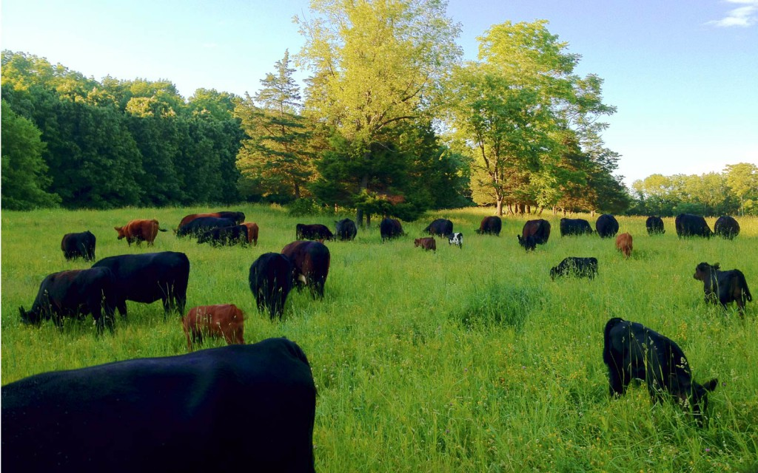
Even with “good weather for growing and harvesting and all our technological advances” it continues to be cheaper to let the cows harvest the grass.

Slide 49
Corn Prices Impact The Value of Forage
CME Corn Futures
December 2017 – December 2019
$3.53 - $4.16, $/bushel
Cheap corn keeps “Cost of Gain” low in the feedlot
Cheap corn limits “Value of Gain” from grass for Stocker and Cow-Calf producers and the value of hay/haylage*
*Assuming that corn continues to be the benchmark to value feedstuffs
Notes:
Finally, regarding the value of forages most of us don’t think about it this way but corn prices have a big impact on the value of forage.
In the past corn has been the benchmark to value feedstuffs.
When corn prices are high, the cost of gain in the feedlot is higher making the value of gain on grass higher. Thus cattle buyers can afford to pay cattle producers more for weight gain on grass since the feedlot gain is higher.
Alternatively right now, the price of corn and cost of gain in the feedlot is much lower, making the value cattle buyers are willing to pay for addition weight lower.
Cattle feeders when faced with lower priced corn will usually put weight gain on in growing yards and feedlots which suggests lower values for forages.

Slide 50
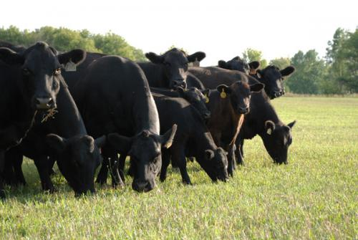
Pasture and Range Conditions overall are expected to be about average.
Excellent
Good
Fair
Poor
Very Poor

Slide 51
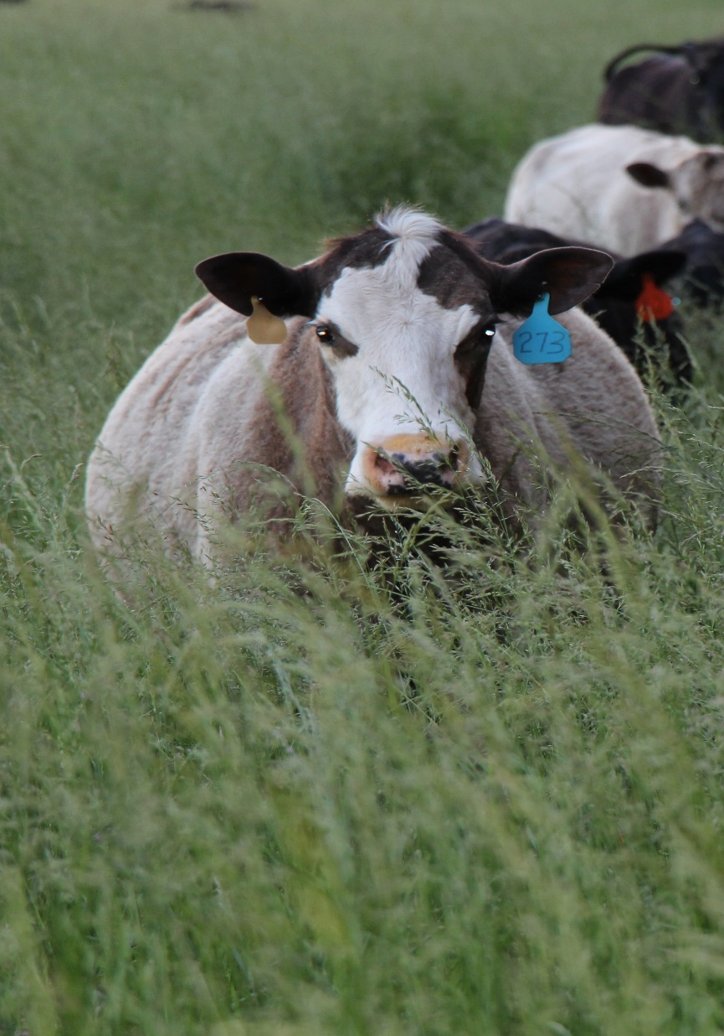
Cow-Calf Producers Need to:
Continue to wage war on forage and feeding costs (focus on mgt. & resources)
Prepare for the next drought…

Slide 52
Stocker Producers
Current Avg. “Value of Gain” of $0.50-$0.75/lb. isn’t very appealing.
Producers must either….
  Find ways to lower their cost of gain (focus on most productive forage sites, procure stockers with a higher level of performance, lower health risks, etc.)
  Get Lucky when they bet on the improving market prices and calf gains to enhance VOG

Slide 53
Forage and Hay Outlook
Chris Prevatt
University of Florida, Extension Economist
Range Cattle Research and Education Center
2017 Southern Region Outlook Conference
September 26, 2017
Notes:
Thank you for the opportunity to talk with you today about the Forage and Hay Outlook.

