Slide 1
Farm Labor Outlook
Derek Farnsworth | Assistant Professor

Slide 2
Acknowledgments
Thanks in advance to the following researchers who created many of the figures and tables used in this presentation:
Tom Hertz (ERS)
Travis Minor (ERS)
Gulcan Onel (UF-FRED)
Skyler Simnitt (UF-FRED)
Fritz Roka (Gulf Coast)

Slide 3
Importance of Farm Labor
Farm wages and salaries represent roughly
  14% of total cash expenses for all farms
  39% of expenses for specialty crops
(Source – ARMS)

Slide 4
Farm Employment Trends

Slide 5
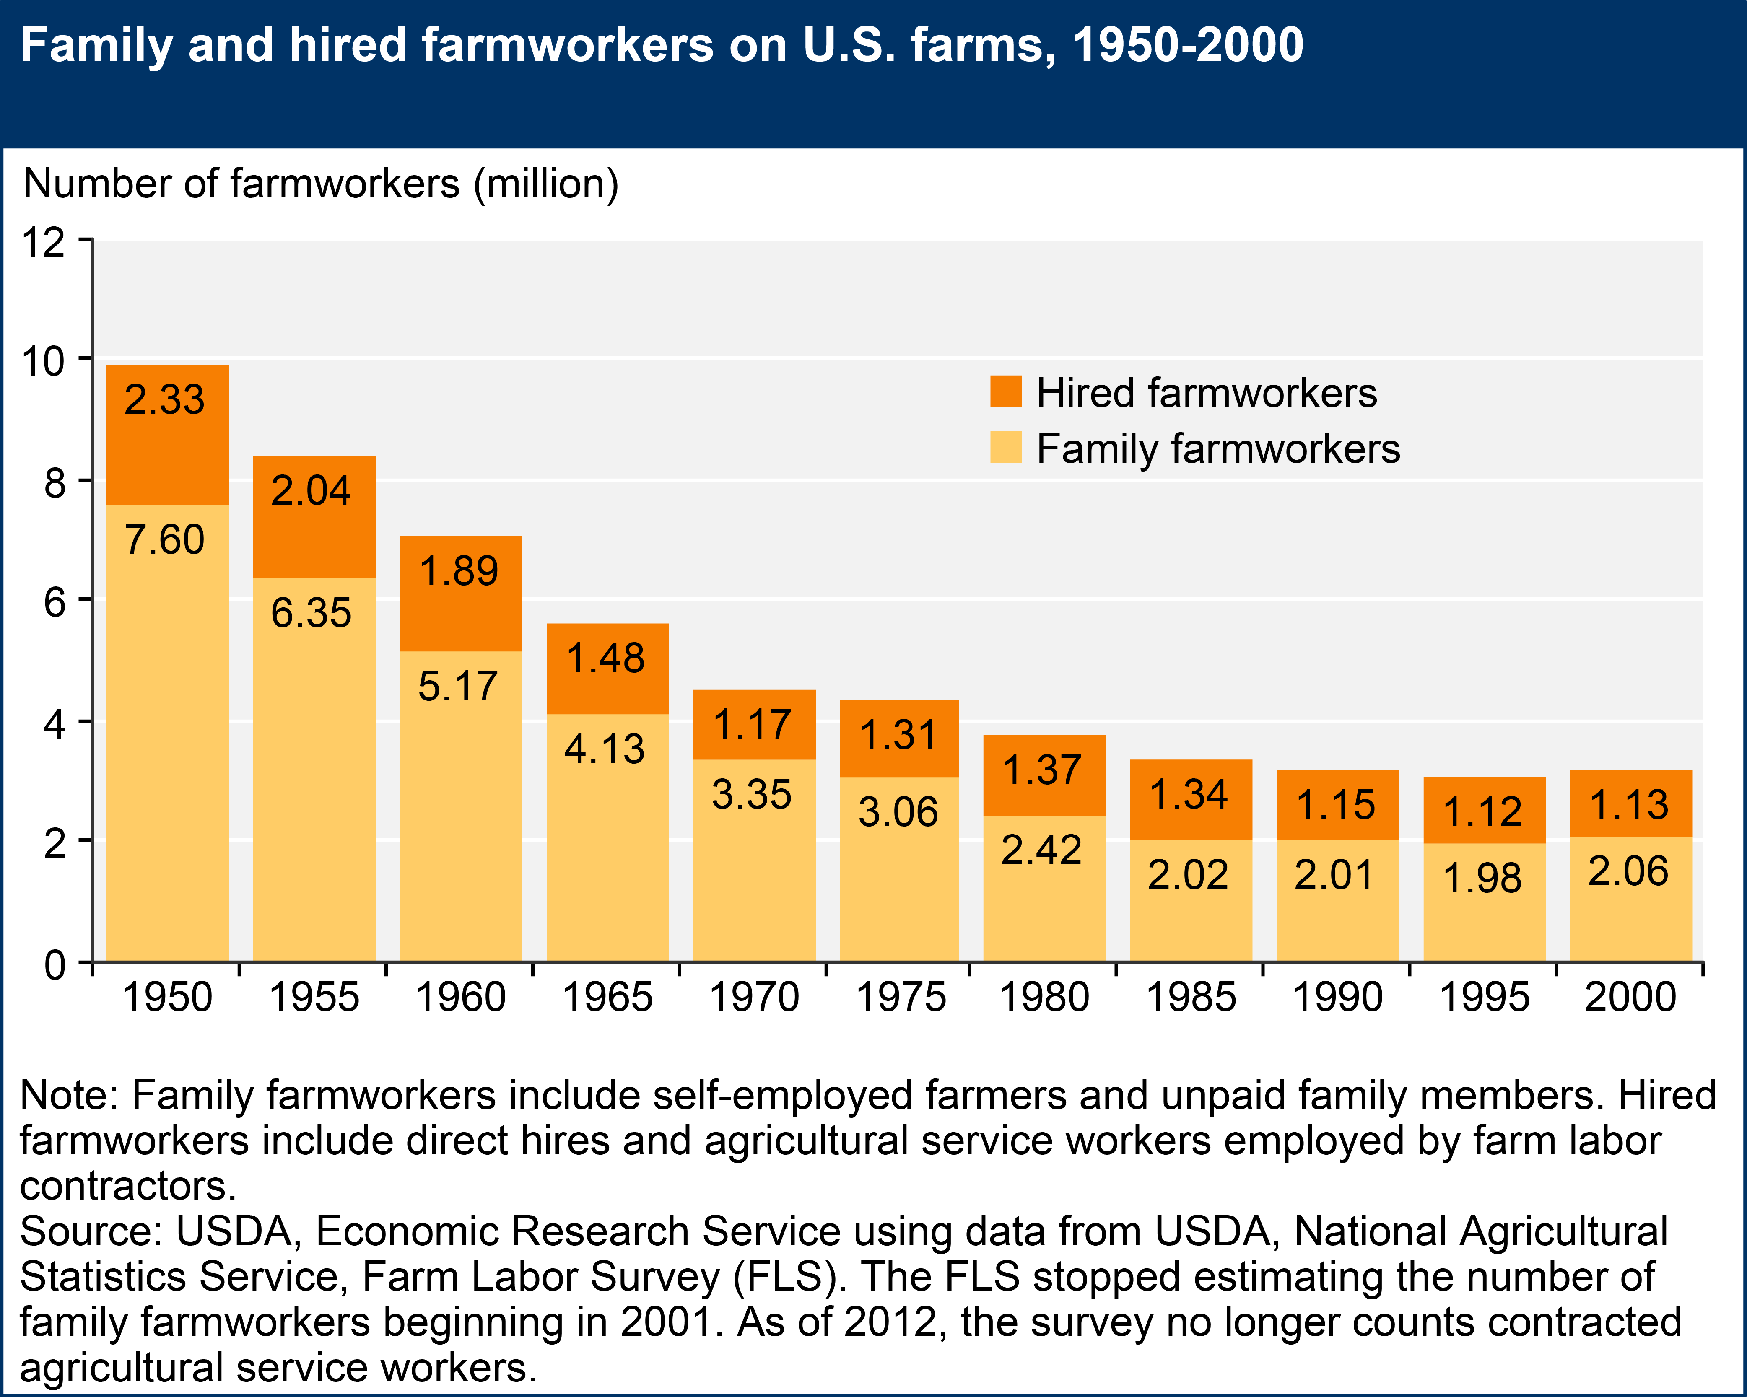

Slide 6
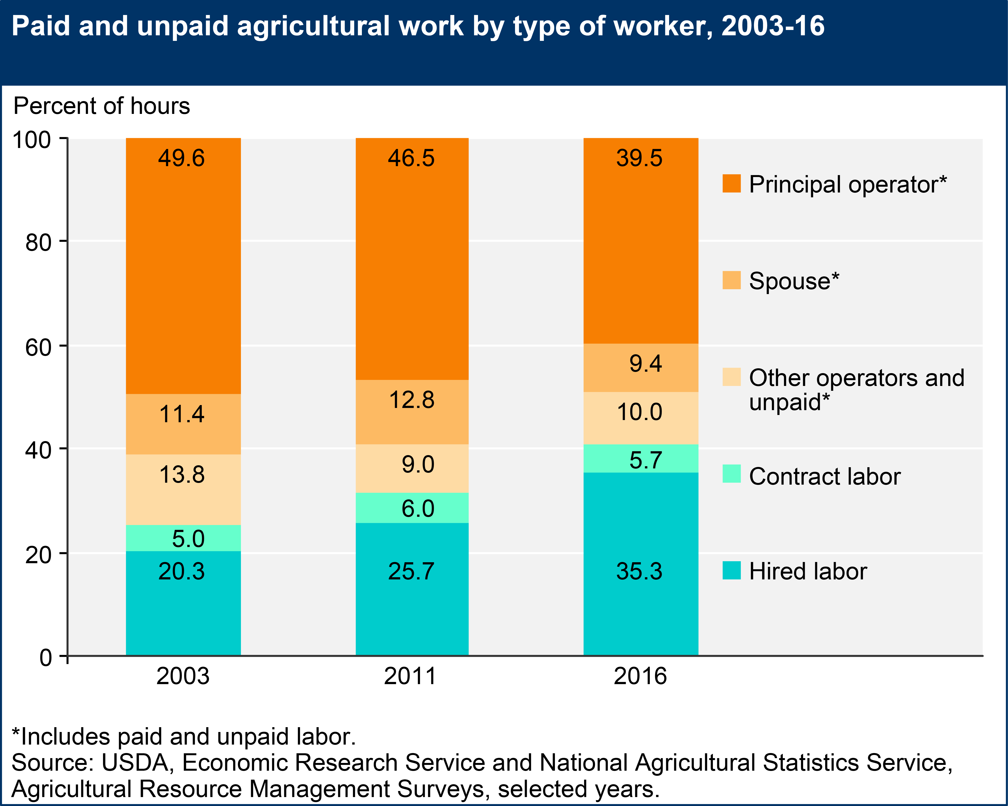

Slide 7
Wage Trends

Slide 8
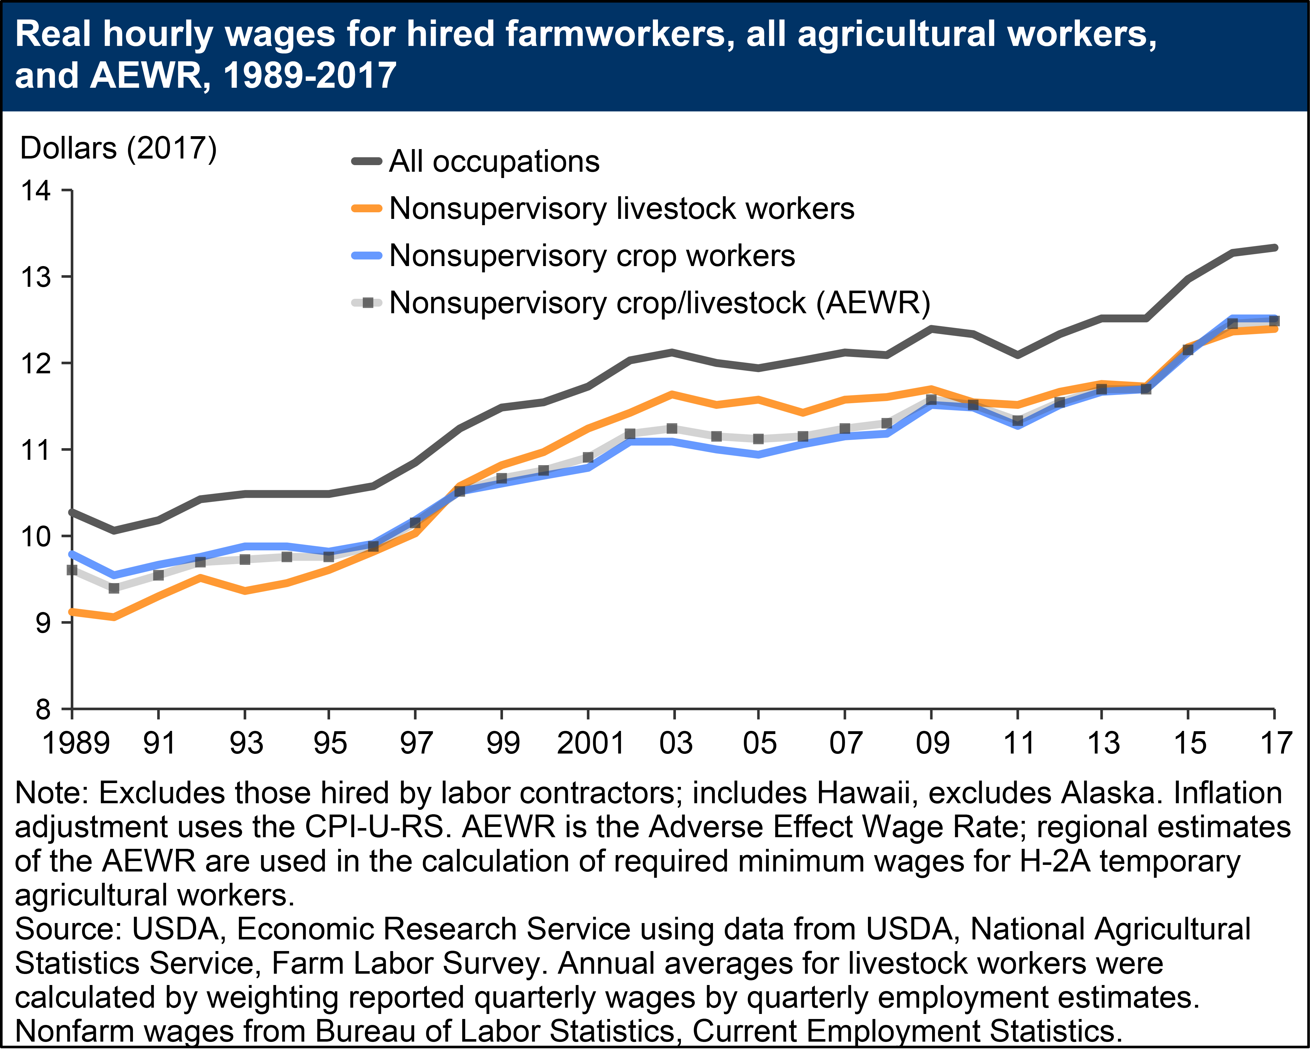

Slide 9
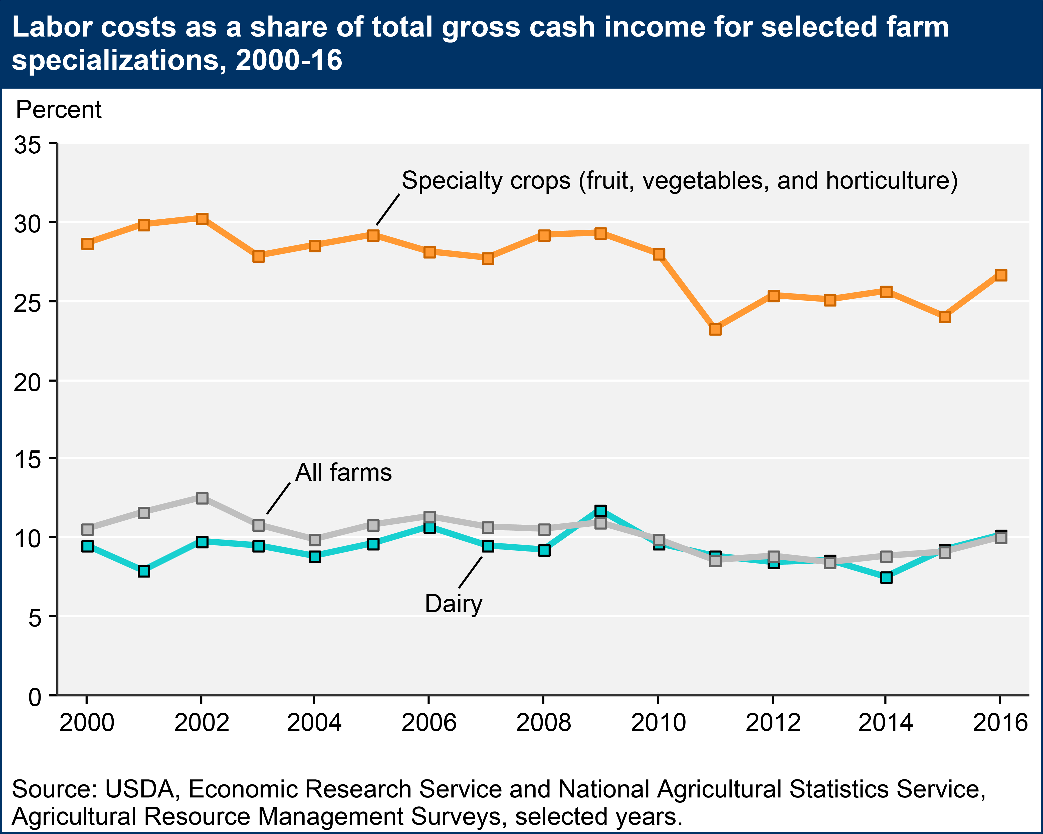

Slide 10
Demographics

Slide 11
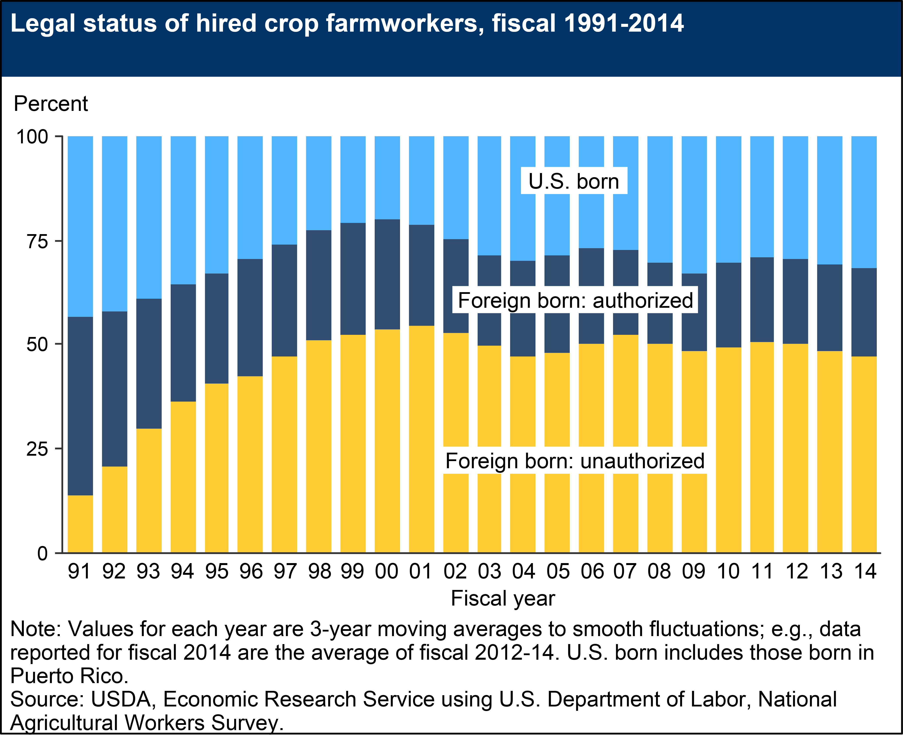

Slide 12
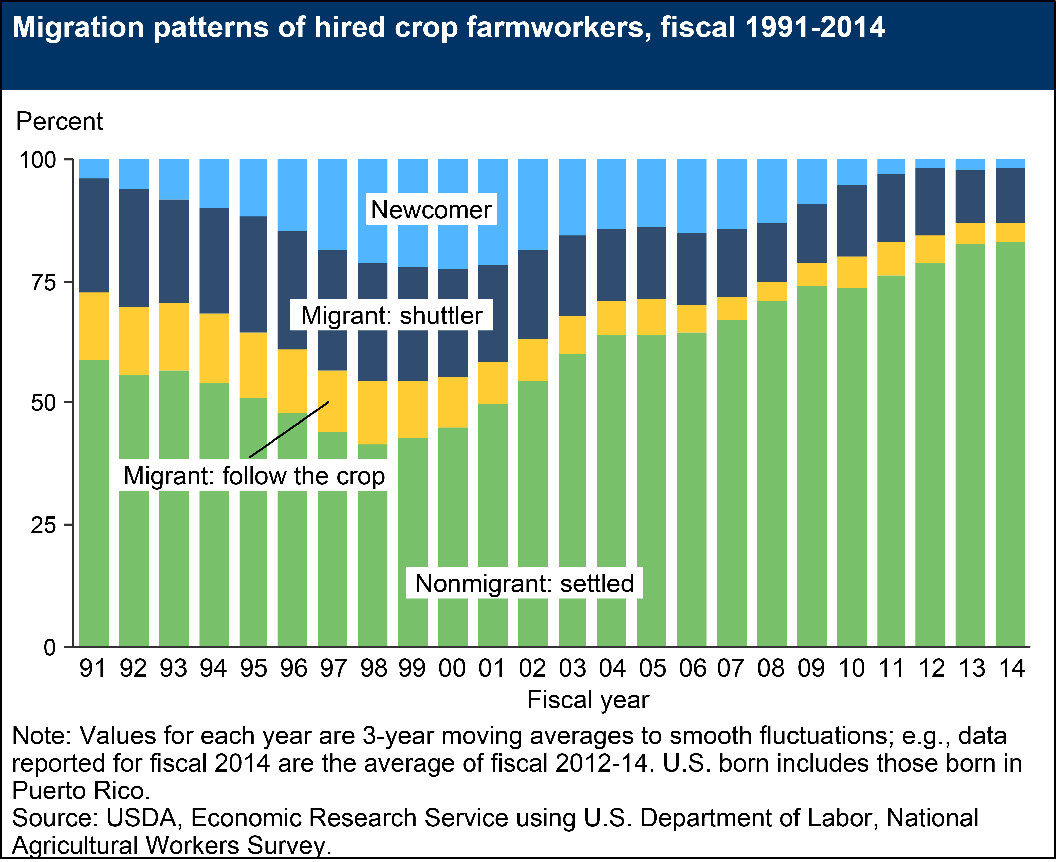

Slide 13
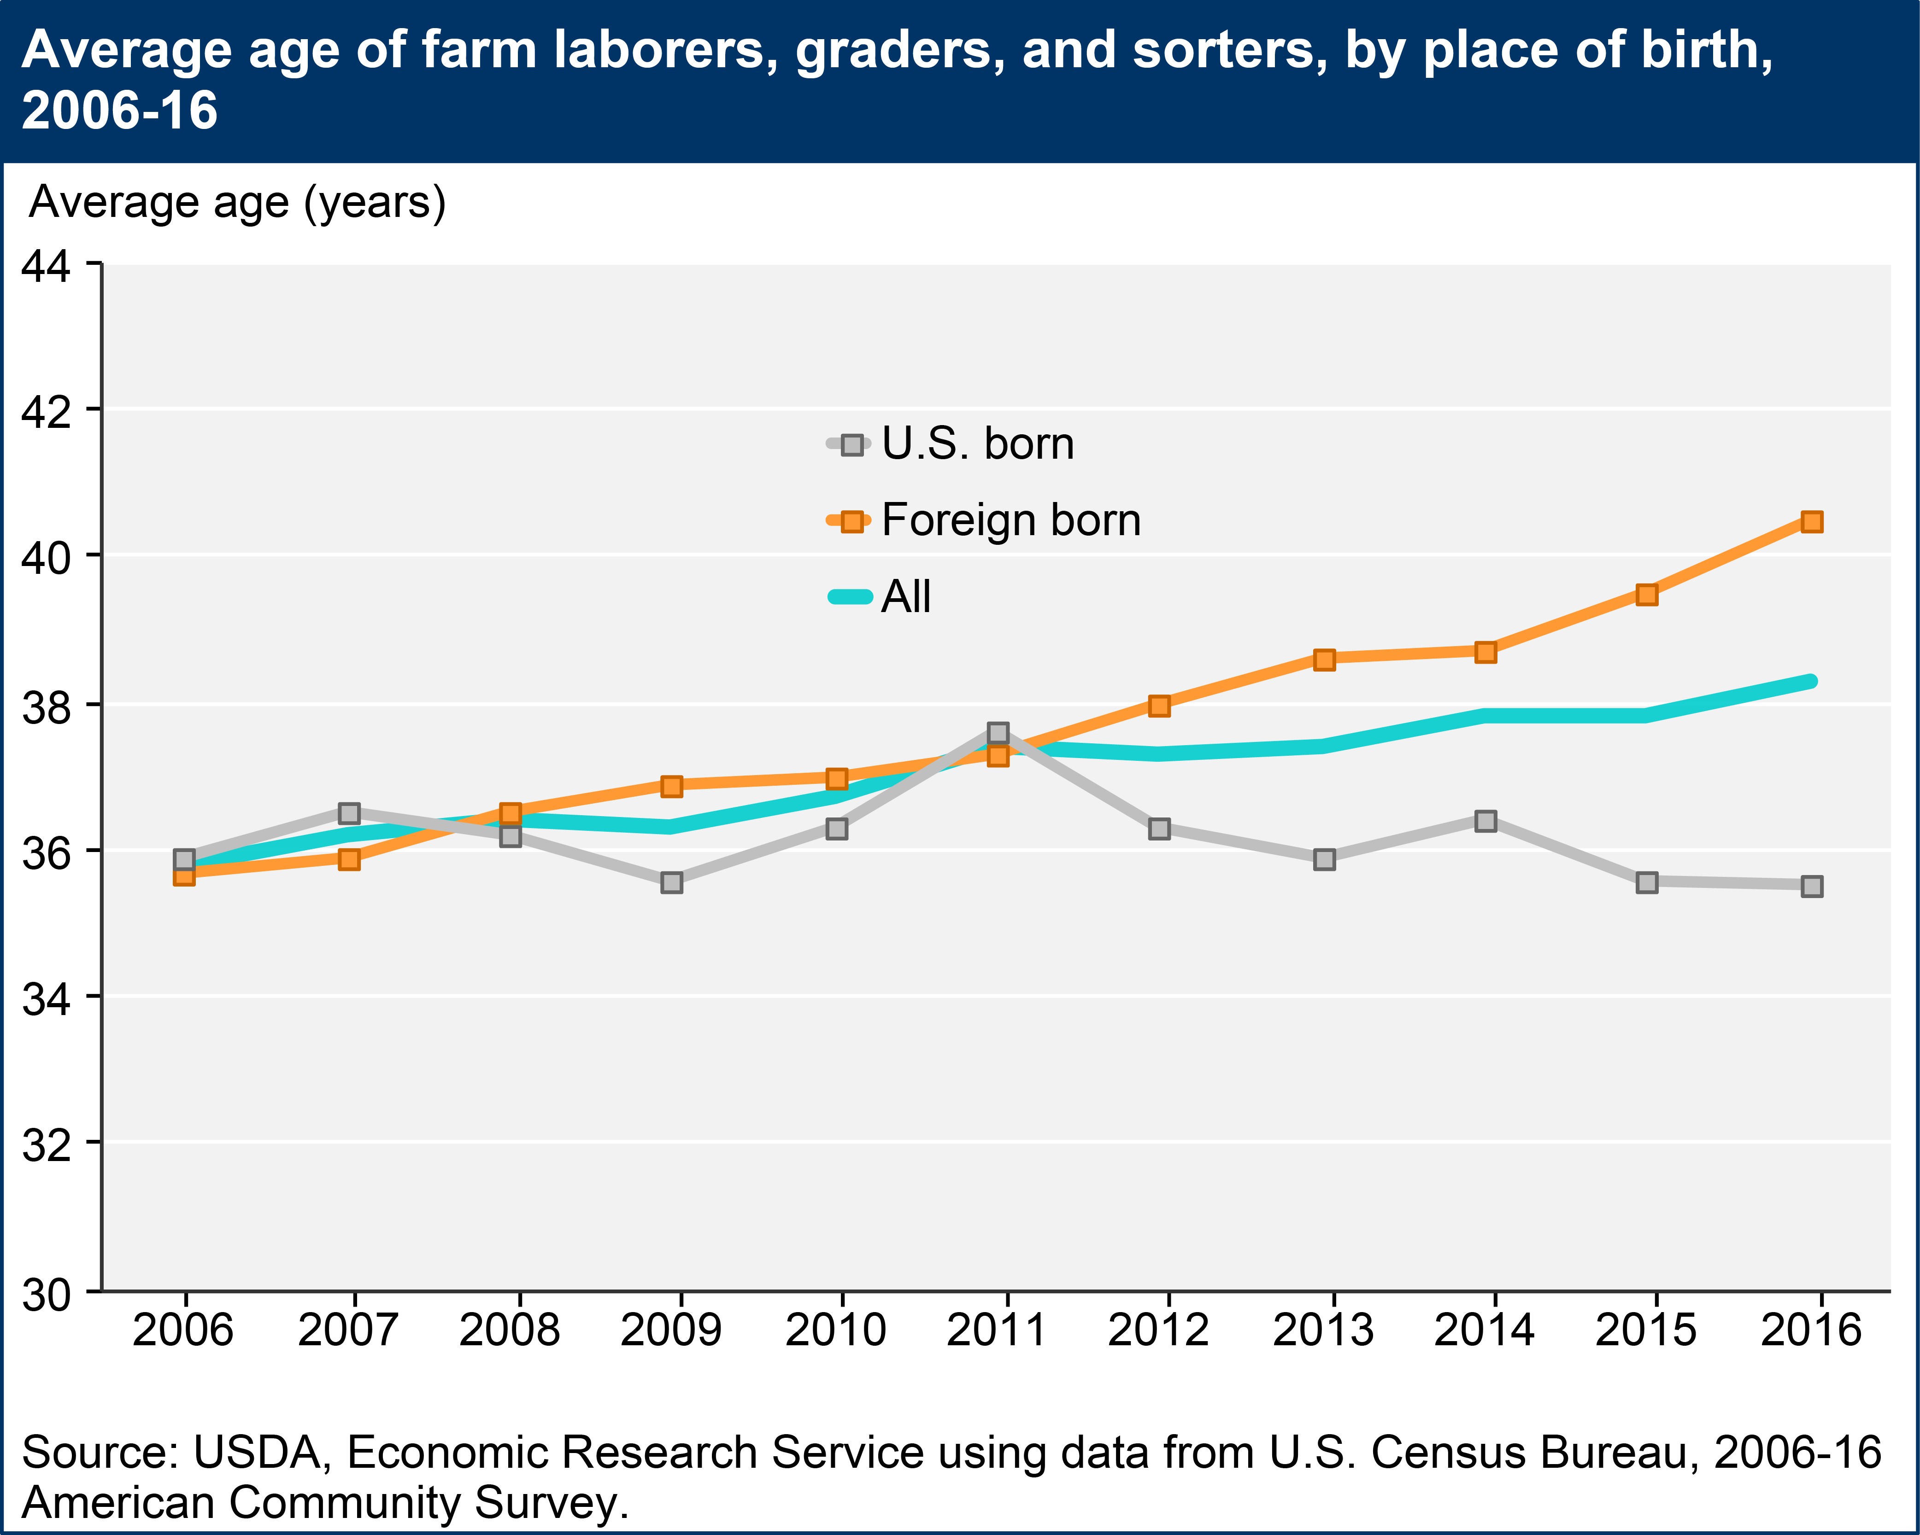

Slide 14
Transition to H-2A

Slide 15
What is H-2A?
Temporary, legal, agricultural “guest” workers from outside the US
Can only fill positions that employers are not able to fill with legal, domestic workers
Considerable bureaucracy and costs

Slide 16
Why H-2A?
Make up for worker “shortage”
Legal
Reliable
Productive

Slide 17
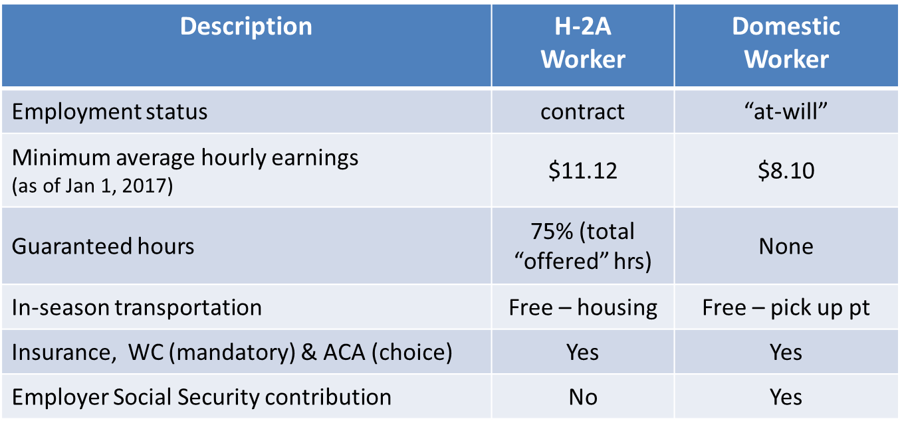
H-2A vs Domestic

Slide 18
Program Growth

Slide 20
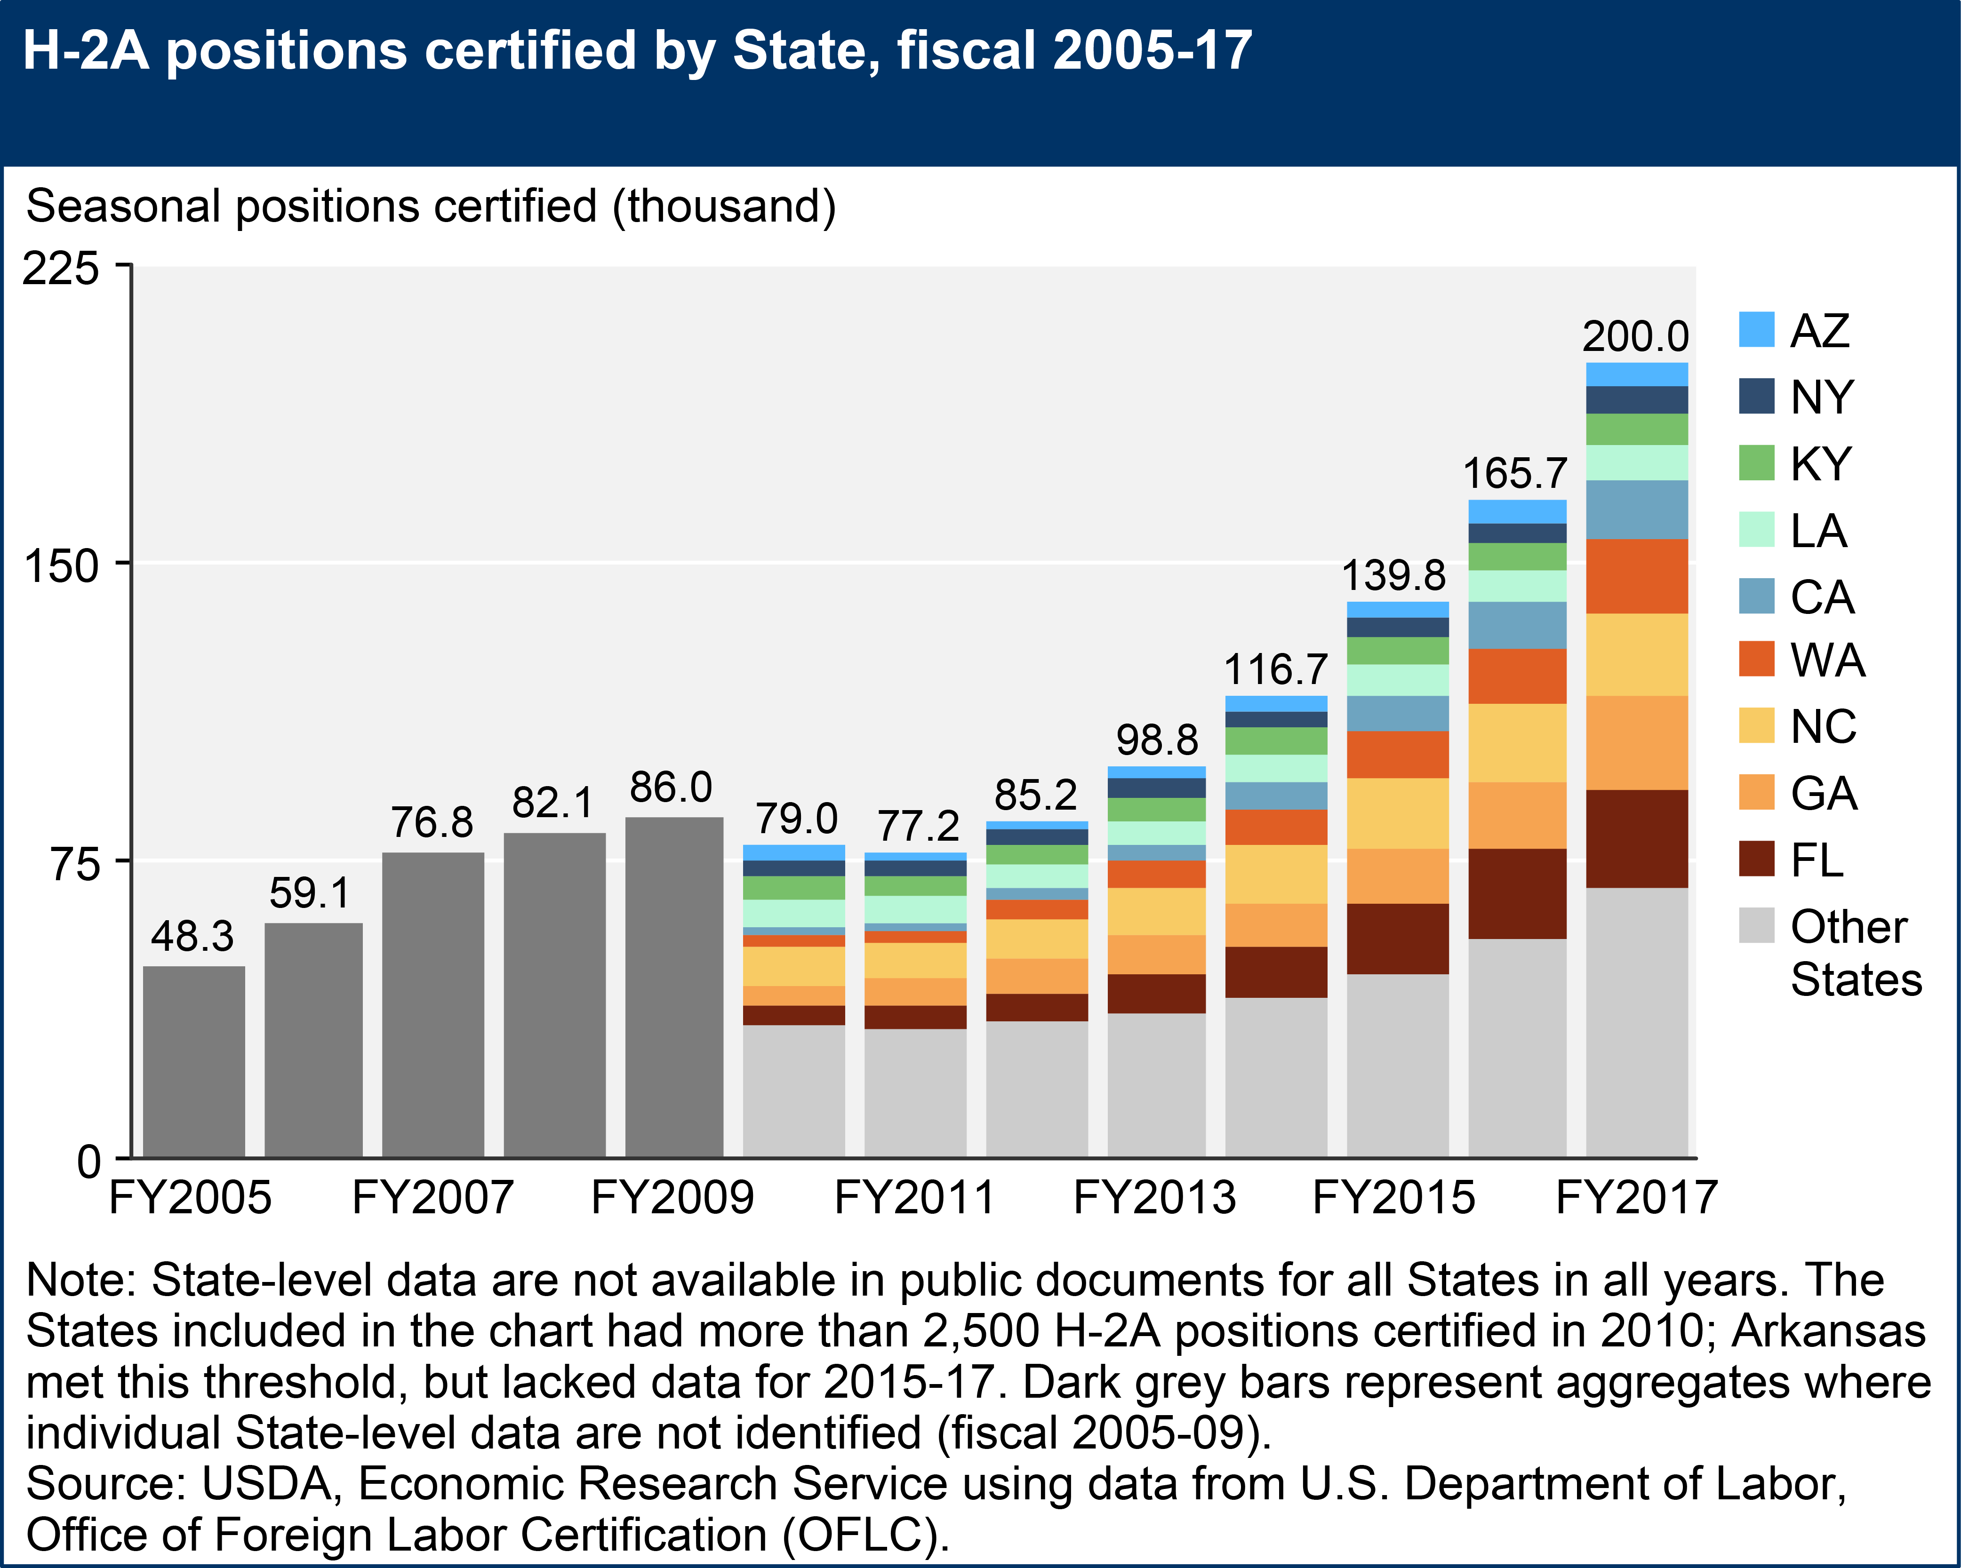

Slide 21
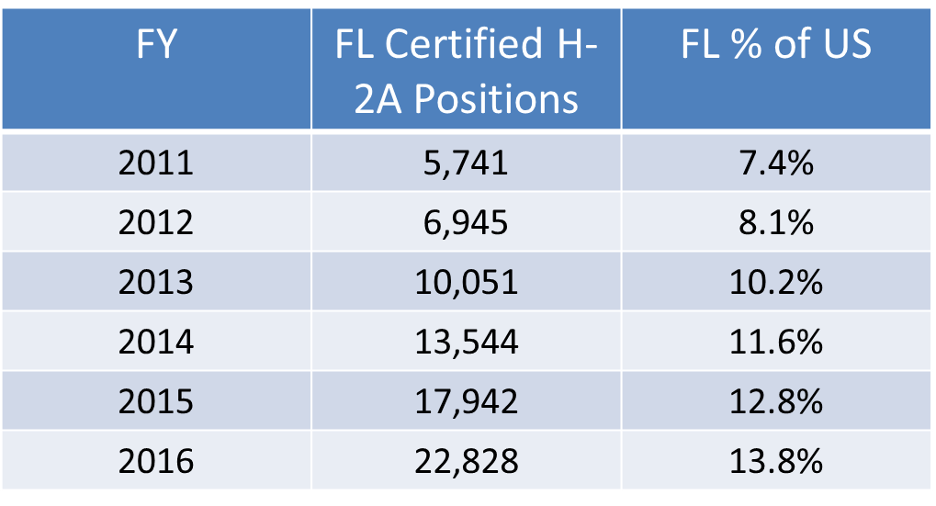
Florida #1 H-2A Employer

Slide 22
Policy Considerations

Slide 23
General Observations
Stricter enforcement
  Fewer workers available
  Increasing wages
Ag & Legal Workforce Act of 2018
  H-2C potentially replace H-2A

Slide 24
H-2A vs H-2C
 | H-2A | H-2C
Minimum wage (Florida, Jan 2018) | AEWR ($11.29/hr) | 115% of federal min wage ($8.34/hr)
Bureaucracy | US DOL | USDA (?)
Housing required | Yes | No (?)
Litigation | Yes | Mediation/ Binding arbitration
Eligible ag-jobs | Seasonal production (limited to specialty crops) | Year round production Expanded: Forestry, fisheries, dairy, packing houses, and meat processing
Unauthorized domestic farmworkers | Not eligible if previously deported. | Eligible to participate

Slide 25
H-2A vs H-2C
 | H-2A | H-2C
Annual Quota | none | 450,000 (40,000 for meat packing)
“At-will” opportunities | none | YES after initial contract completed.
Max contract | <10 mos | 18 mos seasonal jobs (36 mos year-round jobs)
*All H-2C predictions are tentative and subject to change. This table is not meant to be interpreted as a final set of provisions.

Slide 26
Questions?

Slide 27


Connect. Explore. Engage.
Food and Resource Economic Department (FRED)
/fred.ifas.ufl
@UF_IFAS_FRED

