Slide 1
SRMEC Program Update 2018 Southern Outlook Conference Atlanta, Georgia
Ronald Rainey
Director
Southern Risk Management Education Center
University of Arkansas
Website: http://srmec.uaex.edu/
Email: srmec@uaex.edu

Slide 2
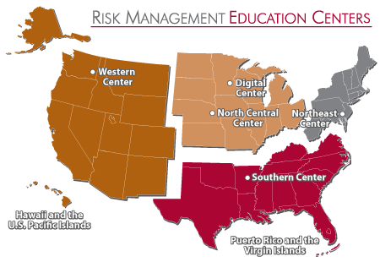
http://extensionrme.org

Slide 3
http://srmec.uaex.edu

Slide 4
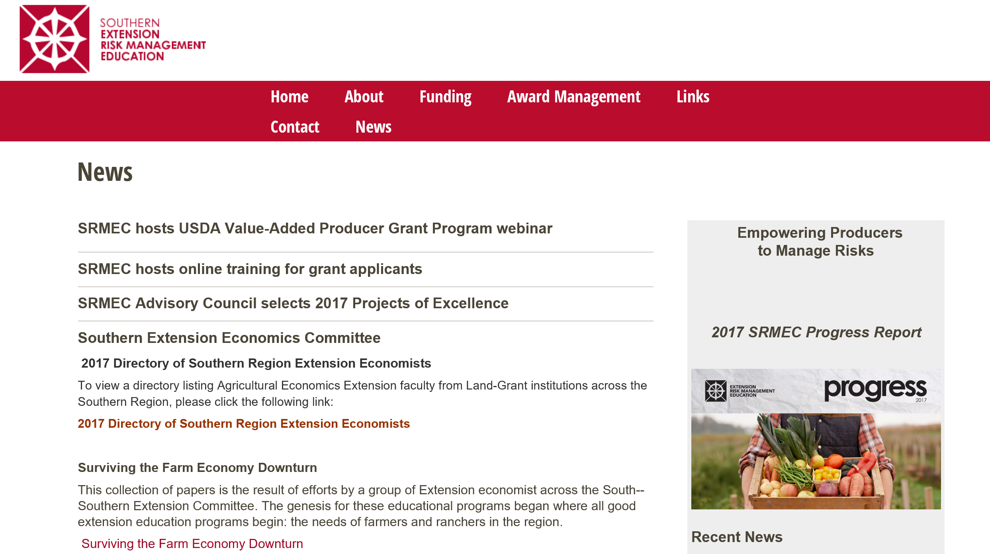

Slide 5
SRMEC RFA
RFA Released: SRMEC RFA was released on Monday, Sept. 17th.
Proposals due Nov. 15th, 2018 5:00 p.m. CST
Educational Project (18-month project), maximum award $50,000. Traditional educational outreach project that educates producers in managing risks.
Exploratory project, capped at $5,000: This category supports small exploratory project awards for up to $5,000 for planning, development, or piloting efforts.
Performance Period: April 1, 2019 – Sept. 30, 2020.
Applicant Webinar will be held Oct. 9th, 10:00a.m.

Slide 6
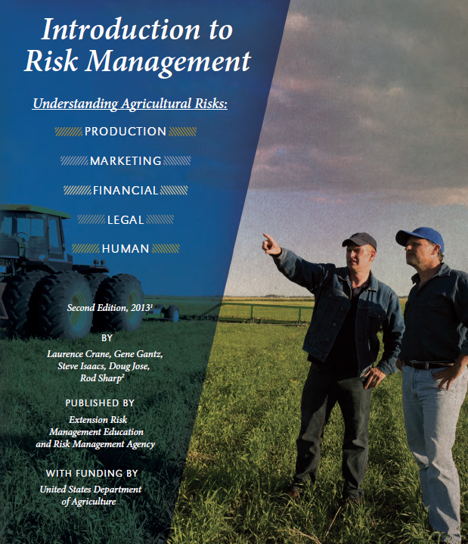
Risk Management Education Areas
Production
Marketing
Financial
Legal
Human

Slide 7
ERME Funded Project Focus: 2002-17
Since 2002, ERME has funded over 9oo projects with at least one project being funded in every state/territory of U.S.

Slide 8
Why Risk Management Education
ERME’s five risk areas give farmers and ranchers a process to seek technical assistance, identify resources and make informed decisions.
ERME Aspirational Goals: Enhance farm and ranch operations and profitability by successfully managing agricultural risks.

Slide 9
ERME Aspirational Goals
PRODUCTION: Enhance understanding of yield variability, insurance products, technology, diversification and management systems to control costs and improve farm or ranch income.
MARKETING: Improve producer understanding and use of commodity price risk management, product (niche) marketing strategies, differentiated (branding) marketing focus and relationship marketing to enhance farm or ranch viability.

Slide 10
ERME Aspirational Goals
FINANCE: Grow farmer and rancher capacity to address strategic business planning, production cost management, recordkeeping analysis, asset management and financial planning to enhance cash flow, profitability and financial performance.
LEGAL: Cultivate farmer and rancher ability to address business organization, contracts, regulatory policies and liability issues to manage businesses’ legal risk exposure.

Slide 11
ERME Aspirational Goals
HUMAN: Develop farmer and rancher understanding of employee recruitment, retention and management; internal and external business communication; business transition and farm safety systems to improve business and worker success.

Slide 12
ERME Aligning with USDA Goals
Maximize the ability of American agricultural producers to prosper by feeding and clothing the world.
Facilitate rural prosperity and economic development.
Strengthen the stewardship of private lands through technology and research.
Provide all Americans access to a safe, nutritious and secure food supply.

Slide 13
SRMEC Priorities
Each project should have a plan for capturing measurable qualitative and quantitative economic effects and/or behavioral changes related to risk management. Projects with detailed evaluation plans that capture higher level producer impacts (i.e. implement versus understand across the ERME spectrum of producer actions) are ranked relatively higher.

Slide 14
Proposed Results & Producer Actions
Five levels of producer actions in order of increasing producer engagement:
Understand
Analyze
Develop
Decide
Implement
Knowledge
Short Term
Actions
Intermediate
Conditions
Long Term

Slide 15
SRMEC Regional Priorities
Develop and deliver programs and decision tools to help producers evaluate and implement a transition to new enterprises or production systems, including enterprise budgets to evaluate niche markets for specialty crops or livestock.
Teach producers to develop and implement marketing strategies using appropriate tools such as futures and options, crop insurance, contracts, direct marketing, social media, etc.
Train producers to understand and implement Food Safety Modernization Act (FSMA) compliance & Good Agricultural Practices (GAP) certification for small and/or family farms.

Slide 16
SRMEC Regional Priorities
Develop and deliver programs to help producers attract, train, and retain employees.
Aid producers in avoiding, diagnosing, and managing financial stress, including financial stress testing, maintaining access to capital, and accessing personal & family counseling services.
Create programs and tools to aid producers in water management decisions related to legislation and regulatory policy, water quality and quantity, and changing weather patterns.

Slide 17
SRMEC Regional Priorities
Educate producers to implement effective, safe, legal, and sustainable use of integrated pest (insect, disease, weeds) management systems.
Assist producers in managing legal risk including contracts, leasing, labor, liability, and direct marketing regulatory compliance.
Create programs targeting underserved producers with education and information on the full scope of USDA agricultural programs as well as public and private sources of capital and agricultural technology.

Slide 18
Extension Risk Management Education
Mission: Educating America’s farmers and ranchers to manage the unique risks of producing food for the world’s table.
“Investing in Producer Results!”
“Empower Producers to Manage Risk!” (Southern)

Slide 19
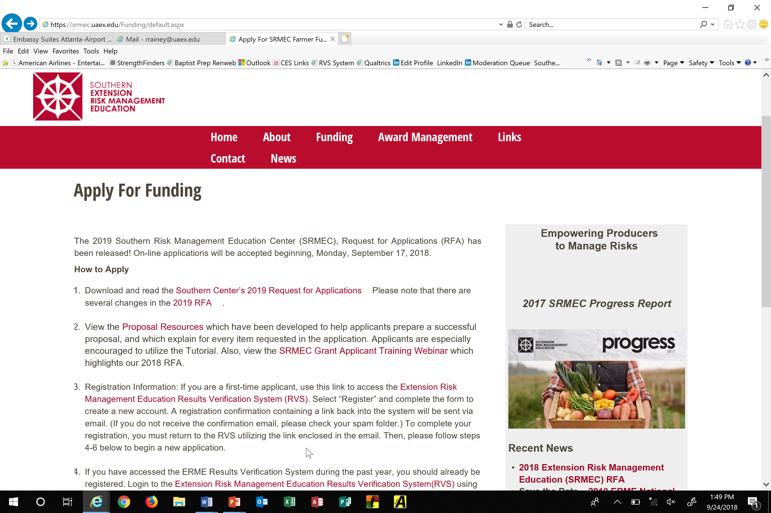

Slide 21
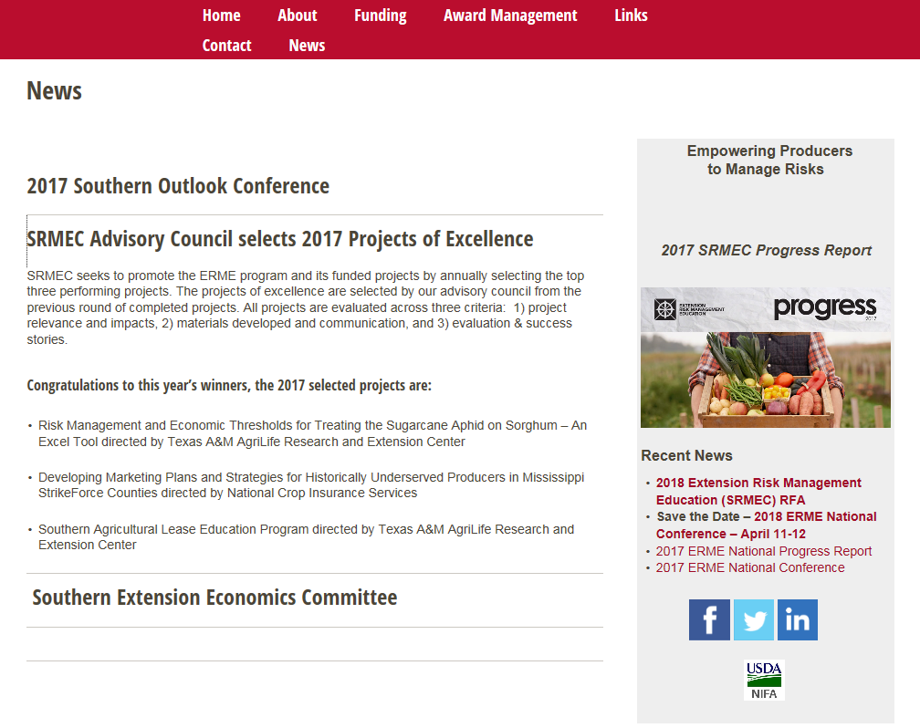

Slide 22
QUESTIONS

