Slide 1
Ag Lending Outlook Southern Outlook Conference
Greg Beachy, VP Enterprise Risk Management
Farm Credit Mid-America
September 24, 2018

Slide 2
Farm Credit Mid-America
Headquartered in Louisville, KY
Indiana, Ohio, Kentucky, Tennessee
$22.5 billion Assets
86,000 Customers
133,000 Loans
Finance 50+ industries

Slide 3
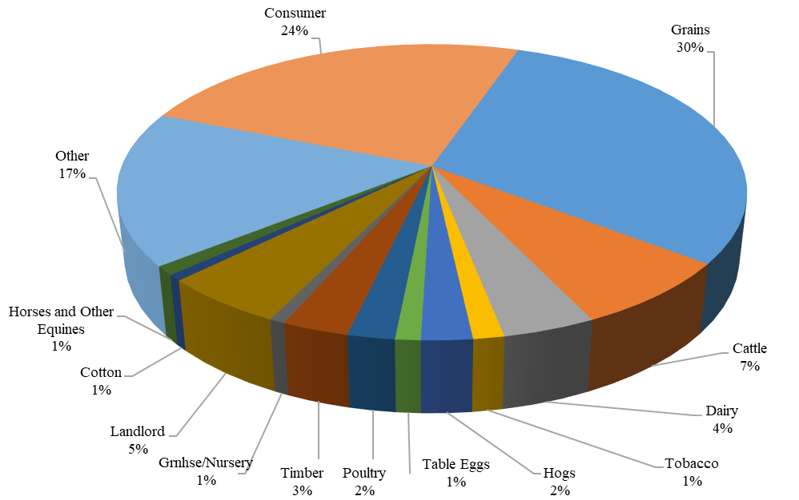
Farm Credit Mid-America (5/31/18)

Slide 4
Farm Debt Market Share

Slide 5
Cropland Value/Acre

Slide 6
Cropland Value/Acre
+105%
+59%
+70%

Slide 7
U.S. Farm Assets

Slide 8
U.S. Farm Debt

Slide 10
U.S. Farm Sector Working Capital

Slide 11
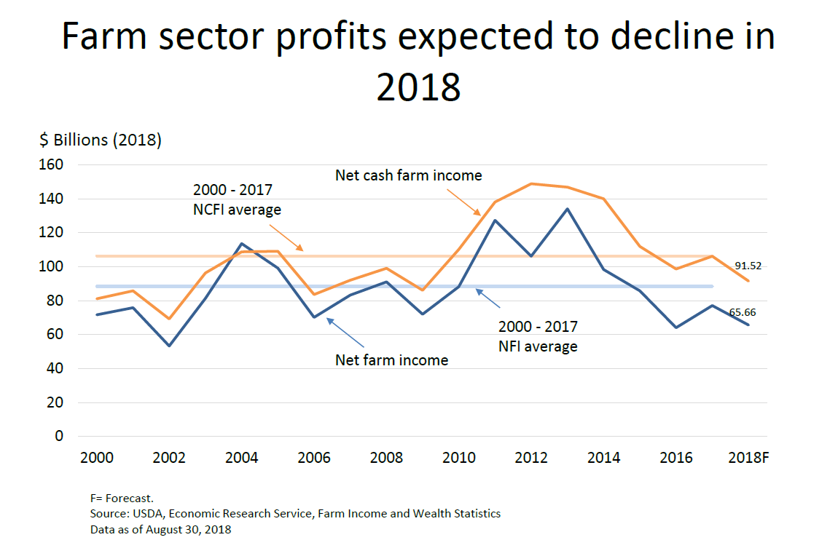

Slide 13
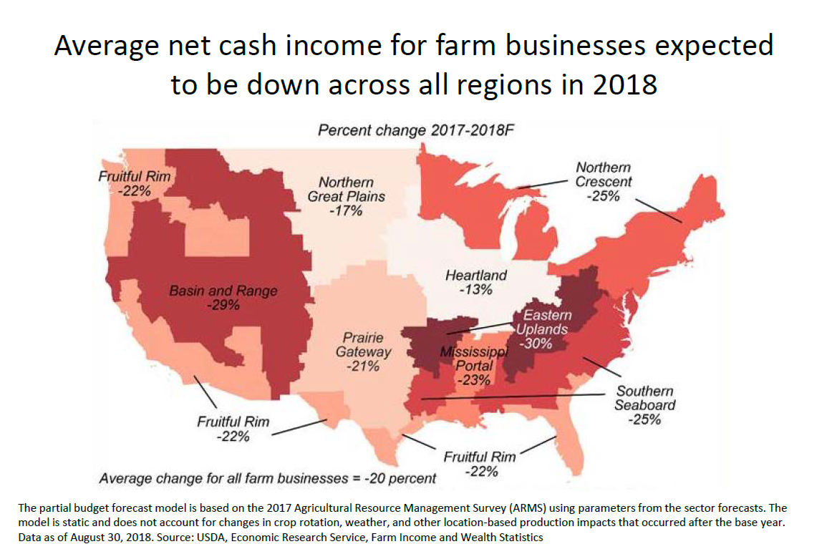

Slide 14
Delinquency Rates on Ag Loans (Commercial Banks)

Slide 15
Charge-Offs on Ag Loans (Commercial Banks)

Slide 16
Economic Summary
In June, the FOMC moved the Federal Funds Rate to a range of 1.75% to 2.00%
The outlook for Fed Funds is 28bps higher than a year ago while the 10yr T-Bond is 11bps higher.
2018 Federal Reserve FOMC Meeting Schedule |  | Fed Funds Action / BoY Forecast
January | 30-31 | No action/98% no action-150bps
March | 20-21 | Raised to 175bps/74% at 175bps
May | 1-2 | No action/74% increase - 175bps
June | 12-13 | Raised to 200bps/53% at 200bps
July/August | 31-1 | No action/57% increase - 200bps
September | 25-26 | 76% increase to 200bps
November | 7-8 | 77% increase to 200bps
December | 18-19 | 51% increase to 225bps

Slide 17
Probability of FOMC Rate Increase
As of September 18, 2018
Source: http://www.cmegroup.com/trading/interest-rates/countdown-to-fomc.html

Slide 18
Probability of FOMC Rate Increase
As of September 18, 2018
Source: http://www.cmegroup.com/trading/interest-rates/countdown-to-fomc.html

Slide 19
Importance of Poultry
Broilers #1 farm cash receipts of 8 states represented in this conference.
Top 5 farm cash receipts in another 3 states.
$24 billion in farm cash receipts of all states represented in this conference.
FCMA finances contract growers with 30+ different integrators.
$300+ million in contract grower loans.

Slide 20
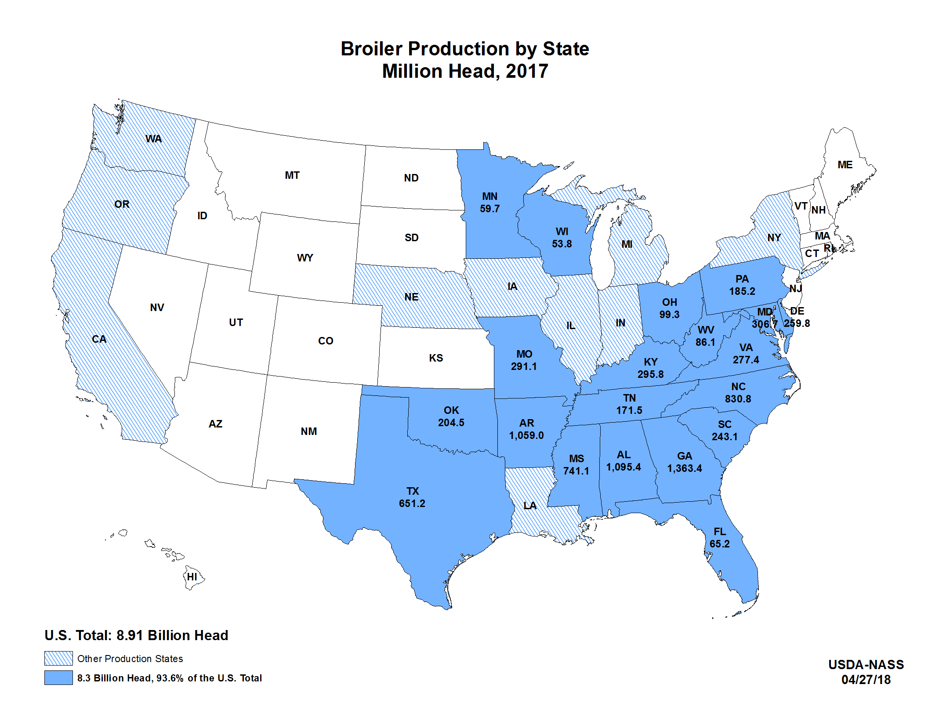

Slide 21
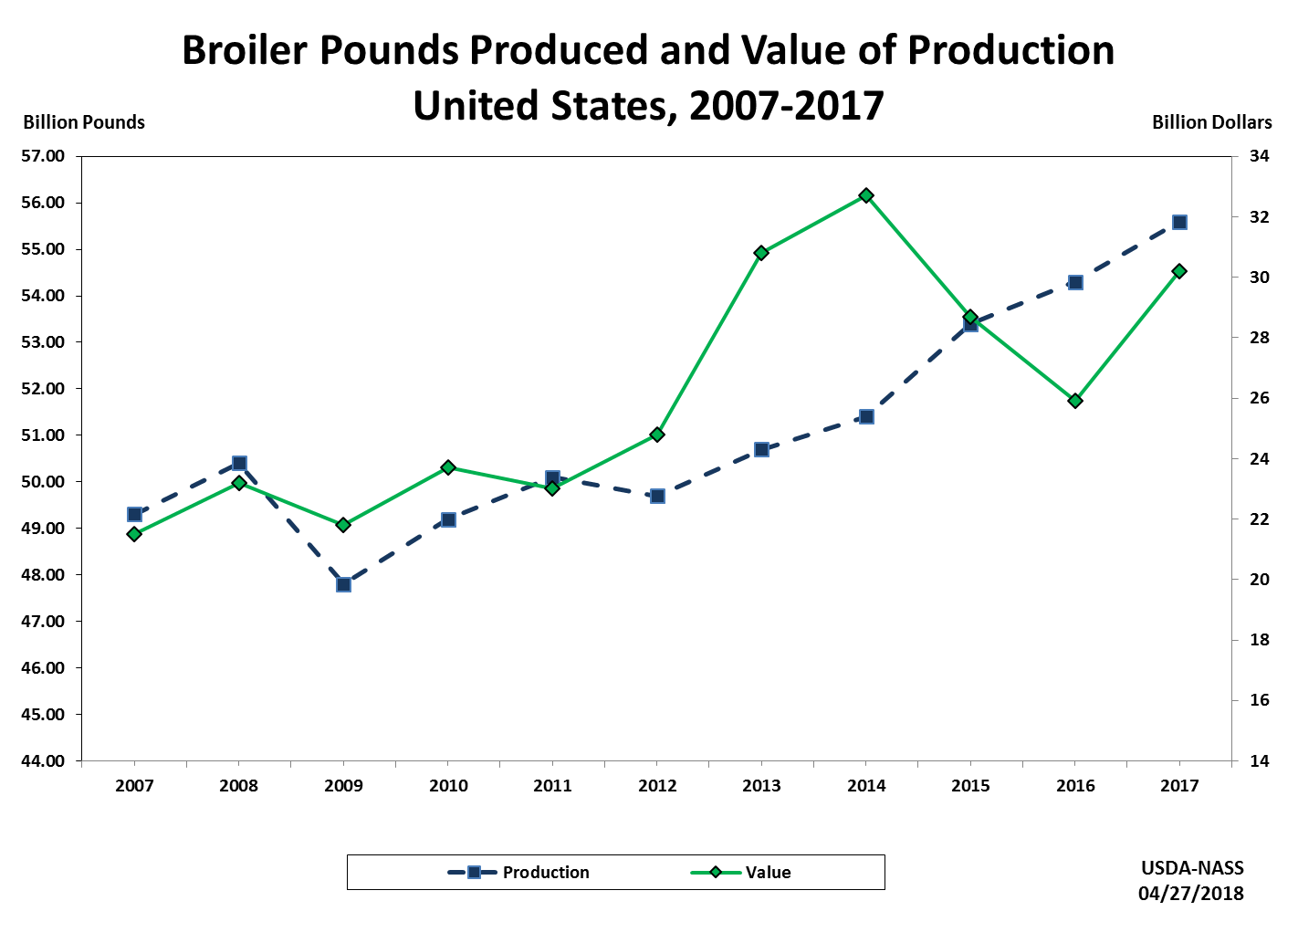

Slide 22
Integrator Counter Party Risk

Slide 23
Final Thought
“Agriculture is our wisest pursuit, because it will in the end contribute most to real wealth, good morals, and happiness.”
--Thomas Jefferson

Slide 24
Questions?

