Slide 1
Southern Timber Industry Situation and Outlook
Yanshu Li
Warnell School of Forestry & Natural Resources
University of Georgia
Yanshu.li@uga.edu

Slide 2
Outline
Major timber products
Forest resources condition
Demand
Timber market prices
Timber market outlook

Slide 3

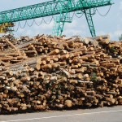

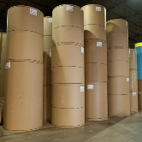
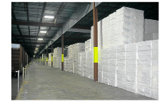



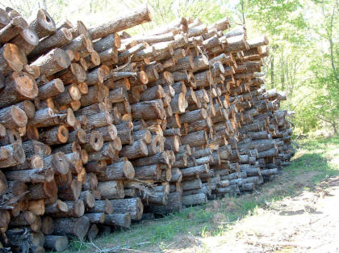



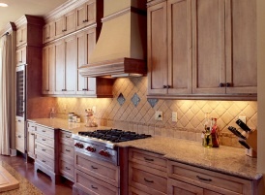

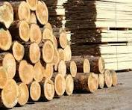
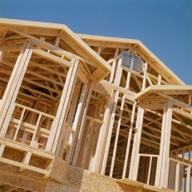
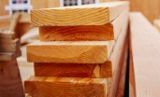
Major timber products
Pulpwood
Paper, paperboard products
Softwood
Wood panels
CNS
Hardwood
Sawlog & veneer log
Lumber

Slide 4
U.S. South is the “wood basket” of the country…
Source: USFS FIA & TPO

Slide 5
and the world
Source: USFS FIA & TPO, FAO

Slide 6
If U.S. South were a country…
No. 1 producer of industrial roundwood
No. 1 producer of pulpwood roundwood
No. 3 producer of sawlog and veneer logs after Canada and Russia

Slide 7
Area of timberland by forest type

Slide 8
Area of timberland by ownership
Source: USFS FIA

Slide 9
Southern industrial roundwood harvest has been recovering, mostly in pulpwood
40%
Source: USFS TPO

Slide 10
In Georgia, total industrial roundwood harvest back to pre-recession level but sawlogs still 18% below 2005 level
Source: USFS FIA, GFC

Slide 11
We are growing more than we cut
1.71 (South total)
1.74
Growth/removal ratio
1.85
1.91
1.63
1.35
1.39
1.98
1.77
Source: USFS FIA

Slide 12
We are growing more than we cut
1.65
1.84
Source: USFS FIA

Slide 13
Growing stock has been accumulated, especially in sawtimber class

Slide 14
Summary of forest resources in U.S. South
Sizeable timberland
The majority of timberland is privately owned
Abundant timber resources, highly sustainable
The recent recession has led to accumulation of sawtimber on the stump

Slide 15

Derived demand from end products
Pulpwood
Paper, paperboard products
Wood panels
CNS
Sawlog & veneer log
Lumber

Slide 16
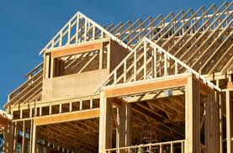
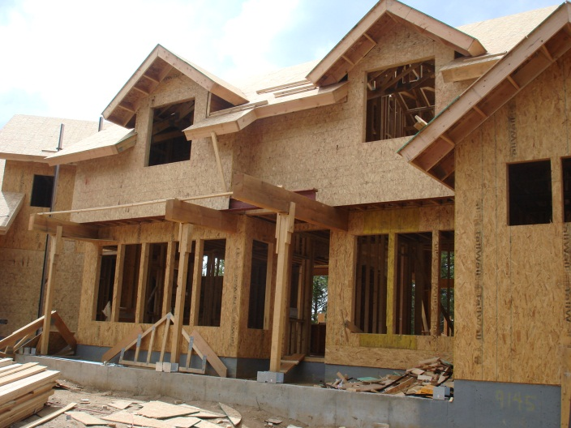
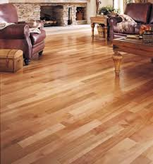
About two-thirds of U.S. lumber and wood structural panels are used in house construction/remodeling, so lumber and panel markets follow housing starts.
Wood industry is among the hardest hit during the recession

Slide 17


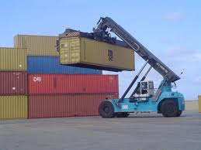
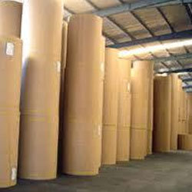
Paperboard demand is more associated with general economy and industrial production.

Slide 18
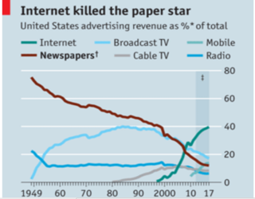

Restructuring in the pulp and paper industry
Demand for graphic paper (newsprint and printing paper) has decreased due to growing digital media usage and increased environmental awareness among consumers
Demand for paperboard products has increased as e-commerce gains popularity
Source: The Economist

Slide 19
Lumber production has increased as housing market recovers, but at a slower rate
11.3%/year

Slide 20
Why lumber production grows slower?
Housing start grew mostly in multi-family
Substitution from other materials
Substitution from Canadian lumber

Slide 21
Lumber production has increased as repair and remodeling expenditure rises
Homeowner repair and remodeling expenditure
US softwood lumber production
US South sfwd lumber production
Source: Random Length, WWPA, Harvard Joint Center for Housing Studies

Slide 22
Structural panel production has increased gradually with residential construction and repair/modeling
Source: Random Length, APA, Harvard Joint Center for Housing Studies

Slide 23
Lumber and panel prices have improved, recently reaching record-high levels
Data source: US Census, Random Length

Slide 24
But pine sawtimber prices in the South show no response to improved lumber prices
Data source: TMS, Random Length

Slide 25
Pine grade sawmill capacity still well below 2006
Source: Forisk

Slide 26
Paper and paperboard production in the U.S.

Slide 27
Pulpwood prices held up well during the recession and after, slightly trended down over the past year
SE pine pulpwood price
RL structural panel price
Data source: TMS, Random Length

Slide 28
Why pulpwood prices held up well during then and declined now?
Paper and paperboard industry fared better during the recession and recovered sooner
Reduced supply of mill residues from lumber mills due to curtailment or closures
Reduced supply of pulpwood due to reduction in harvest (for sawlogs)
Demand for OSB pushes up pulpwood prices as housing start improves
Emerged demand for energy product (wood pellets, woody biomass for electricity)
As sawmill production resumes, improved supply of mill residues and pulpwood put downward pressure on pulpwood price

Slide 29
Stumpage prices in U.S. South
(nominal price)
Data source: TMS

Slide 30
Observations
Pine sawtimber and CNS prices dropped more than 30% during the recession while pulpwood prices held well
Pine sawtimber prices remain flat despite the recovery in housing market
CNS prices improved but not back to the pre-recession level
Current pulpwood prices are at historical record high
Price spread between sawtimber, CNS and pulpwood narrows

Slide 31
Stumpage prices in U.S. South
(1982 real price)
Pine sawtimber and CNS at historical lows!
Data source: TMS

Slide 32
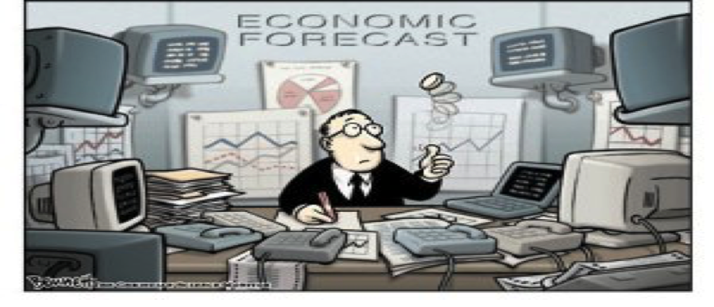
Timber market outlook

Slide 33
Key supply and demand factors affecting timber products prices
Demand
U.S. housing start and residential repairing & remodeling activities are key drivers for the demand for solid wood products
Industrial uses will rise with overall economy trend
Trade policies (e.g. US-Canada Softwood Lumber Agreement)
Demand for paperboard depends on the growth of manufacturing sectors and general economy
Demand from oversea markets
Demand for energy products

Slide 34
Key supply and demand factors affecting timber products prices (con’t.)
Supply
Timber inventory level
Mill capacity and operating rate
Weather condition and local logging capacity
Landowners’ expectations

Slide 35
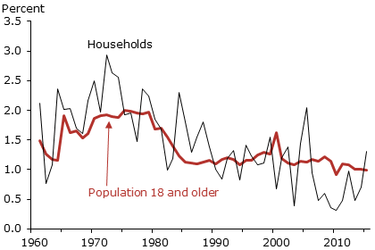
U.S. population grows slowly
Household formation growth has been improving but lower than long-term average
Source: Federal Reserve Bank of San Francisco

Slide 36
US general economy has been improving slowly
Unemployment rate
Source: IMF

Slide 37
Housing starts will continue slow recovery
1.3 million
945,000
Source: Fannie Mae, September 2017

Slide 38
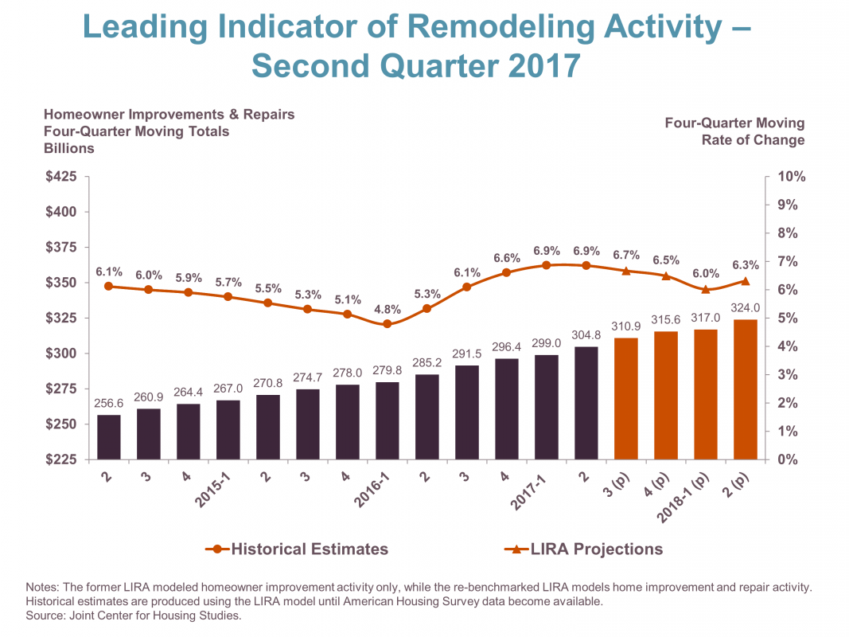
Remodeling and repairs growth might trend down slightly

Slide 39
Industrial production growth rate
Forecast
Source: IMF, Federal Reserve Board

Slide 40
Some other factors to consider
Impacts of Hurricane Harvey and Irma
Impacts of wildfire in BC
Final decision on the U.S.-Canada softwood lumber agreement
Impacts of Brexit on wood pellets export

Slide 41
Summary
Demand for timber products is expect to improve slowly with the recovery of housing market, expansion of repair & remodeling expenditures, and some favorable factors
A large over-supply on the stump will continue to keep sawtimber prices down
Pulpwood prices are expected to remain strong but will feel downward pressure from increased lumber production
It still take years to get to the new norm

