Slide 1
2017-18 Cotton Situation and Outlook
Don Shurley
Cotton Economist/Professor Emeritus of Cotton Economics
Southern Region Outlook Conference
September 25-27, 2017
Atlanta, GA

Slide 2
Recent Past Cotton Economic Factors
Declining Demand
High Stocks– World and China
Declining US Acreage and Production
High stocks were actually irrelevant because the majority was
held in China and the market knew that most of that was not
going into the pipeline. It was China’s stocks policy that was
important, not the stocks number.

Slide 3
The New Dynamics of the Cotton Market
Demand is Improving
China stocks have been reduced
Emergence of new export markets
US has gained market share
Massive stocks had less impact on prices than most imagined
because China reduced area and production, cut imports, and
utilized stocks in their mills– 2 years of very good government
reserve sales.

Slide 4
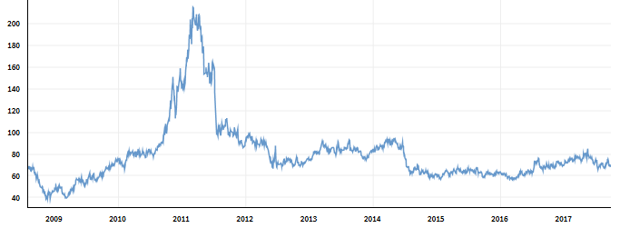
Continuous Nearby Cotton Futures
and US Average Price Received By Crop Marketing Year
2011-12
88.50
2012-13
74.77
2013-14
79.58
2009-10
62.10
2010-11
82.12
2016-17
68.20
2014-15
64.10
2015-16
61.75
2008-09
48.95

Slide 5
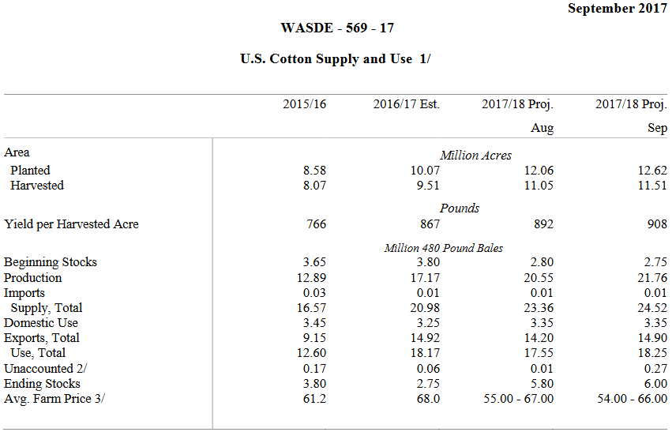

Slide 6
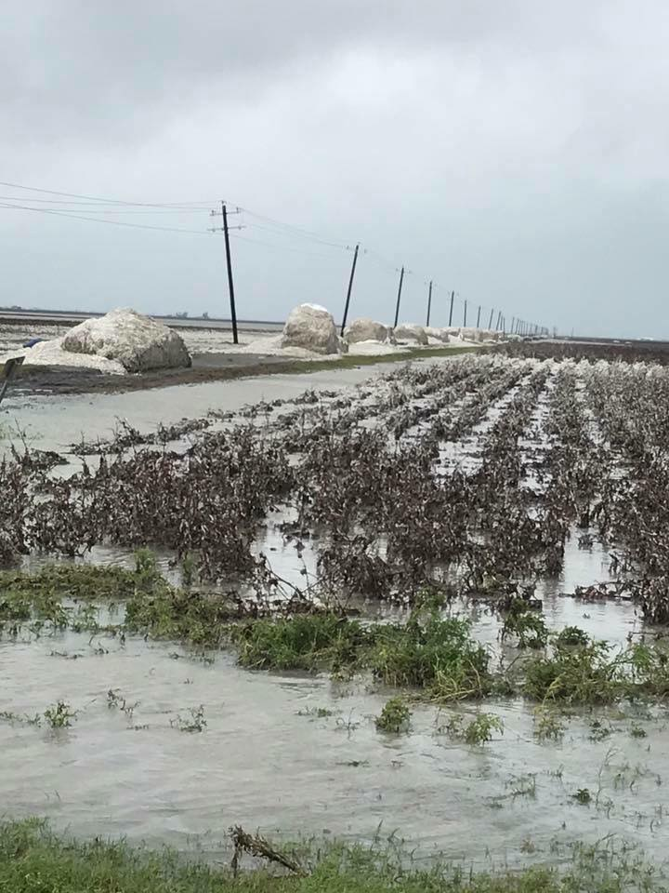
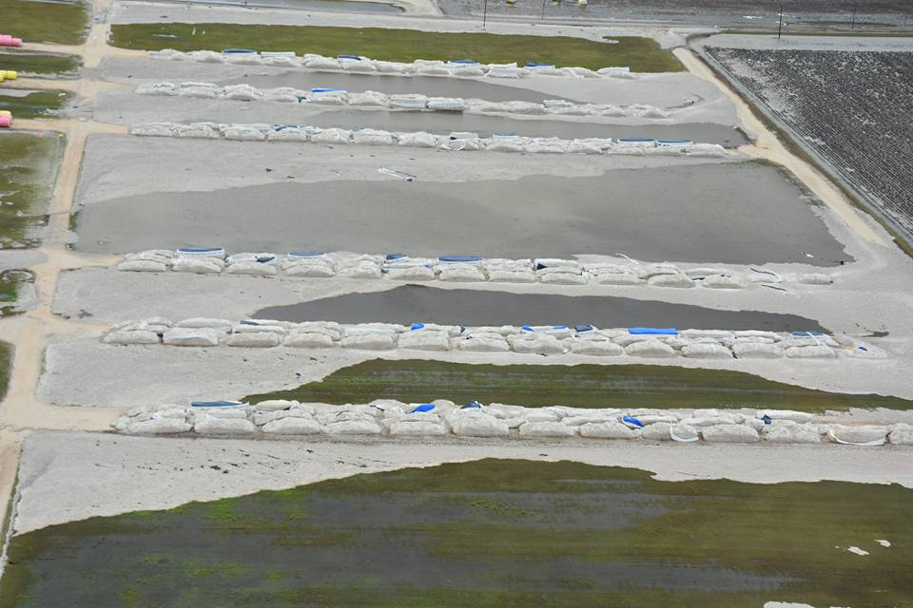
Hurricane Harvey
Texas 9.33 million bales
Estimates
400,000 to 800,000 bales loss

Slide 7
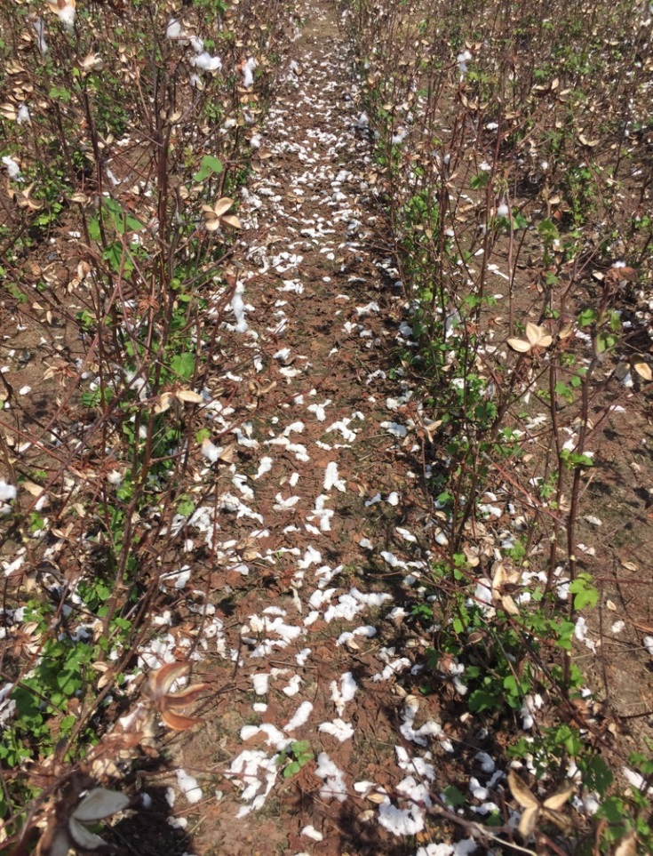
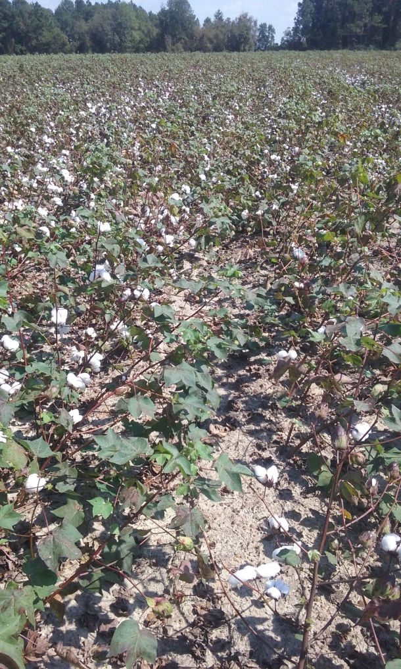
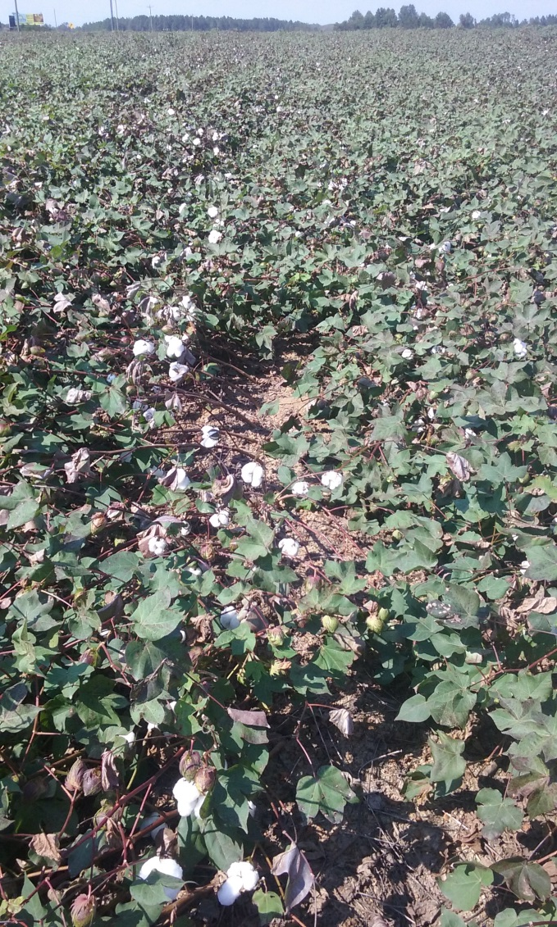
Hurricane Irma
Georgia 2.7 million bales
Estimated 10 to 20% loss, highly variable

Slide 8
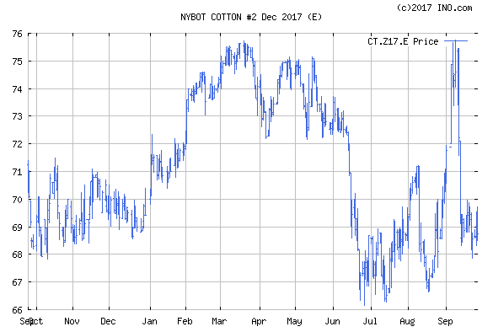
-Exports doing well
-China’s Use increasing
-NCC est. 11 mill ac but prices hold
-USDA “Outlook” est 11.5
Harvey
Sept report
-21.76 mb
-uncertainty about the crop
-technical/speculative “sell off”
-June number 12.055 mill ac
-prices stabilize; recover
-August est 20.55 mb
-USDA 12.2 mill ac on 3/31
-Ist crop est 19.2 mb in May
-but 2016 crop exports reduce 2017 carry-in

Slide 9
US Cotton Acres Planted, Harvested, and Average Yield Per Acre

Slide 10
US Cotton Exports and Market Share (% of World Exports)
Market Share
Exports

Slide 11
Production and Exports by Major Foreign Exporting Countries*
* Includes India, Australia, Brazil, and Uzbekistan.

Slide 12
Ending Stocks– China, US, and Rest of the World

Slide 13
“The China Gap”
China Cotton Production vs Use

Slide 14
Remaining 2017 Crop Outlook
USDA October numbers will reduce the crop
Look to see if projected exports remain strong
Will demand continue to improve?
Crops in India, China, Australia
Prices likely 67 to 73 cents (maybe 65 – 75)

Slide 15
Cotton Policy Update
Cottonseed program still a possibility
-Hope to get it in Appropriations Conference Bill in December
-Would be for 2018 crop
-Would give landowner options on Generic Base acre
Still pursuing USDA to authorize CGCS Program
-Would be for 2017 and 2018 crops
Trying to get cotton back in Title I of new farm bill

Slide 16
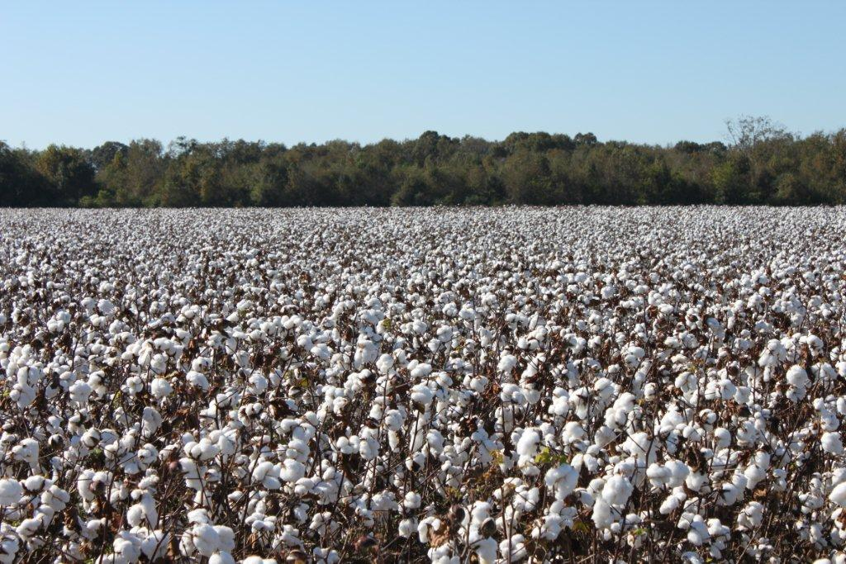
THANK YOU

